Slide 1
Database Management Systems

Slide 2
Introduction
Data:
It is the measurement of any measurable physical or conceptual entity or process or fact.
It has no meaning in itself.
It has implicit meaning.
Its context or environment of measurement gives its implicit meaning.
Example:
{40.46, 56.32, 75.88}
weight of students = {40.46, 56.32, 75.88}

Slide 3
Introduction
Information:
It is the processed and interpreted data.
Its meaning is explicit.
Example:
weight of any 3 students = {40.46, 56.32, 75.88}
The weight of the heaviest among the 3 students = 75.88
Average weight of the above 3 student = 57.56
Rank of NIT-R in 2018-19 = 13
Campus Placement percentage of CSE NIT-R = 99%

Slide 4
Introduction
Database:
Collection of related data representing some part of real world.
Example:
Bank Database, University Database, Facebook Database.
Election Database, Income Tax Database etc.
Each database has a definite use or application.

Slide 5
Introduction
Database Management System:
Its is a software that is used to define, create, maintain and control access to database.
Example: Oracle, MySQL, DB2, Postgress etc.

Slide 6
Introduction
Database System:
It is a computerized system (hardware + software) that is used to store, retrieve and manipulate data in a database.
Hardware requirements:
Secondary Storage like Disks and Tapes
Processors and associated Primary memory
Software requirements:
DBMS and Application programs

Slide 7
Introduction
Two ways of storing, retrieving and managing data:
1. File based System
2. DBMS based System

Slide 8
Introduction
1. File based System:
File:
It is a collection of records.
Record is a set of logically related data.
A file is represented as
file-name(list of fields)
Example:
StaffSalary(staffNo, fName, lName, sex, salary, branchNo) in Payroll Department
Staff(staffNo, fName, lName, position, sex, dateOfBirth, branchNo) in Personnel Department

Slide 9
Introduction
Fields
staffNo | fName | lName | sex | salary | branchNo
701 | John | Smith | M | 5000 | 11
702 | Mary | Lee | F | 6000 | 8
Records
File Name
StaffSalary
Conceptual Structure of a file

Slide 10
Introduction
File based Processing:
File Handling Routines
Data Entry,
Reports
File Definition
Payroll Application Program of Payroll Department
Payroll files
File Handling Routines
Data Entry,
Reports
File Definition
Personnel Application Program of Personnel Department
Personnel files

Slide 11
Introduction
Limitations of File based System:
Data Redundancy and Inconsistency:
Same data may be present in different files (causing more space cost), and may lead to inconsistent data when one instance of a data is modified, but its other instances in other files are not modified.
Atomicity Problems:
Sometimes it is needed to execute ALL or NONE of a group of queries / instructions. In file-processing system, maintaining this type of atomic nature of execution is not possible.

Slide 12
Introduction
Integrity Problems:
Data stored may sometimes require a natural constraint (e.g. AGE cannot be a negative integer) or business-specific constraints (e.g., GRADE of a student can be E / A / B / C / D / F / I , and no other character) to be applied on them.
Managing these integrity constraints on creation and during each modification of data is not possible through file-processing system.
Difficulty in Accessing Data:
In file-processing system, users are not abstracted from the physical access of data. Hence users should know the location of files to retrieve data. In course of time, if file structure changes, the users face trouble.

Slide 13
Introduction
Concurrent Access Anomalies:
In desired scenario of multiple users accessing/altering same data, file-processing system may fail. Locks cannot be created between user access causing the problem.
Data Isolation:
Isolating a desired data from more than one file is challenging in file-processing system.
Security Problems:
All users are not designated to access all data. There is a logical grant / revoke of ‘right of access’ by business policy makers, which a database should adhere to. In file-processing system, there is no such scope.

Slide 14
Introduction
2. DBMS based System:
Data Entry & Reports
Payroll Application Program of Payroll Department
DBMS
User
Data Entry & Reports
Personnel Application Program of Personnel Department
User
DBMS Server
Database
DBMS based Processing:

Slide 15
Introduction
Components of DBMS:

Slide 16
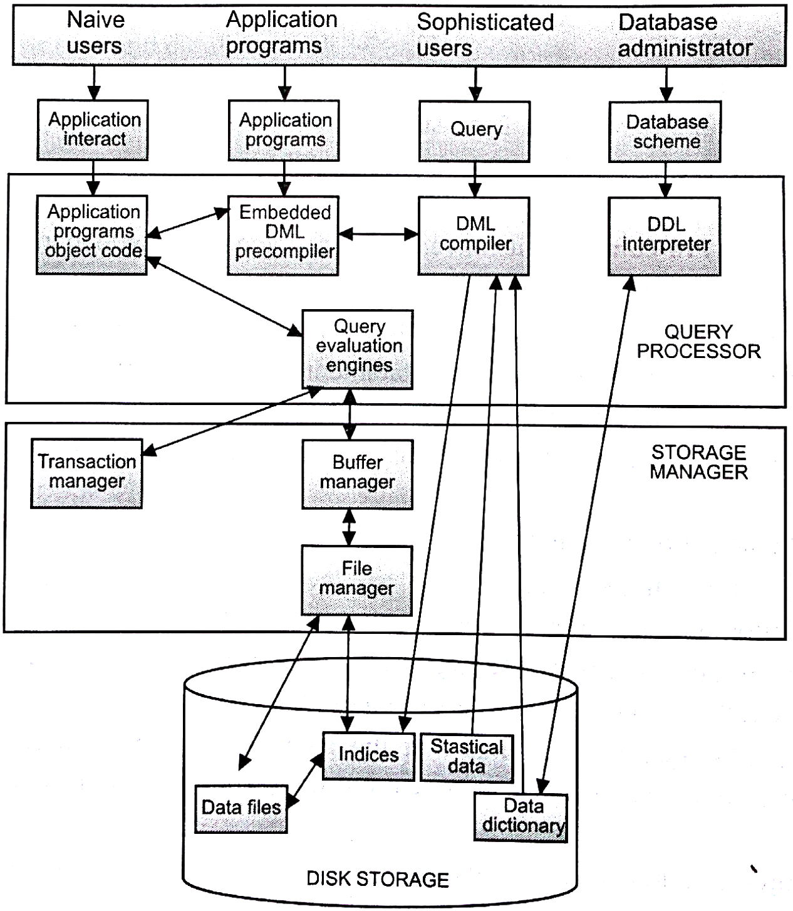

Slide 17
Introduction
2. DBMS based System:
Advantages:
Data duplication eliminated
Controlled redundancy.
Restricting unauthorized access.
Providing backup and recovery.
Providing Multiple User Interface.
Enforcing Security and integrity constraints.
Centralized Control and Data quality enhanced.

Slide 18
Introduction
2. DBMS based System:
Disadvantages:
Problems associated with centralization
Cost of software/hardware and migration
Complexity of backup and recovery
Can’t be used for many real time embedded systems

Slide 19
Levels of Abstraction in Database:
User-1
User-2
User-n
View-1
View-2
View-n
External Level
External/Conceptual
Mapping
Conceptual Schema
Conceptual Level
Conceptual/Internal
Mapping
Physical Schema
Internal Level
Database

Slide 20
Levels of Abstraction in Database:
External Level:
It contains user views of the database.
The user’s view describes only that part of the database which is relevant to a user.
Different user views have different representation of the same data according to user’s need or comfort.
It also provides a level of security by allowing certain group of users to access only certain types of data and not the entire database.
Example:
Viewing one’s bank transaction, balance etc.
Viewing one’s online purchase order, exam result etc.

Slide 21
Levels of Abstraction in Database:
Conceptual Level:
It contains the description of all the data in the database of an organization and the relationships among the data.
It contains the logical structure of the entire database.
It represents:
All entities, attributes and their relationships
Constraints of the data
Semantic information about the data
Security and Integrity information
It should not contain any storage details about the data
Example:
Student data is logically stored using relation schema as
Student(RollNo, Name, Branch, DoB, Sex)

Slide 22
Levels of Abstraction in Database:
Internal Level:
It describes how the data is physically stored in the database.
It is concerned with:
Storage space allocation for data and indexes,
Record descriptions for storage
Record Placement
Data compression and encryption techniques

Slide 23
Levels of Abstraction in Database:
Data Model:
It is a collection of high-level data description constructs that hide many low level storage details.
It description is more closer to how data is stored in a database, than to how a user thinks of the data with respect to enterprise it represents.
Example: Relational Data Model
Semantic Data Model:
It a more abstract, high-level data model that conceptually describes a real world enterprise more accurately in terms of how a user thinks of the enterprise.
Example: ER diagram

Slide 24
Levels of Abstraction in Database:
Schema:
It is a description of data using a data model.
Database Schema:
It is the description of a database using a data model.
Database Instance:
It is the data in the database at a specific given instance of time.

Slide 25
Levels of Abstraction in Database:
Data Independence:
It is the main objective of the three-level architecture.
Schema changes in the upper levels are unaffected by schema changes in the lower levels.
Types of Data Independence:
Logical Data Independence
Physical Data Independence

Slide 26
Levels of Abstraction in Database:
Logical Data Independence
It refers to the immunity of the external schemas to the changes in the conceptual schema.
Physical Data Independence
It refers to the immunity of the conceptual schemas to the changes in the physical schema.

Slide 27
Database Languages:
Data Definition Language (DDL)
It is used to create conceptual and external schemas.
Data Manipulation Language (DML)
It is used to manipulate the data stored in a database.
Types of DML:
2.1 Procedural DML:
describes how the data is to be obtained.
2.2 Non-Procedural DML:
describes only what data has to be obtained.

Slide 28
Three-tier DBMS Architecture:
First Tier
Client
Task
User Interface
Second Tier
Application Server
Task
Business logic
Data Processing logic
First Tier
Database Server
Task
Data Validation
Database Access

Slide 29
Relational Model:
Relation:
It is a 2D table with set of rows and columns
It present real world objects
Columns(field) represent the attributes of real world objects
Rows(tuple/record) represent instances of real world objects
Example:
Student
RollNo | Name | Address | Sex | MobileNo
2018001 | John | Rourkela | M | 98764000
2018022 | Mark | Kolkata | M | 78654387
2017061 | Mary | Delhi | F | 78905325

Slide 30
Relational Model:
Degree of a Relation:
It is the number of attributes in a relation
Cardinality of a Relation:
It is the number of tuples in a relation.
Domain of an Attribute:
It is a set of values from which an attribute can be assigned with any one of its values.

Slide 31
Relation Schema:
Schema = logical representation, model or blue-print
It is the logical representation of a relation
It is represented by a relation schema name defined by a set of attribute and domain name pairs.
Example:
Student(RollNo:number, Name:char, CGPA:number, DOB:date)
Relation Instance:
It is the set of the rows of a relation at a specific instance of time.
Relational Database Schema:
It is the set of relation schemas forming the database

Slide 32
Structured Query Language (SQL) of Oracle:
It is used to create tables
It is used to insert, delete, update tables.
It is used to retrieve data from the tables.

Slide 33
Command to Create Relation/Table:
commands are not case-sensitive
create table <table-name>(column_name data type,…..);
Example:
create table student(rollno number, name char(20), CGPA number);
Command to display the attributes and their domains of a table:
describe <table-name>;
Example:
describe <student>;

Slide 34
Command to insert values into a table:
insert into <table-name(column names)> values (value1,….);
Example:
insert into student(rollno, name , CGPA) values(2017001, ‘john’, 8.5);
insert into student(rollno, name , CGPA) values(2017024, ‘mary’, 7.5);
---OR------------------------
insert into <table-name> values (value1,….);
Example:
insert into student values(2017001, ‘john’, 8.5);

Slide 35
Student
rollno | name | CGPA
2017001 | john | 8.5
2017024 | mary | 7.5
Command to display all the rows & columns of a table:
select * from <table-name>;
Example:
select * from student;

Slide 36
Student
rollno | name | CGPA
2017001 | john | 8.5
2017024 | mary | 7.5
Command to display all columns & specific rows of a table:
select * from <table-name> where <conditions>;
Example:
select * from student where student.rollno=2017001;
select * from student where student.name=‘john’;
select * from student where student.CGPA>7;

Slide 37
Student
rollno | name | CGPA
2017001 | john | 8.5
2017024 | mary | 7.5
Command to display specific columns & all rows of a table:
select <column name(s)> from <table-name>;
Example:
select rollno, name from student;
Command to display specific columns & rows of a table:
select <column name(s)> from <table-name> where <conditions>;
Example:
select rollno, name from student where student.rollno=2017024;

Slide 38
Command to delete a row(s) from a table:
delete from <table-name> where <conditions>;
Example:
delete from student where student.rollno=2017001;
Command to delete all rows of a table:
truncate table <table-name>;
Example:
truncate table student;
Student
rollno | name | CGPA

Slide 39
Command to update the column value(s) in a table:
update <table-name> set <col-1=val-1,col-2-val-2,…>
where <conditions>;
Example:
update student set student.CGPA=9.98 where student.roll=2017024;
Command to drop a column from a table:
alter table <table-name> drop (col-1);
Example:
alter table student drop (CGPA);
Command to drop multiple columns from a table:
alter table <table-name> drop (col-1,col-2…);
Example:
alter table student drop (name,CGPA);

Slide 40
Command to add a column to a table:
alter table <table-name> add (col-1 data type, col-2 data type);
Example:
alter table student add branch char(20);
Command to modify the column(s) in a table:
alter table <table-name> modify (col-1 data type, …);
Example:
alter table student modify (rollno char(10));
Command to Rename a column in a table:
alter table <table-name> rename column col-1 to col-2;
Example:
alter table student rename column rollno to roll_number;

Slide 41
Command to rename a table:
alter table <table-name> rename to <table-name-2>;
Example:
alter table student rename to student_details;
Command to delete a table:
drop table <table-name>;
The dropped tables retain their space in disk
They are accessed via ‘recycle bin’
Example:
drop table student;

Slide 42
Command to remove a dropped table from recycle bin:
purge table <table-name>;
Example:
purge table student;
Command to remove all dropped tables from recycle bin:
purge recycle bin;
Command to restore a dropped table from recycle bin:
flashback table <table-name> to before drop;
Example:
flashback table student to before drop;

Slide 43
Properties of a Relation:
The names of relations are distinct
The names of the attributes in a relation is distinct
Each attribute must be assigned with a single value from its domain
The order of attributes does not matter
Each tuple of a relation is distinct
The order of tuples does not matter.
Super key of a Relation:
It is a single or a set of attributes that uniquely identifies a tuple within a relation.
Candidate key of Relation:
It is a super key with minimal number of attributes
There can be many candidate keys for a relation

Slide 44
Primary key of Relation:
It is the candidate key that has been selected for a relation.
Other candidate keys are called alternate keys.
Foreign key:
It a single or a set of attributes of a relation (child relation) that matches the primary/candidate key of another relation (parent relation) or the same relation.
It is used to link two tables.

Slide 45
rollno | name
2017001 | john
2017024 | mary
Course-ID | C-name
CS3002 | DBMS
CS3015 | OS
Student
Course
rollno | Course-ID | Grade
2017001 | CS3002 | A
2017001 | CS3015 | B
2017024 | CS3002 | B
2017024 | CS3015 | A
Grade

Slide 46
Null Value:
Not applicable
Unknown

Slide 47
Relational Model Constraints:
1. Domain Constraint:
It specifies that for each tuple the value of each of its attribute, A, must be an atomic value from the domain of A.
2. Entity Integrity:
It specifies that in a base relation, no attribute(s) of a primary key can be null.
3. Referential Integrity:
If a foreign key exits in a child relation, then either the foreign key value(s) must match the primary key value(s) of the parent relation or the foreign key value(s) must be null.

Slide 48
FA-ID | Faculty-Advisor-name
FA976 | Smith
FA764 | Tomas
Faculty_Advisor
rollno | name | FA-ID
2017001 | john | FA976
2017021 | james | FA764
2017024 | mary | FA764
2017024 | rose | NULL
student

Slide 49
Command to Specify Primary & Foreign Key for a table:
Create table <table-name>
( col-1 data-type,
col-2 data-type, …
constraint <constraint_name> primary key (col-1,col-2,…)
);
Example:
Create table student
(rollno number,
name char(20),
constraint student_pk primary key (rollno)
);

Slide 50
Command to Specify Primary Key using alter table command:
Alter table <table-name>
add constraint <constraint_name> primary key (col-1,col-2,…);
Example:
alter table student
add constraint student_pk primary key (rollno);
Command to drop Primary Key using alter table command:
Alter table <table-name> drop constraint <constraint_name> ;
Example:
alter table student drop constraint student_pk;

Slide 51
Disable Primary Key using alter table command:
Alter table <table-name>
disable constraint <constraint_name>;
Example:
alter table student
disable constraint student_pk;
Enable Primary Key using alter table command:
Alter table <table-name>
enable constraint <constraint_name> ;
Example:
alter table student
enable constraint student_pk;

Slide 52
Command for Foreign Key constraint:
create table <table-name>
( col-1 data-type,
col-2 data-type,
col-3 data-type,
constraint <foreign_key_name> foreign key (col-2)
references <parent_table_name(col-2)>,
constraint <foreign_key_name> foreign key (col-3)
references <parent_table_name(col-3)>,
);

Slide 53
Command for Foreign Key constraint:
Example:
create table grade
( roll number,
courseID char(20),
grade char(10),
constraint grade_pk primary key (roll,courseID),
constraint fk_student foreign key (roll) references student (roll),
constraint fk_course foreign key (courseID) references course(courseID)
);

Slide 54
Foreign Key constraint can be added or dropped using alter table command
Data types in Oracle:
Character (char)
Numeric (number)
Date
LOB
RAW and Long RAW
ROWID and UROWID

Slide 55
Character Data types
1. char
2. varchar2 & varchar
3. LOB character data types
4. LONG data types

Slide 56
1. Char Data types
It stores fixed-length character strings between 1 and 2000 bytes.
Default length is one byte.
If a string is shorter, then it is blank-padded to the fixed length.
If a string is too large, Oracle Database returns an error.
Ex. Name char( 20 byte) //default
Name char( 20 char)
2. Varchar2 and varchar Data types
varchar2 stores variable-length character strings between 1 and 4000 bytes.
If a string is shorter, then it is not padded.
If a string is too large, Oracle Database returns an error.
Varchar is synonymous to varchar2.
Varchar2 is advised to use over varchar.

Slide 57
3. LOB Character Data types
LOB = Large Object
LOB datatypes for character data are CLOB and NCLOB.
They can store up to 8 TB of data.
4. Long Data types (LONG)
It can store up to 2 GB of variable-length string.
It is not recommended by oracle.

Slide 58
Numeric Data types
Number data type:
Number datatypes store positive and negative fixed and floating-point numbers, zero, infinity, and values that are the undefined result of an operation (that is, is "not a number" or NAN).
Syntax:
Column-name number(precision, scale)
Precision is the total number of digits
Scale is the total number of digits to the right of the decimal point
If a precision is not specified, the column stores values as given.
If no scale is specified, the scale is zero.
Example:
Height number(8,4);

Slide 59
Date Data types
1. data
2. timestamp
3. timestamp with time zone
4. timestamp with local time zone

Slide 60
1. Date Data type
It is used to represent a date with the default format ‘yyyy-mm-dd’.
It also represents time.
Example:
create table student
( roll number,
name char(20 char),
DOB date,
constraint student_pk primary key (roll)
);
insert into student values(111,'AA',date '1999-02-17');
insert into student values(222,'bbb',date '2002-12-25');

Slide 61
Format date using to_date( ) function:
Syntax:
To_date(<string>,<format>)
Example:
insert into student values(111,'AA',to_date(’25-01-2017‘,’dd-mm-yyyy’);
Format date display using to_char( ) function:
Example:
Select to_char(DOB,’month-dy-yyyy’) from student;
Output = January-fri-2017
Dates can be added and subtracted
They can be compared

Slide 62
2. timestamp Data type
format ‘yyyy-mm-dd:hh24:mi:ss.ff’.
Timestamp[fractional_second_precision]
fraction_of_second can range from 0 to 9
Default value is 6
Example:
create table student
( roll number,
name char(20 char),
DOB timestamp,
constraint student_pk primary key (roll)
);
insert into student values(111,'AA', timestamp '2010-01-10 13:15:04.22');

Slide 63
3. timestamp Data type with time zone
Example:
create table student
( roll number,
name char(20 char),
DOB timestamp with time zone,
constraint student_pk primary key (roll)
);

Slide 64
4. timestamp Data type with local time zone
Example:
create table student
( roll number,
name char(20 char),
DOB timestamp with time zone,
constraint student_pk primary key (roll)
);

Slide 65
LOB Data types
LOB = large object
1. BLOB
2. CLOB and NCLOB
3. BFILE

Slide 66
BLOB
The BLOB datatype stores unstructured binary data in the database.
BLOBs can store up to 128 terabytes of binary data.
Binary data like audio data, image data, etc.
CLOB and NCLOB
The CLOB and NCLOB datatypes store up to 128 terabytes of character data in the database.
CLOBs store database character set data
NCLOBs store Unicode national character set data.

Slide 67
3. BFILE
The BFILE datatype stores unstructured binary data in operating-system files outside the database of a DBMS.
A BFILE column stores a file locator that points to an external file outside the database of a DBMS.
The amount of BFILE data that can be stored is limited by the operating system.
BFILEs are read only and it cannot be modified.
The operating system must maintain the file integrity, security, and durability for BFILEs.

Slide 68
RAW and LRAW Data types
Oracle Net Services and Import/Export automatically convert CHAR, VARCHAR2, and LONG data between the database character set and the user session character set, if the two character sets are different.
RAW and LRAW data types store binary data that should not be interpreted when moved between systems.
RAW has maximum size of 2000 bytes
LRAW has maximum size of 2 GB

Slide 69
ROWID and UROWID Data types
Internally, every database table has a ROWID pseudocolumn.
It stores binary values called rowids.
Each rowid represents the storage address of a row.
A physical rowid identifies a row in an ordinary table.
A logical rowid identifies a row in an index-organized table.
The ROWID datatype can store only physical rowids.
The UROWID (universal rowid) datatype can store physical, logical, or foreign (non-Oracle) rowids.
Example:
Select rowid, name from student where student.roll=11;

Slide 70
Substring pattern matching:
Select * from student s where s.name like ‘%ra%’;
It will retrieve all the student with names like Ram, Raman, Ramesh, Raju, Ranjit.

Slide 71
Order by clause:
An ORDER BY clause allows you to specify the order in which rows appear in the result set.
ORDER BY < column-Name | ColumnPosition | Expression>
[ ASC | DESC ] [ NULLS FIRST | NULLS LAST ]
Example:
Select * from student order by CGPA;
Select roll, name from student order by name ASC;
Select roll, name from student order by name ASC NULLS FIRST;

Slide 72
Select name, roll from student order by name DESC, roll ASC;
Name Roll
Zukar 111
Zukar 112
Young 113
Mark 114
Select name, roll from student order by name DESC, roll DESC;
Name Roll
Zukar 112
Zukar 111
Young 113
Mark 114

Slide 73
Group by clause:
A GROUP BY clause groups a result into subsets that have matching values for one or more columns.
In each group, no two rows have the same value for the grouping columns.
NULLs are considered equivalent for grouping purposes.
Group by <col-name(s),function(s)> from <table_name>
where <conditions> group by <col-name(s)>

Slide 74
Roll | Name | Gender | State
111 | John | M | MP
112 | Moses | M | OD
113 | john | M | TN
114 | Mary | F | WB
115 | Alia | F | MP
Example:
Select name from student group by name;
Name
John
Moses
Mary
Alia

Slide 75
Roll | Name | Gender | State
111 | John | M | MP
112 | Moses | M | OD
113 | john | M | OD
114 | Mary | F | OD
115 | Alia | F | WB
Example:
Select gender from student group by gender;
Gender
M
F

Slide 76
Roll | Name | Gender | State
111 | John | M | MP
112 | Moses | M | OD
113 | john | M | OD
114 | Mary | F | OD
115 | Alia | F | WB
Example:
Select state from student group by state;
State
MP
OD
WB

Slide 77
Roll | Name | Gender | State
111 | John | M | MP
112 | Moses | M | OD
113 | john | M | OD
114 | Mary | F | OD
115 | Alia | F | WB
Example:
Select state, count(*) as No_Students from student group by state;
State No_Students
MP 1
OD 3
WB 1

Slide 78
Roll | Name | CGPA | State
111 | John | 9.9 | MP
112 | Moses | 7.5 | OD
113 | john | 8.65 | OD
114 | Mary | 6.78 | OD
115 | Alia | 8.26 | WB
Example:
Select state, max(CGPA),min(CGPA),avg(CGPA) from student group by state;
State Max(CGPA) Min(CGPA) Avg(CGPA
MP 9.9 9.9 9.9
OD 8.65 6.78 7.643
WB 8.26 8.26 8.26

Slide 79
Roll | Name | Gender | State
111 | John | M | MP
112 | Moses | M | OD
113 | john | M | OD
114 | Mary | F | OD
115 | Alia | F | WB
Example:
Select state, count(*) as No_Students from student
group by state order by state ASC;
State No_Students
OD 3
MP 1
WB 1

Slide 80
Roll | Name | Gender | State
111 | John | M | MP
112 | Moses | M | OD
113 | john | M | OD
114 | Mary | F | OD
115 | Alia | F | WB
Example:
Select gender, count(*) as No_Students from student s
where s.state = ‘OD’
group by gender order by gender ASC;
Gender No_Students
F 1
M 2

Slide 81
Having Clause:
A HAVING clause restricts the results of a GROUP BY.
The HAVING clause is applied to each group of the table.
If there is no GROUP BY clause, the HAVING clause is applied to the entire result as a single group.
HAVING <group-conditions>

Slide 82
Roll | Name | CGPA | State
111 | John | 9.9 | MP
112 | Moses | 7.5 | OD
113 | john | 8.65 | OD
114 | Mary | 6.78 | OD
115 | Alia | 8.26 | WB
Example:
Select state, count(*) from student group by state having count(*)=1;
State Count(*)
MP 1
WB 1

Slide 83
Roll | Name | CGPA | State
111 | John | 9.9 | MP
112 | Moses | 7.5 | OD
113 | john | 8.65 | OD
114 | Mary | 6.78 | OD
115 | Alia | 8.26 | WB
Example:
Select state, count(*) from student group by state having min(CGPA)>8;
State Count(*)
MP 1
WB 1

Slide 84
Roll | Name | Gender | State
111 | John | M | MP
112 | Moses | M | OD
113 | john | M | OD
114 | Mary | F | OD
115 | Alia | F | WB
Example:
Select state, count(*) from student where state = ‘OD’
group by gender having count(*) = 1;
Gender Count(*)
F 1

Slide 85
Roll | Name | Gender | State
111 | John | M | MP
112 | Moses | M | OD
113 | john | M | OD
114 | Mary | F | OD
115 | Alia | F | WB
Example:
Select state from student;
State
MP
OD
OD
OD
WB
Duplicates are present

Slide 86
Roll | Name | Gender | State
111 | John | M | MP
112 | Moses | M | OD
113 | john | M | OD
114 | Mary | F | OD
115 | Alia | F | WB
Example:
Select Distinct(state) from student;
State
MP
OD
WB
No Duplicates are present

Slide 87
Deletion Effect on child table:
On delete cascade:
if a record in the parent table is deleted, then the corresponding records in the child table will automatically be deleted.

Slide 88
On delete cascade:
Example:
rollno | name
2017001 | john
2017024 | mary
Course-ID | C-name
CS3002 | DBMS
CS3015 | OS
Student
Course
rollno | Course-ID | Grade
2017001 | CS3002 | A
2017001 | CS3015 | B
2017024 | CS3002 | B
2017024 | CS3015 | A
Grade

Slide 89
On delete cascade:
Syntax:
CREATE TABLE table_name
( col-1 datatype,
col-2 datatype,
...
CONSTRAINT <fk_name> FOREIGN KEY (col-1, ...)
REFERENCES <parent_table> (col-1, ...) ON DELETE CASCADE );

Slide 90
On delete cascade:
Example:
create table grade
(roll number(5),
courseID varchar2(20),
CGPA number(6,4),
constraint grade_pk primary key (roll,courseID),
constraint fk_student foreign key (roll) references student(roll)
on delete cascade,
constraint fk_course foreign key (courseID) references course(courseID)
on delete cascade
);

Slide 91
Deletion Effect on child table:
2. On delete set null:
If a record in the parent table is deleted, then the corresponding records in the child table will have the foreign key fields set to null.
The records in the child table will not be deleted.
3. On delete no action:
It prevent deleting a row in the parent table is deleted, when that row is referenced in the child table.
This the default action of delete command.

Slide 92
Update Effect on child table:
Update in parent table(candidate key) is allowed if the statement does not leave any rows in the child table without a referenced parent key value.
Update of primary key of parent table are not allowed.
Set Operations:
1. Union
2. Intersection
3. Set difference
4. IN, NOT IN
5. ANY
6. ALL

Slide 93
1. Union operation:
rollno | Course-ID | Grade
2017001 | CS3002 | A
2017001 | CS3015 | B
rollno | name
2017001 | john
2017024 | mary
2017024 | CS3002 | B
2017024 | CS3015 | A
Syntax:
<Set-1> union <Set-2>;
The resultant set contains the elements of set-1 and set-2 without duplicates.
Example:
Select rollno from student union select rollno from grade;
Rollno
2017001
2017024
Student
Grade

Slide 94
1. Union operation:
Syntax:
<Set-1> union all <Set-2>;
The resultant set contains the elements of set-1 and set-2 with duplicates.
Example:
Select rollno from student union select rollno from grade;
Rollno
2017001
2017024
2017001
2017001
2017024
2017024

Slide 95
2. Intersect operation:
rollno | Course-ID | Grade
2017001 | CS3002 | A
2017001 | CS3015 | B
rollno | name
2017001 | john
2017024 | mary
2017024 | CS3002 | B
2017024 | CS3015 | A
Syntax:
<Set-1> intersect <Set-2>;
The resultant set contains only those elements that are present in both set-1 and set-2.
Example:
Select rollno from student intersect select rollno from grade;
Rollno
2017001
2017024
Student
Grade

Slide 96
3. Set difference operation:
rollno | name
2017001 | john
2017024 | mary
rollno | Course-ID | Grade
2017001 | CS3002 | A
2017001 | CS3015 | B
Syntax:
<Set-1> minus <Set-2>;
The resultant set contains only those elements which are present in set-1, but are not present in set-2.
Example:
Select rollno from student minus select rollno from grade;
Rollno
2017024
Student
Grade

Slide 97
4. Set Member operation (IN):
rollno | name
2017001 | john
2017024 | mary
rollno | Course-ID | Grade
2017001 | CS3002 | A
2017001 | CS3015 | B
Syntax:
Select col-1,col-2 from <table_name> where col-1 IN (Set_of_Values);
Example:
Select rollno,name from student where rollno IN (select rollno from grade);
Rollno Name
2017001 john
Student
Grade

Slide 98
4. Set Member operation (NOT IN):
rollno | name
2017001 | john
2017024 | mary
rollno | Course-ID | Grade
2017001 | CS3002 | A
2017001 | CS3015 | B
Syntax:
Select col-1,col-2 from <table_name> where col-1 IN (Set_of_Values);
Example:
Select rollno,name from student where rollno NOT IN (select rollno from grade);
Rollno Name
2017024 mary
Student
Grade

Slide 99
5. ALL :
rollno | name
2017001 | john
2017024 | mary
rollno | Course-ID | Grade
2017001 | CS3002 | A
2017001 | CS3015 | B
Syntax:
Select col-1,col-2 from <table_name> where col-1 op ALL(Set_of_Values);
Where op ={>,<,=>,=,!=}
Example:
Select rollno,name from student where rollno > ALL (1997011,2017020);
Rollno Name
2017024 mary
Student
Grade

Slide 100
5. ALL :
rollno | name
2017001 | john
2017024 | mary
rollno | Course-ID | Grade
2017024 | CS3002 | A
2017024 | CS3015 | B
Student
Grade
Example:
Select rollno,name from student where rollno = ALL (select rollno from
grade);
Rollno Name
2017024 mary

Slide 101
6. ANY :
rollno | Course-ID | Grade
2017001 | CS3002 | A
2017001 | CS3015 | B
rollno | name
2017001 | john
2017024 | mary
Student
Grade
Syntax:
Select col-1,col-2 from <table_name> where col-1 op ANY(Set_of_Values);
Where op ={>,<,=>,=,!=}
Example:
Select rollno,name from student where rollno > ANY (1997011,2017020);
Rollno Name
2017001 john
2017024 mary

Slide 102
7. Exists, Not Exists :
rollno | name
2017001 | john
2017024 | mary
MscID | Rollno | Instru
M001 | 2017001 | Drum
M002 | 2017022 | Piano
M003 | 2017001 | Bass
Example:
Select * from student s where exists (select * from music m
where s.rollno=m.rollno);
Rollno Name
2017001 john
Select * from student s where not exists (select * from music m
where s.rollno=m.rollno);
Rollno Name
2017024 mary
Student
Music

Slide 103
Joins :
Two or more tables can be joined based on some conditions.
Types of Join:
1. Inner Join
1.1. Equi Join
1.2. Self Join
1.3. Natural join
1.4. Theta join
2. Outer Join
2.1. Left outer join
2.2. Right outer join
2.3. Full outer join
3. Cartesian Product

Slide 104
Equi-Join:
rollno | name
2017001 | john
2017024 | mary
rollno | Course-ID | Grade
2017001 | CS3002 | A
2017024 | CS3002 | Ex
2017001 | CS1000 | B
2017024 | CS1000 | C
Student
Grade
It joins two tables using the equal(=) comparison operator in the join condition.
Example:
Select * from student s, grade g where s.rollno = g.rollno;
Rollno Name Rollno Course-ID Grade
2017001 john 2017001 CS3002 A
2017001 john 2017001 CS1000 B
2017024 mary 2017024 CS3002 Ex
2017024 mary 2017024 CS1000 C

Slide 105
Equi-Join:
Example:
Select s.rollno, Course-ID, grade from student s, grade g where s.rollno = g.rollno;
Rollno Course-ID Grade
2017001 CS3002 A
2017001 CS1000 B
2017024 CS3002 Ex
2017024 CS1000 C

Slide 106
Equi-Join:
rollno | name
2017001 | john
2017024 | mary
rollno | Course-ID | Grade
2017001 | CS3002 | A
2017024 | CS3002 | Ex
2017001 | CS1000 | B
2017024 | CS1000 | C
Student
Grade
Equi-join can also be done using key words join with on(join conditions).
Example:
Select * from student s join grade g on (s.rollno = g.rollno);
Rollno Name Rollno Course-ID Grade
2017001 john 2017001 CS3002 A
2017001 john 2017001 CS1000 B
2017024 mary 2017024 CS3002 Ex
2017024 mary 2017024 CS1000 C

Slide 107
Self-Join:
Self-join causes a table to be joined to itself.
EmpID | Emp-name | MngID
2017001 | john | NULL
2017024 | mary | 2017001
2017022 | leo | 2017026
2017026 | Gita | NULL
EmpID | Emp-name | MngID
2017001 | john | NULL
2017024 | mary | 2017001
2017022 | leo | 2017026
2017026 | Gita | NULL
Employee as m
Employee as e
Example:
Select * from employee m join employee e on (m.EmpID = e.MngID);
EmpID Emp-name MngID EmpID Emp-name MngID
2017001 john NULL 2017024 mary 2017001
2017026 Gita NULL 2017022 leo 2017026

Slide 108
Self-Join:
Compute the list of managers and their employees
EmpID | Emp-name | MngID
2017001 | john | NULL
2017024 | mary | 2017001
2017022 | leo | 2017026
2017026 | Gita | NULL
EmpID | Emp-name | MngID
2017001 | john | NULL
2017024 | mary | 2017001
2017022 | leo | 2017026
2017026 | Gita | NULL
Employee as m
Employee as e
Example:
Select m.name as Manager, e.name as Employee from employee m
join employee e on (m.EmpID = e.MngID);
Manager Employee
john mary
Gita leo

Slide 109
Natural Join:
In equi-join the common columns of the two tables were duplicated.
Natural join removes these duplicate columns.
Natural join implicitly involves equal operator on common columns of the tables.
So, equal operator and common columns should not be specified.
It is done using the key word “natural join”.

Slide 110
Natural Join:
rollno | name
2017001 | john
2017024 | mary
rollno | Course-ID | Grade
2017001 | CS3002 | A
2017024 | CS3002 | Ex
2017001 | CS1000 | B
2017024 | CS1000 | C
Student
Grade
Example:
Select * from student natural join grade;
Rollno Name Course-ID Grade
2017001 john CS3002 A
2017001 john CS1000 B
2017024 mary CS3002 Ex
2017024 mary CS1000 C

Slide 111
Theta Join:
It is join operation in which the join operator is not equal operator.
rollno | name
2017001 | john
2017024 | mary
rollno | Course-ID | Grade
2017001 | CS3002 | A
2017024 | CS3002 | Ex
2017001 | CS1000 | B
2017024 | CS1000 | C
Student
Example:
Select * from student s join grade g on (s.rollno < g.rollno);
Rollno Name Rollno Course-ID Grade
2017001 john 201724 CS3002 A
2017001 john 201724 CS1000 C
Grade

Slide 112
Left Outer Join:
In inner joins only the rows that satisfied the join conditions are joined.
In outer joins not only the rows that satisfy the join conditions are joined, but also, the rows that do not satisfy the join conditions are joined.
A new table is produced by first joining the rows of the left table of a join that satisfy the join conditions with the rows of the right table and then by joining the rows of the left table that do not satisfy the join conditions with the rows of the right table.
But, in such rows of the new table, the columns of the right table are assigned with NULL values.

Slide 113
Left Outer Join:
rollno | name
2017001 | john
2017024 | mary
2017022 | Gita
2017030 | Mark
rollno | Course-ID | Grade
2017001 | CS3002 | A
2017024 | CS3002 | Ex
Grade
Student
Example:
Select * from student s left outer join grade g on (s.rollno =g.rollno);
Rollno Name Rollno Course-ID Grade
2017001 john 2017001 CS3002 A
2017024 mary 2017024 CS3002 Ex
2017022 Gita NULL NULL NULL
2017030 Mark NULL NULL NULL

Slide 114
Right Outer Join:
rollno | name
2017001 | john
2017024 | mary
2017022 | Gita
2017030 | Mark
rollno | Course-ID | Grade
2017001 | CS3002 | A
2017024 | CS3002 | Ex
Grade
Student
Example:
Select * from grade g right outer join student s on (g.rollno = s.rollno);
Rollno Course-ID Grade Rollno Name
2017001 CS3002 A 2017001 john
2017024 CS3002 Ex 2017024 mary
NULL NULL NULL 2017022 Gita
NULL NULL NULL 2017030 Mark

Slide 115
Full Outer Join:
SptrID | Rollno | Game
S001 | 2017001 | Soccer
S002 | 2017024 | Volley
MscID | Rollno | Instru
M001 | 2017001 | Drum
M002 | 2017022 | Piano
Sports
Music
Example:
Select * from sports s full outer join music m on (s.rollno = m.rollno);
SptrID Rollno Game MscID Rollno Instru
S001 2017001 Soccer M001 2017001 Drum
S002 2017024 Volley NULL NULL NULL
NULL NULL NULL M002 2017022 Piano

Slide 116
Cartesian Product:
Every row of the left table is joined with all the rows of the right table.
In this join there is no join condition
Key word is “cross join”
Sports
Music
SptrID | Rollno | Game
S001 | 2017001 | Soccer
S002 | 2017024 | Volley
MscID | Rollno | Instru
M001 | 2017001 | Drum
M002 | 2017022 | Piano
SptrID | Rollno | Game | MscID | Rollno | Instru
S001 | 2017001 | Soccer | M001 | 2017001 | Drum
S001 | 2017001 | Soccer | M002 | 2017022 | Piano
S002 | 2017024 | Volley | M001 | 2017001 | Drum
S002 | 2017024 | Volley | M002 | 2017022 | Piano

Slide 117
Cartesian Product:
Example:
Select * from sports, music;
Select * from sports cross join music;

Slide 118
Other Constraints:
1. Not null
2. Unique
3. Check(expression)
Example:
create table election
( eid number(5),
ssn number(5) unique,
name varchar2(20 char) default ‘xxxx’ not null,
age number(4,2) default 0 not null,
constraint election_pk primary key (eid),
constraint check_age check(age >= 18)
);

Slide 119
Other Constraints:
4. Trigger
View:
It is a subset of one or more base tables
It is a way to provide relevant data to appropriate users.
It provides a level of security.
Types: 1. Virtual views 2. Materialized views.
Virtual views are never stored in the database, but their definitions are stored.
Materialized views are stored in the database along with their definitions.

Slide 120
SptrID | Rollno | Game
S001 | 2017001 | Soccer
S002 | 2017024 | Volley
View:
Sports
SptrID | Game
S001 | Soccer
S002 | Volley
SptrID | Rollno
S001 | 2017001
S002 | 2017024
Rollno | Game
2017001 | Soccer
2017024 | Volley
Some views of the Sports Table

Slide 121
View:
MscID | Rollno | Instru
M001 | 2017001 | Drum
M002 | 2017022 | Piano
SptrID | Rollno | Game
S001 | 2017001 | Soccer
S002 | 2017024 | Volley
Music
Sports
SptrID | Game
S001 | Soccer
MscID | Instru
M001 | Drum
View

Slide 122
View:
Syntax:
create view <view_name> as select col-1,col-2 from <tab-1,tab-2>
where <conditions>;
Example:
Create view music_view as select mscid, instru from music;
Create view music_view as select mscid, instru from music
where roll= 2017022;

Slide 123
View:
Example:
Create view music_sport_view as
select mscid, sprtsid,game,instru
from music m, sports s
where (m.roll = s.roll);
Views can be queried like a normal table.
Views that are created from a single table, can be updated, inserted and deleted.
Views having aggregates, group by, union all, subquery in the select clause etc can not be updated.

Slide 124
Materialized View:
Syntax:
create materialized view <view_name>
as select col-1,col-2 from <tab-1,tab-2> where <conditions>;
Example:
Create materialized view music_view as select mscid, instru from music;
Create materialized view music_view as select mscid, instru from music
where roll= 2017022;

Slide 125
Relational Model of a Table in a Database:
A table is represented as a relation in relational model.
A relation, r, over a collection of sets = {D₁, D₂,…D_{n}}, is a subset of their Cartesian Product = D₁x D₂x...D_{n}.
The set D_{i} is a set of values representing a domain.
Domain D_{i} is specified by the data types provided by a DBMS.
So, a relation, r, is a set of n-tuples {d₁, d₂,...d_{n}} where d_{i} ℇ D_{i}.

Slide 126
Relational Model of a Table in a Database:
Example:
Let there be two sets
roll={001,002}
name={john, mary}
Their Cartesian product is
roll x name ={(001, john),
(001, mary),
(002, john),
(002, mary)}
tuples
roll | name
001 | john
002 | mary
Student relation

Slide 127
Relational Model of a Table in a Database:
Relation Schema:
It is the logical structure of a relation.
R(A₁:D₁, A₂:D₂, A₃:D₃,…. A_{n}:D_{n})
R is the name of the Schema
A_{i} is a column/attribute
D_{n} is the domain of the column/attribute
Example:
STUDENT(Roll:Number(6), Name:Varchar2(10 char))
A collection of relation schema is called relational database schema.

Slide 128
Relational Query Languages:
1. Relational Algebra
2. Relational Calculus

Slide 129
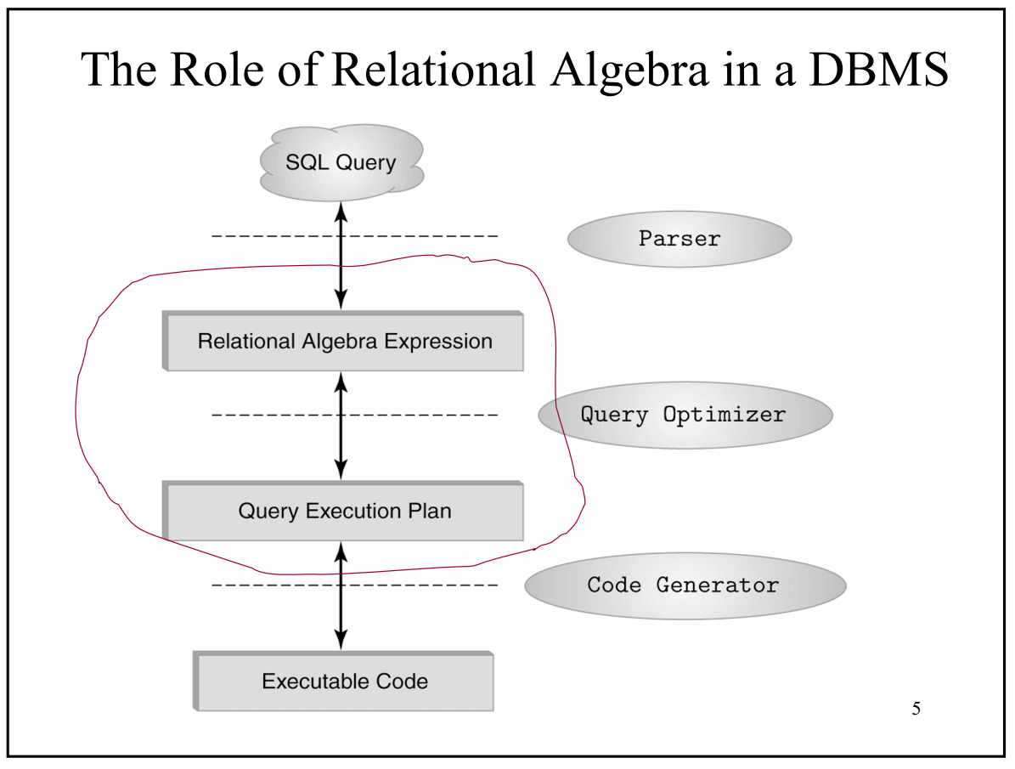
Relational Algebra:

Slide 130
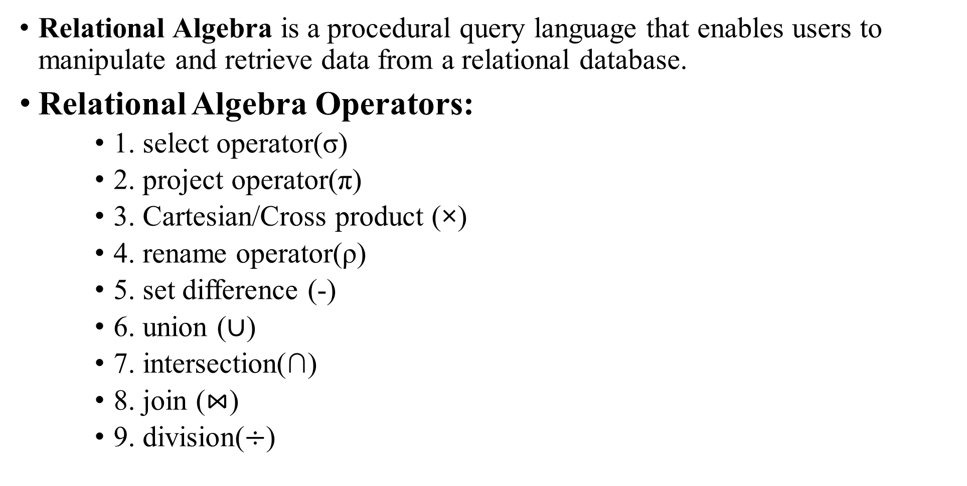
Relational Algebra is a procedural query language that enables users to manipulate and retrieve data from a relational database.
Relational Algebra Operators:
1. select operator(σ)
2. project operator(π)
3. Cartesian/Cross product (×)
4. rename operator(ρ)
5. set difference (-)
6. union ($∪$)
7. intersection(∩)
8. join ($⋈$)
9. division($÷$)

Slide 131
select operator(σ)
It is used to produce a new relation by selecting a set of tuples from a relation that satisfies some selection conditions specified on its attributes.
It is represented by the Greek symbol σ (sigma)
General representation:
σ _{<selection_conditions>}(Relation)
Example:
σ _{roll=101}(STUDENT)
σ _{Dept=‘CS’ AND state=‘OD’}(STUDENT)
σ _{state} _{≠ ‘OD’}(STUDENT)
In SQL, operator(σ) is specified in the WHERE clause of a query.

Slide 132
Example:
Select * from student where state=‘OD’;
σ _{state=‘OD’}(student)
Roll | Name | Gender | State
111 | John | M | MP
112 | Moses | M | OD
113 | john | M | OD
114 | Mary | F | OD
115 | Alia | F | WB
Select operation
Roll | Name | Gender | State
112 | Moses | M | OD
113 | john | M | OD
114 | Mary | F | OD

Slide 133
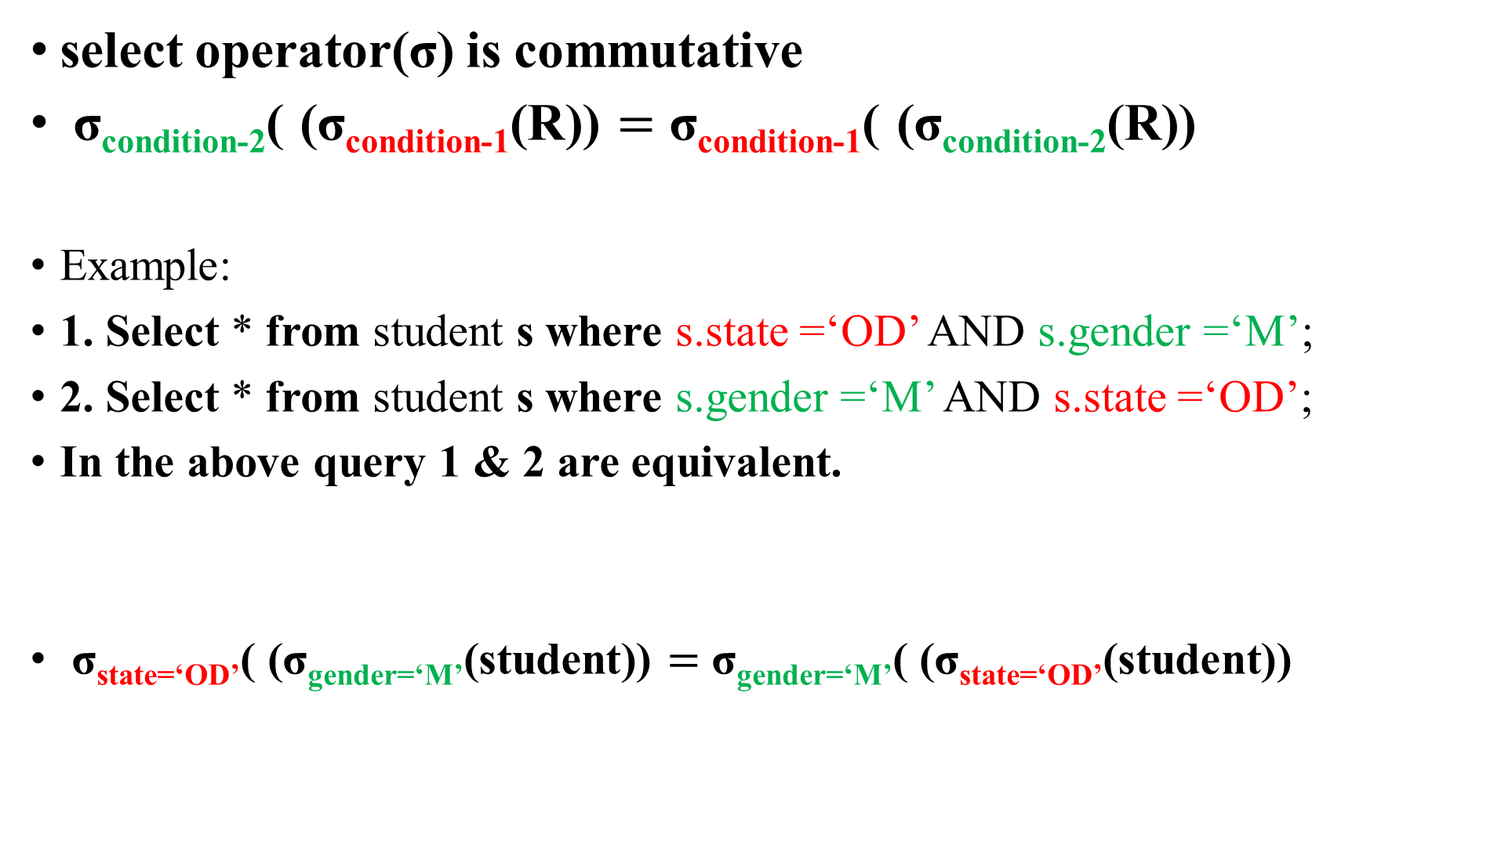
select operator(σ) is commutative
σ_{condition-2}( (σ_{condition-1}(R)) $=$ σ_{condition-1}( (σ_{condition-2}(R))
Example:
1. Select * from student s where s.state =‘OD’ AND s.gender =‘M’;
2. Select * from student s where s.gender =‘M’ AND s.state =‘OD’;
In the above query 1 & 2 are equivalent.
σ_{state=‘OD’}( (σ_{gender=‘M’}(student)) $=$ σ_{gender=‘M’}( (σ_{state=‘OD’}(student))

Slide 134
project operator(π)
It is used to produce a new relation by selecting some attributes, specified by a user, of a relation.
It is represented by the Greek symbol π (pi)
General representation:
π _{<attributes_list>}(Relation)
Example:
π _{roll,name}(STUDENT)
π _{roll}(STUDENT)
In SQL, operator(π) is specified in the SELECT clause of a query.

Slide 135
Example:
Select roll, name from student;
π _{name}(student)
Roll | Name | Gender | State
111 | John | M | MP
112 | Moses | M | OD
113 | John | M | OD
114 | Mary | F | OD
115 | Alia | F | WB
Project operation
Roll | Name
111 | John
112 | Moses
113 | John
114 | Mary
115 | Alia

Slide 136
Example:
Select distinct(name) from student;
π _{name}(student)
Projection removes duplicate tuples
Roll | Name | Gender | State
111 | John | M | MP
112 | Moses | M | OD
113 | John | M | OD
114 | Mary | F | OD
115 | Alia | F | WB
Project operation
Name
John
Moses
Mary
Alia

Slide 137
Example:
Select roll, name from student where state=‘OD’;
π _{roll, name}( σ _{state=‘OD’}(student))
Roll | Name | Gender | State
111 | John | M | MP
112 | Moses | M | OD
113 | john | M | OD
114 | Mary | F | OD
115 | Alia | F | WB
1. Select operation
Roll | Name | Gender | State
112 | Moses | M | OD
113 | john | M | OD
114 | Mary | F | OD
2. Project operation
Roll | Name
112 | Moses
113 | john
114 | Mary

Slide 138
Rename operator(ρ):
It is used to give new names to attributes and relations.
It is represented by the Greek symbol ρ (rho)
General representation:
ρ _{s(b1,b2…bn)}(Relation)
ρ _{s} (Relation)
ρ _{(b1,b2…bn)}(Relation)
where s is the new name of a relation
b1, b2… are the new name of the attributes
Example:
ρ student_details (roll_number, full_name, department) (student)

Slide 139
In SQL, operator(ρ) is accomplished using the key word ‘AS’ ‘rename to’.
Example:
alter table student rename to student_details;
ρ _{student_details}(student)

Slide 140
Example:
Select roll as roll_number, name as student_name, state as state_code
from student s where s.state =‘OD’;
ρ (roll_number, student_name, state_code)(σ _{state=‘OD’}(student))

Slide 141
Example:
insert into odiya_students (roll_number, student_name, state_code)
select roll, name, state from student s where s.state =‘OD’;
ρ odiya_students(roll_num, student_name, state_code)(σ _{state=‘OD’}(student))
odiya_students(roll_number, student_name, state_code) ← (σ _{state=‘OD’}(student))
The symbol(←) also means assignment

Slide 142
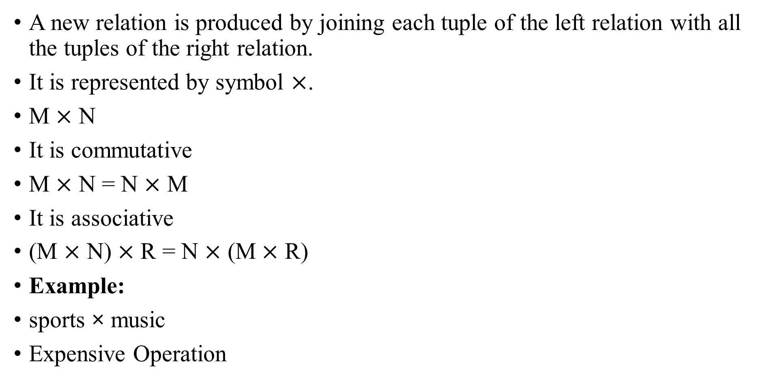

Cartesian/Cross Product ($×$):
A new relation is produced by joining each tuple of the left relation with all the tuples of the right relation.
It is represented by symbol $×$.
M $×$ N
It is commutative
M $×$ N = N $×$ M
It is associative
(M $×$ N) $×$ R = N $×$ (M $×$ R)
Example:
sports × music
Expensive Operation
Sports
Music
SptrID | Game
S001 | Soccer
S002 | Volley
MscID | Instru
M001 | Drum
M002 | Piano
sports × music
SptrID | Game | MscID | Instru
S001 | Soccer | M001 | Drum
S001 | Soccer | M002 | Piano
S002 | Volley | M001 | Drum
S002 | Volley | M002 | Piano

Slide 143
Example:
Select * from sports, music;
Select * from sports cross join music;
sports × music

Slide 144

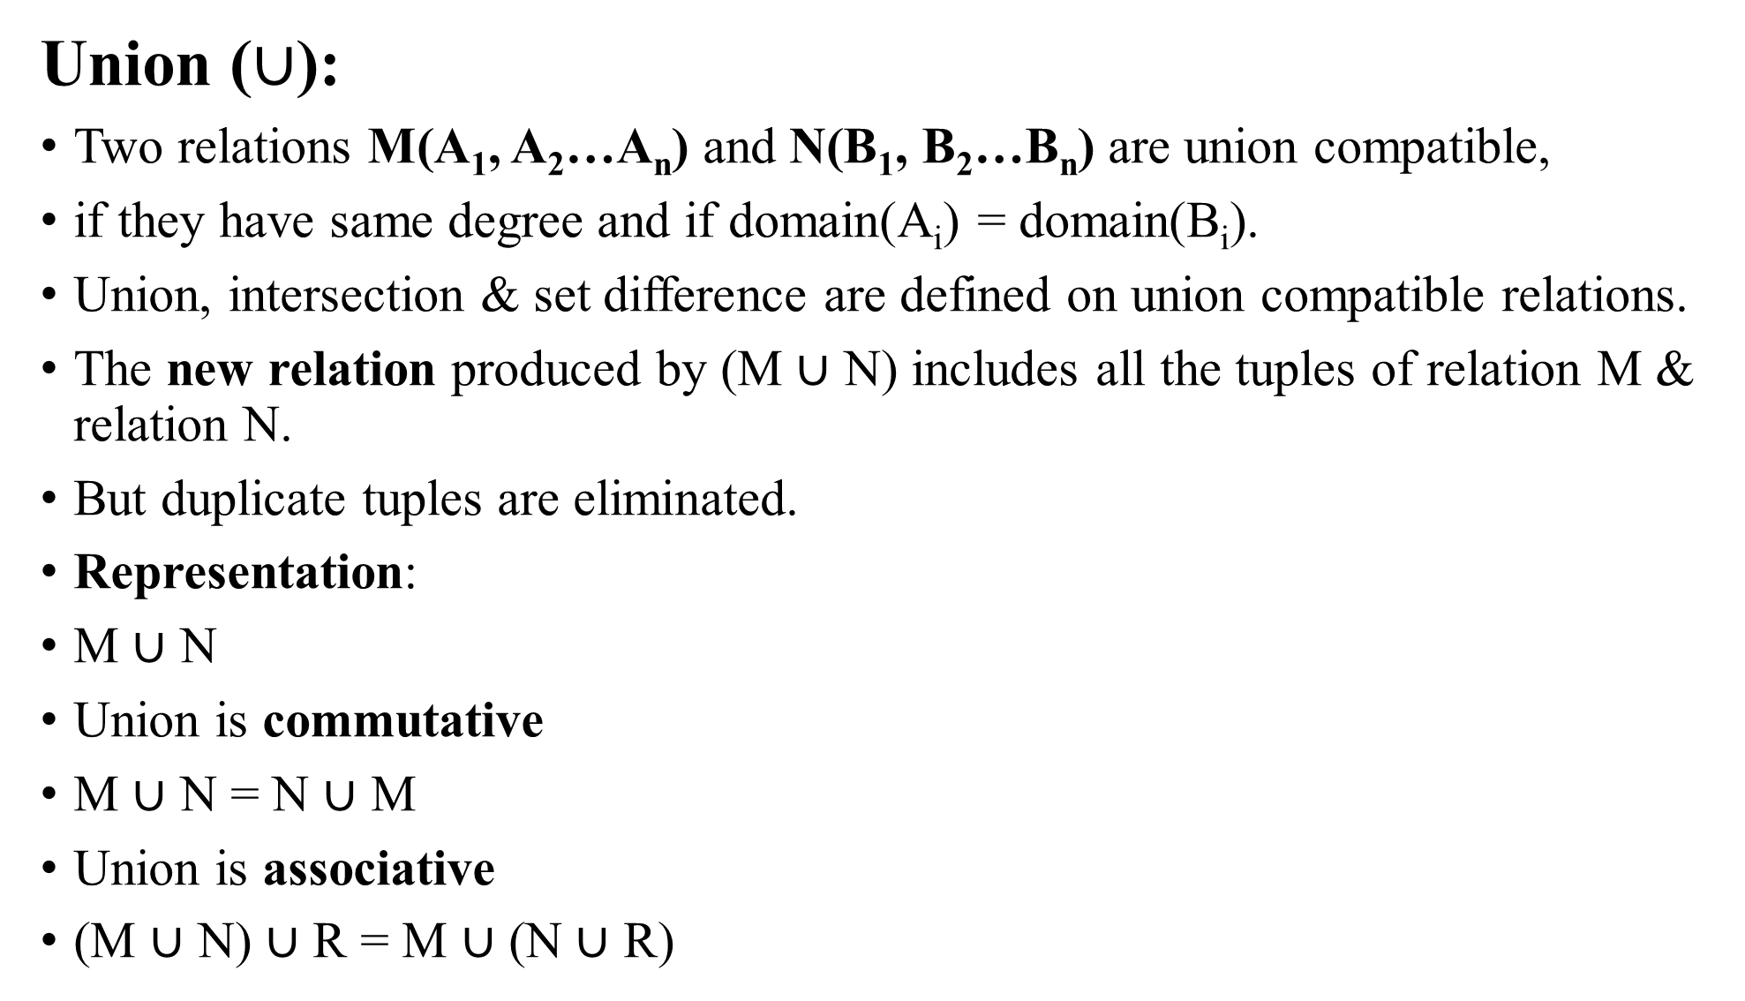
Union ($∪$):
Two relations M(A₁, A₂…A_{n}) and N(B₁, B₂…B_{n}) are union compatible,
if they have same degree and if domain(A_{i}) = domain(B_{i}).
Union, intersection & set difference are defined on union compatible relations.
The new relation produced by (M $∪$ N) includes all the tuples of relation M & relation N.
But duplicate tuples are eliminated.
Representation:
M $∪$ N
Union is commutative
M $∪$ N = N $∪$ M
Union is associative
(M $∪$ N) $∪$ R = M $∪$ (N $∪$ R)
CSE
ECE
Roll | Game
111 | Soccer
222 | Volley
Roll | Game
323 | Tennis
214 | TT
Roll | Game
111 | Soccer
222 | Volley
323 | Tennis
214 | TT
CSE $∪$ ECE

Slide 145
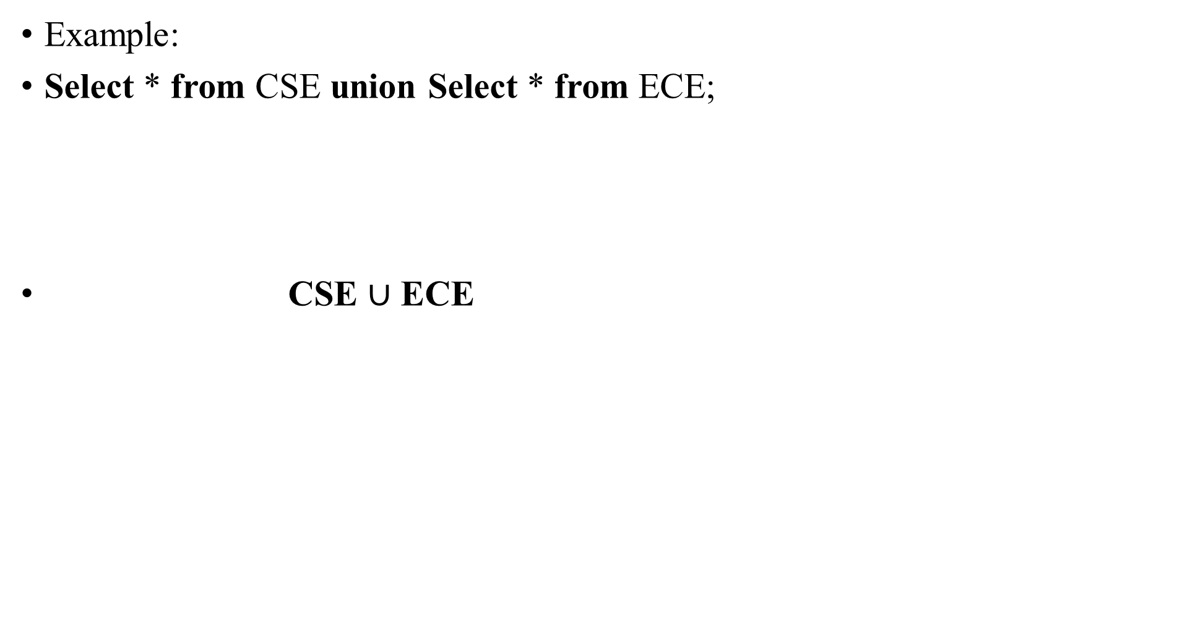
Example:
Select * from CSE union Select * from ECE;
CSE $∪$ ECE

Slide 146

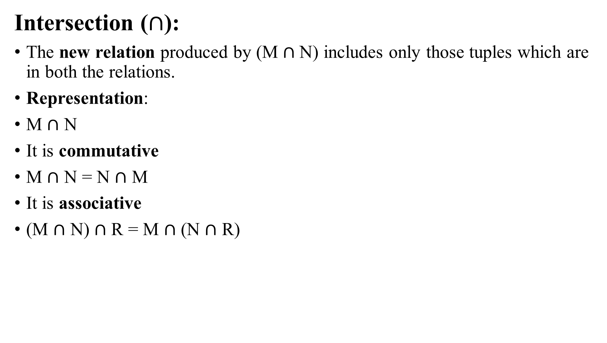
Intersection ($∩$):
The new relation produced by (M $∩$N) includes only those tuples which are in both the relations.
Representation:
M $∩$ N
It is commutative
M $∩$ N = N $∩$ M
It is associative
(M $∩$ N) $∩$ R = M $∩$ (N $∩$ R)
CSE
ECE
CourseID | Name
111 | DSA
222 | DBMS
CourseID | Name
111 | DSA
214 | ED
CSE $∩$ ECE
CourseID | Name
111 | DSA

Slide 147
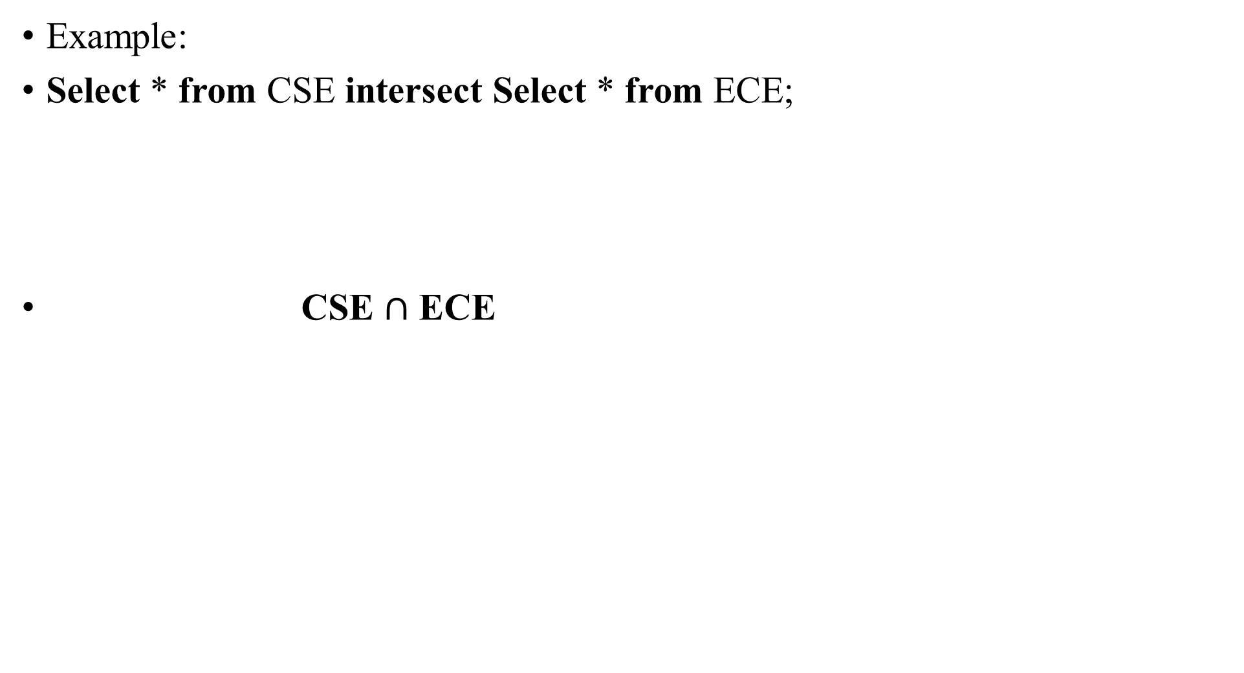
Example:
Select * from CSE intersect Select * from ECE;
CSE $∩$ ECE

Slide 148

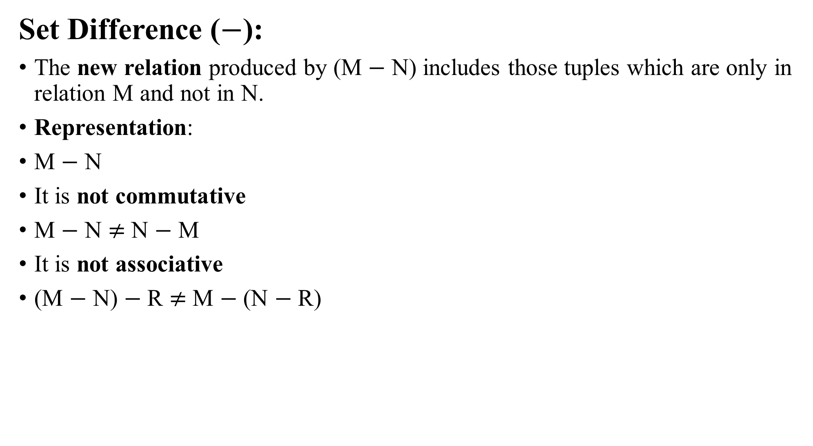
Set Difference ($−$):
The new relation produced by (M $−$ N) includes those tuples which are only in relation M and not in N.
Representation:
M $−$ N
It is not commutative
M $−$ N $≠$ N $−$ M
It is not associative
(M $−$ N) $−$ R $≠$ M $−$ (N $−$ R)
CSE
ECE
CourseID | Name
111 | DSA
222 | DBMS
CourseID | Name
111 | DSA
214 | ED
CSE $−$ ECE
CourseID | Name
222 | DBMS

Slide 149
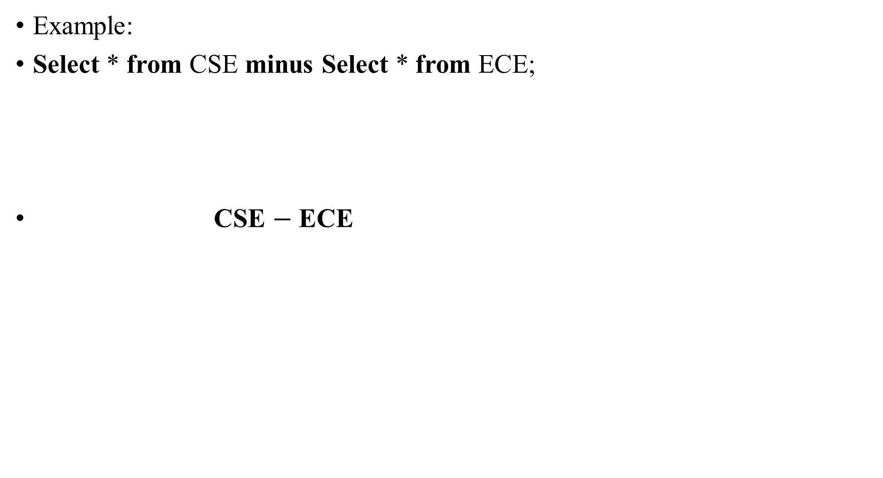
Example:
Select * from CSE minus Select * from ECE;
CSE $−$ ECE

Slide 150
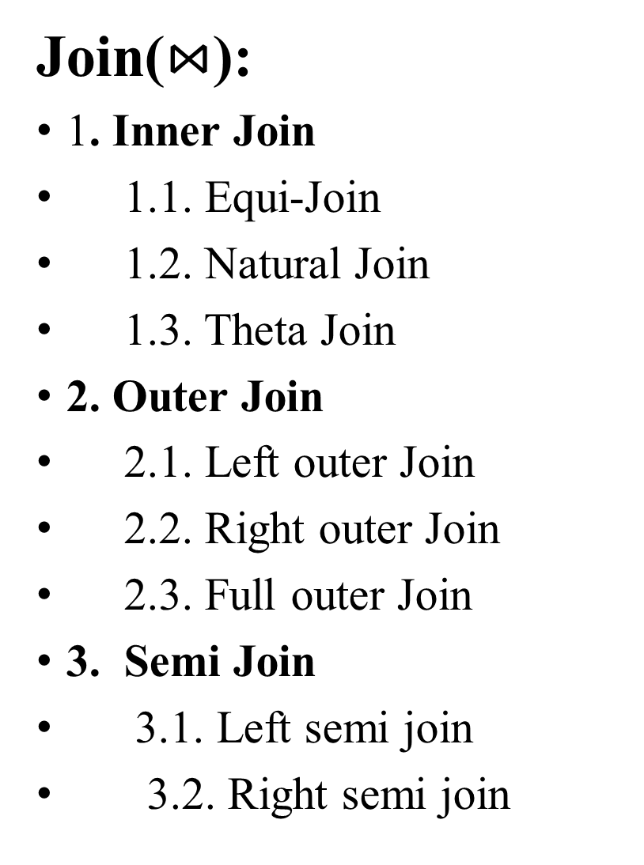
Join($⋈$):
1. Inner Join
1.1. Equi-Join
1.2. Natural Join
1.3. Theta Join
2. Outer Join
2.1. Left outer Join
2.2. Right outer Join
2.3. Full outer Join
3. Semi Join
3.1. Left semi join
3.2. Right semi join
4. Anti semi join or Anti join
4.1. Left Anti Join
4. 2. Right Anti Join

Slide 151
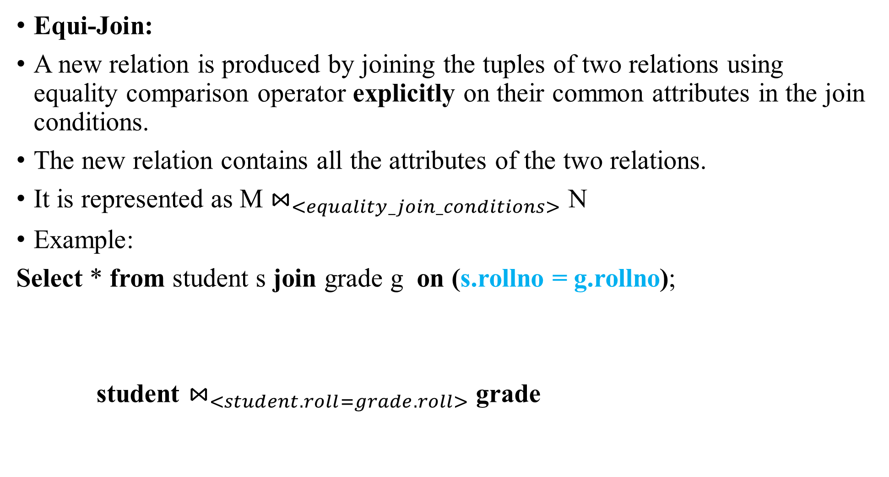
Equi-Join:
A new relation is produced by joining the tuples of two relations using equality comparison operator explicitly on their common attributes in the join conditions.
The new relation contains all the attributes of the two relations.
It is represented as M $⋈_{<equality_join_conditions>}$ N
Example:
Select * from student s join grade g on (s.rollno = g.rollno);
student $⋈_{<student.roll=grade.roll>}$ grade

Slide 152
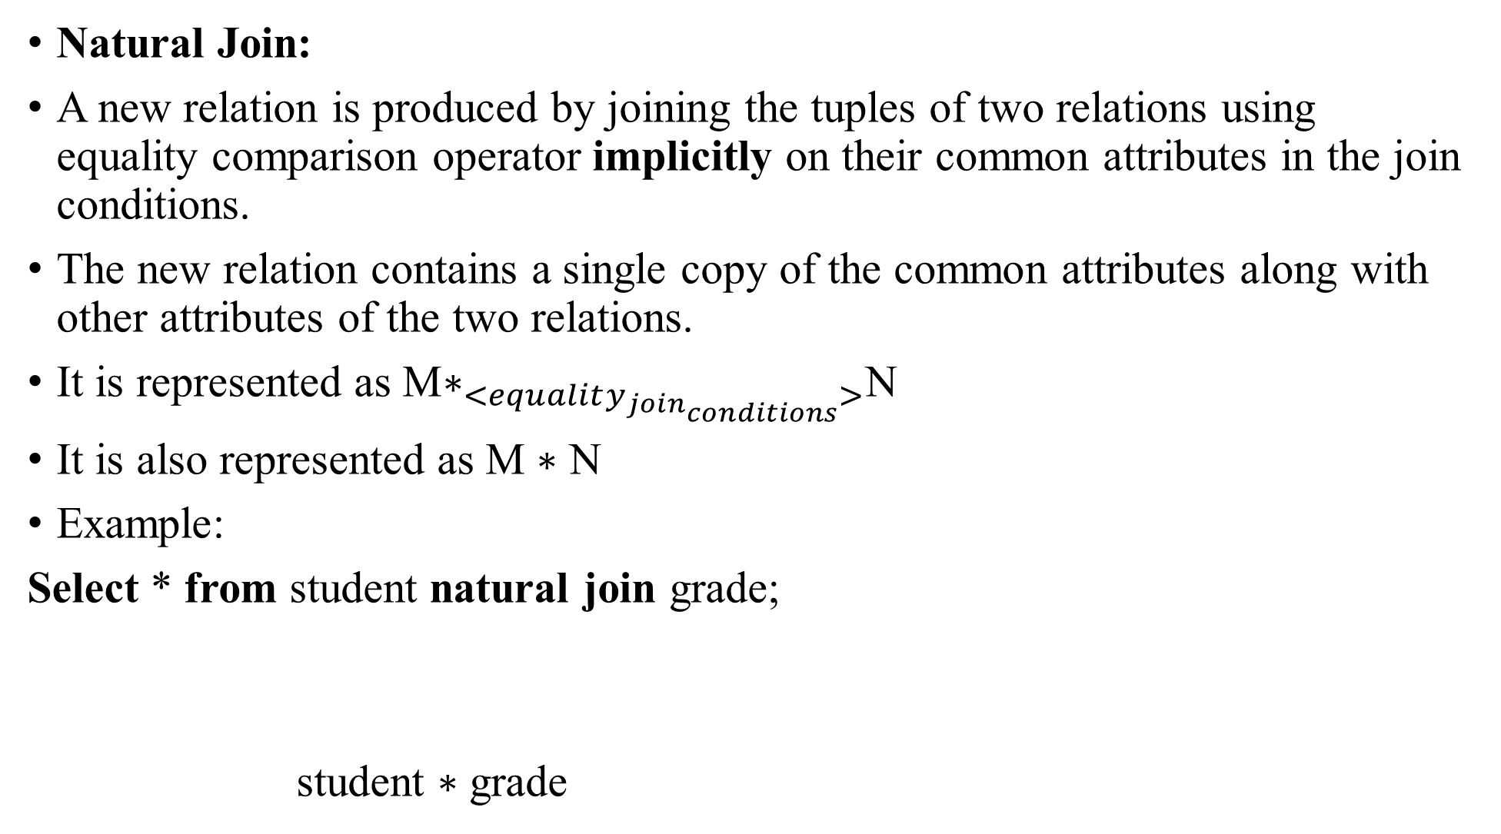
Natural Join:
A new relation is produced by joining the tuples of two relations using equality comparison operator implicitly on their common attributes in the join conditions.
The new relation contains a single copy of the common attributes along with other attributes of the two relations.
It is represented as M$∗_{<equality_{join_{conditions}}>}$N
It is also represented as M $∗$ N
Example:
Select * from student natural join grade;
student $∗$ grade

Slide 153
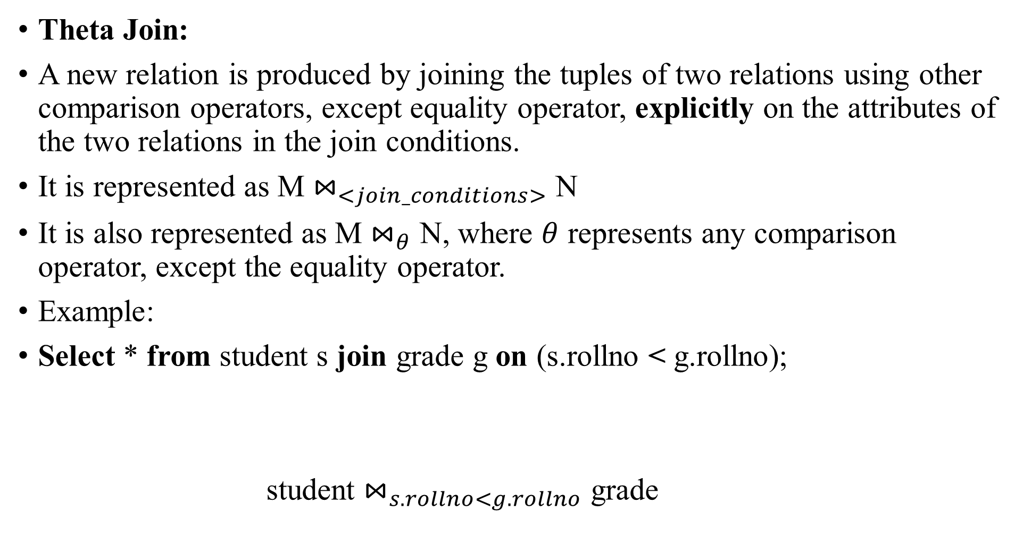
Theta Join:
A new relation is produced by joining the tuples of two relations using other comparison operators, except equality operator, explicitly on the attributes of the two relations in the join conditions.
It is represented as M $⋈_{<join_conditions>}$ N
It is also represented as M $⋈_{θ}$ N, where $θ$ represents any comparison operator, except the equality operator.
Example:
Select * from student s join grade g on (s.rollno < g.rollno);
student $⋈_{s.rollno<g.rollno}$ grade

Slide 154
Inner Joins are commutative and associative.

Slide 155
Left Outer Join:
A new relation is produced by first joining the tuples of the left relation of a join that satisfy the join conditions with the tuples of the right relation and then by joining the tuples of the left relation that do not satisfy the join conditions with the tuples of the right relation.
But, in such tuples of the new relation, the columns of the right relation are assigned with NULL values.
It is represented as M _{<join_conditions>}N
Example:.
Select * from student s left outer join grade g on (s.rollno =g.rollno);
student _{<s.rollno=g.rollno>}grade

Slide 156

Right Outer Join:
It is represented as M N
Example:.
Select * from student s right outer join grade g on (s.rollno =g.rollno);
student _{<s.rollno=g.rollno>}grade

Slide 157
Full Outer Join:
It is represented as M N
Example:.
Select * from student s full outer join grade g on (s.rollno =g.rollno);
student _{<s.rollno=g.rollno>}grade
Outer joins are commutative and associative.

Slide 158

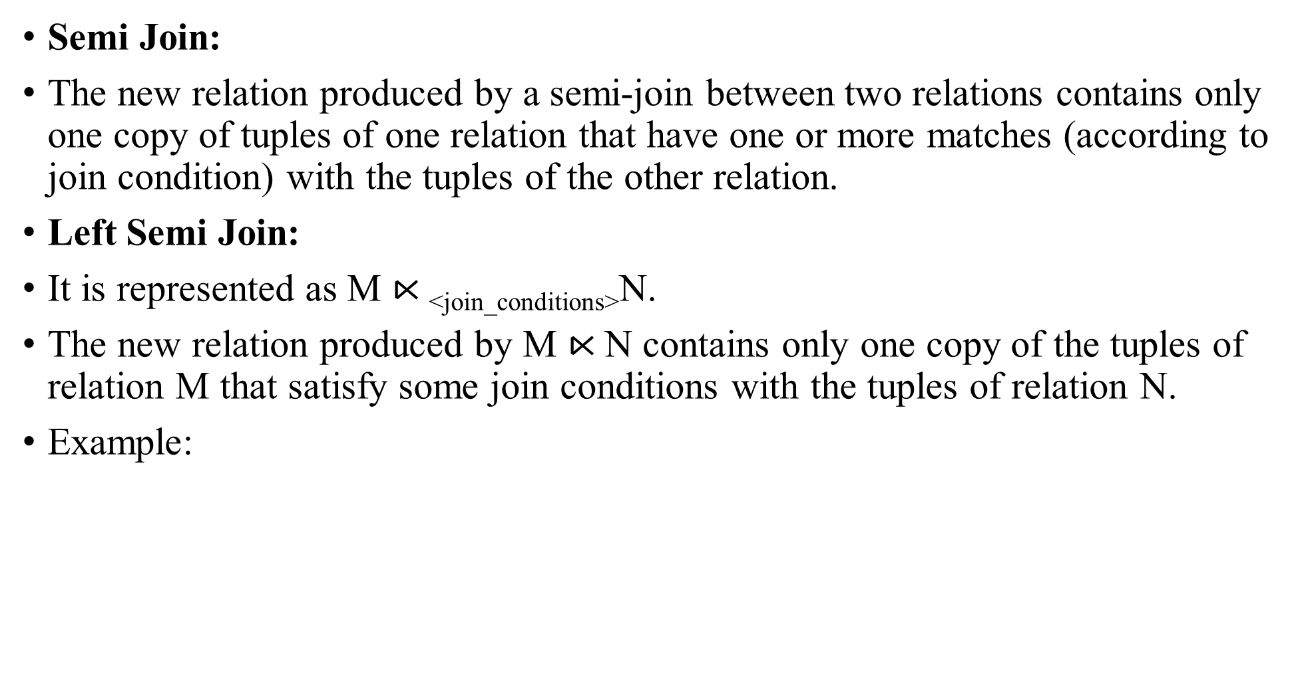
Semi Join:
The new relation produced by a semi-join between two relations contains only one copy of tuples of one relation that have one or more matches (according to join condition) with the tuples of the other relation.
Left Semi Join:
It is represented as M $⋉\text{<}\text{join}\text{_}\text{conditions}\text{>}$N.
The new relation produced by M $⋉$N contains only one copy of the tuples of relation M that satisfy some join conditions with the tuples of relation N.
Example:
A | B
1 | 2
3 | 2
5 | 6
B | C
2 | 3
2 | 55
54 | 66
A | B
1 | 2
3 | 2
Relation M
M $⋉\text{<}\text{M}\text{.}\text{B}\text{=}\text{N}\text{.}\text{B}\text{>}$N
Relation N

Slide 159
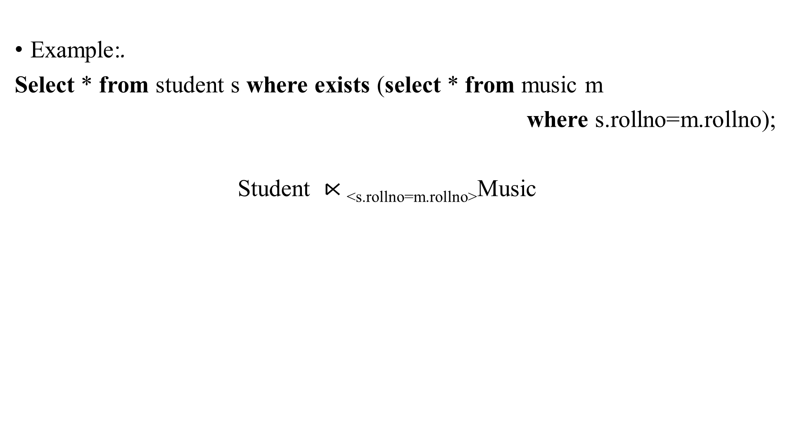
Example:.
Select * from student s where exists (select * from music m
where s.rollno=m.rollno);
Student $⋉\text{<}\text{s}\text{.}\text{rollno}\text{=}\text{m}\text{.}\text{rollno}\text{>}$Music

Slide 160
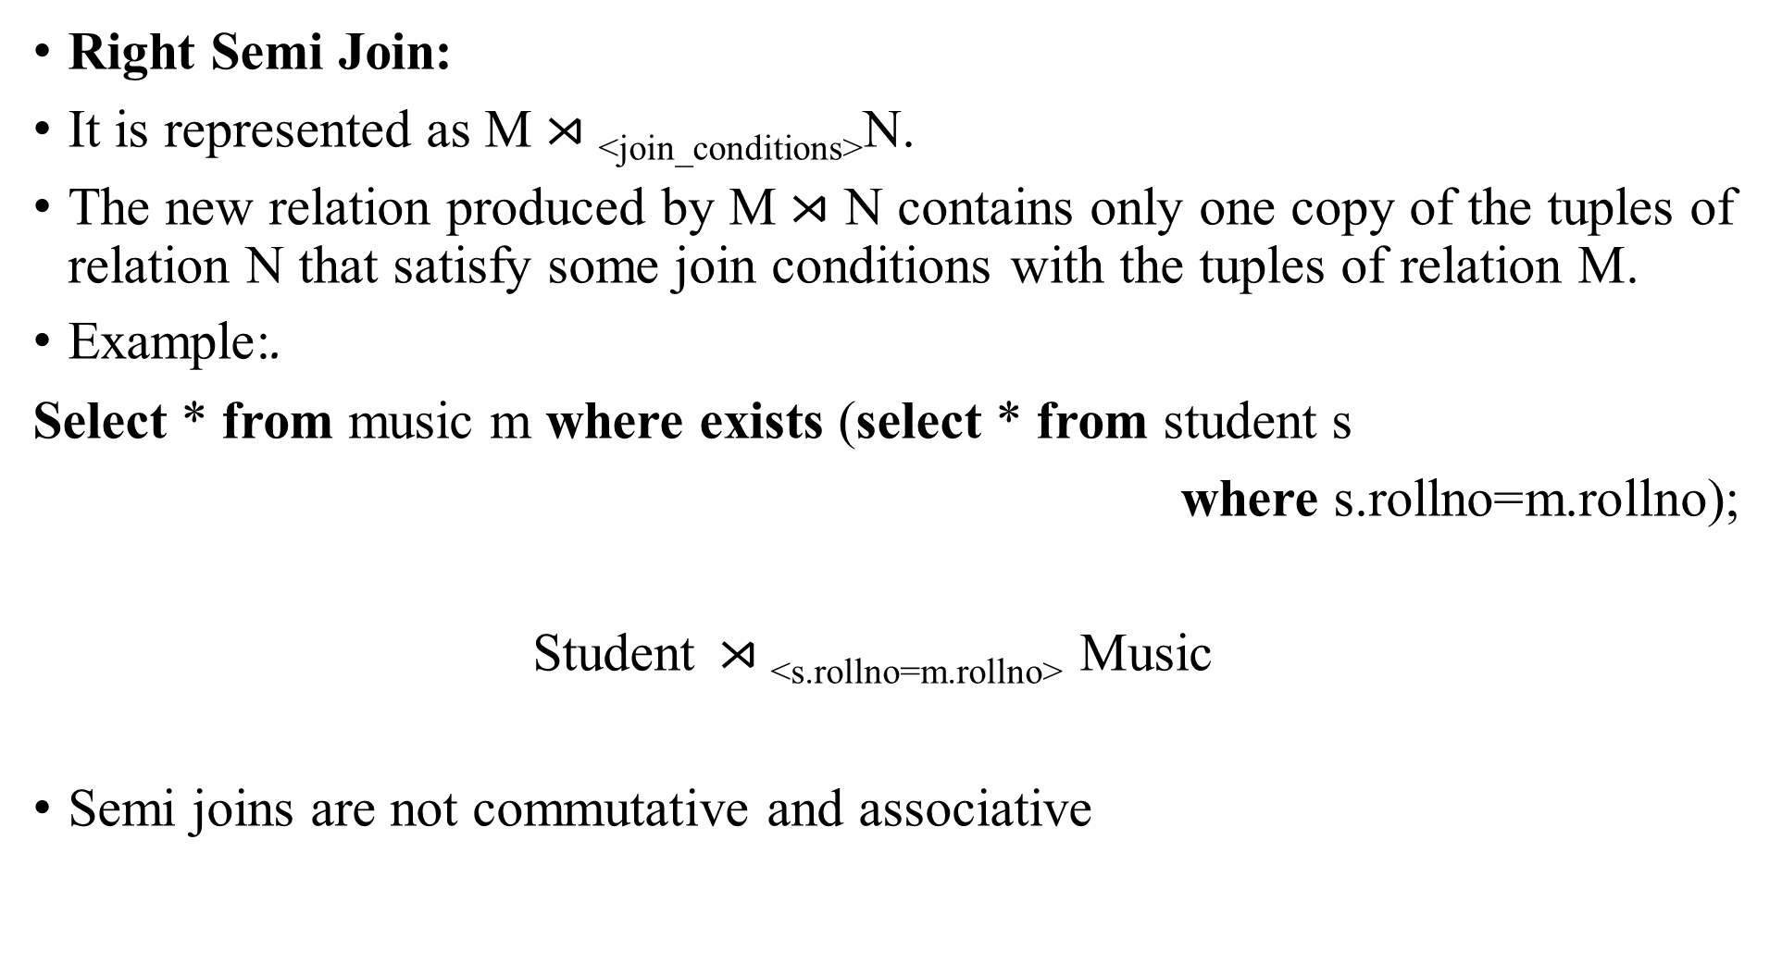
Right Semi Join:
It is represented as M $⋊\text{<}\text{join}\text{_}\text{conditions}\text{>}$N.
The new relation produced by M $⋊$ N contains only one copy of the tuples of relation N that satisfy some join conditions with the tuples of relation M.
Example:.
Select * from music m where exists (select * from student s
where s.rollno=m.rollno);
Student$⋊\text{<}\text{s}\text{.}\text{rollno}\text{=}\text{m}\text{.}\text{rollno}\text{>}$ Music
Semi joins are not commutative and associative

Slide 161

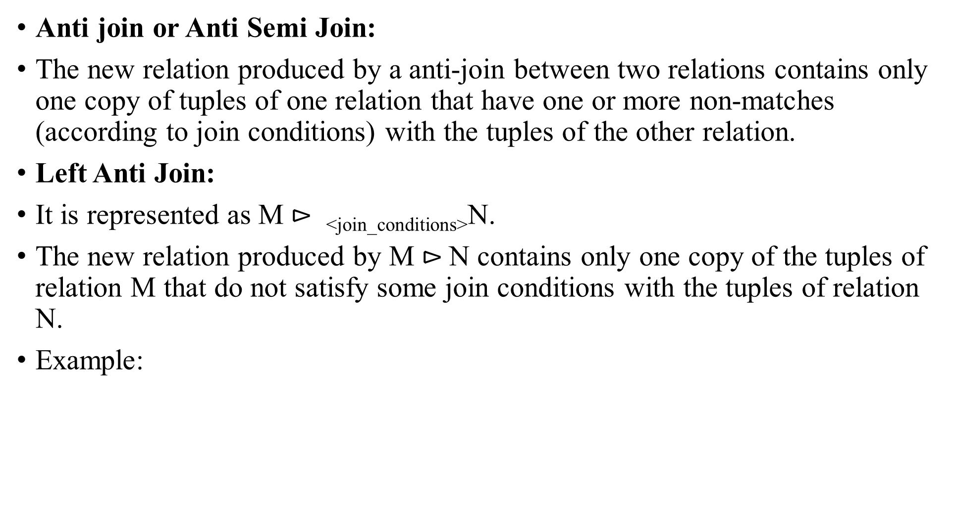
Anti join or Anti Semi Join:
The new relation produced by a anti-join between two relations contains only one copy of tuples of one relation that have one or more non-matches (according to join conditions) with the tuples of the other relation.
Left Anti Join:
It is represented as M $⊳ \text{<}\text{join}\text{_}\text{conditions}\text{>}$N.
The new relation produced by M $⊳$N contains only one copy of the tuples of relation M that do not satisfy some join conditions with the tuples of relation N.
Example:
A | B
1 | 2
3 | 7
5 | 6
B | C
2 | 3
2 | 55
54 | 66
A | B
3 | 7
5 | 6
Relation M
Relation N
M $⊳\text{<}\text{M}\text{.}\text{B}\text{=}\text{N}\text{.}\text{B}\text{>}$N

Slide 162
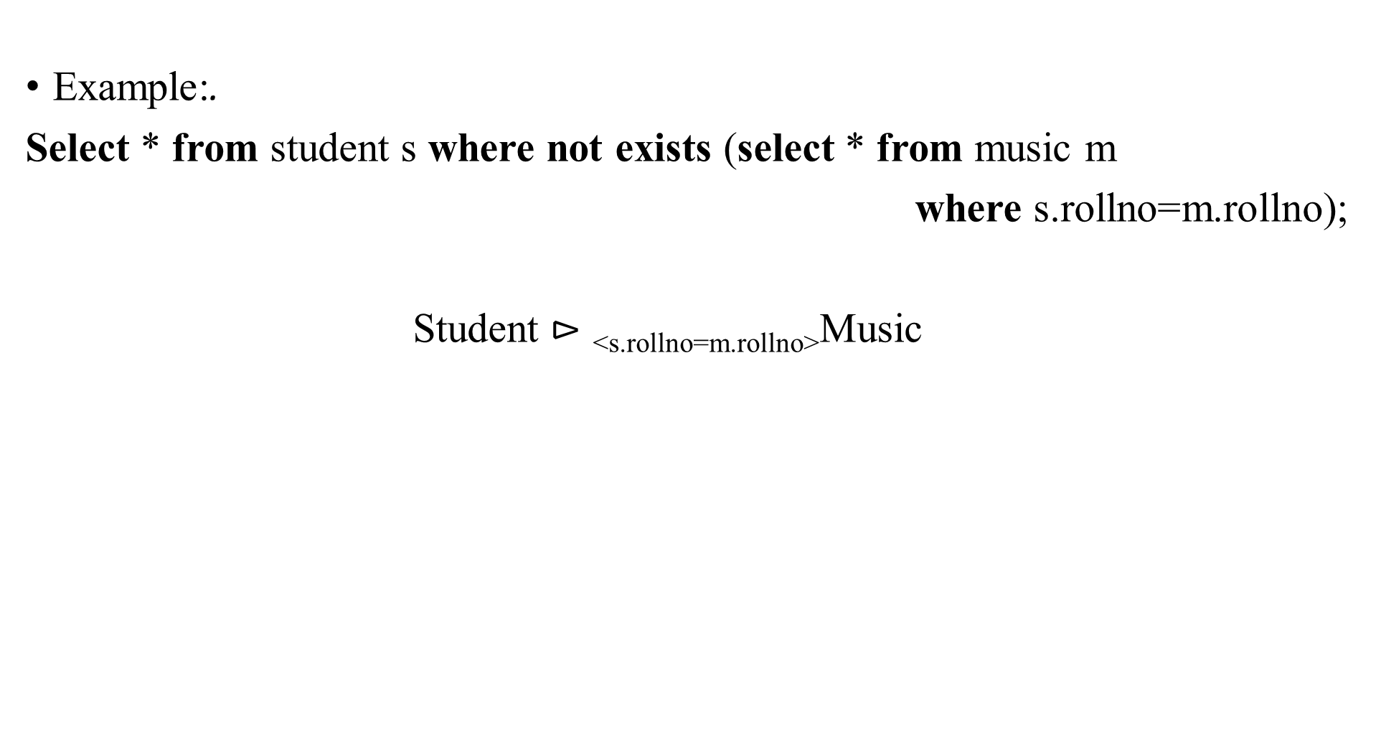
Example:.
Select * from student s where not exists (select * from music m
where s.rollno=m.rollno);
Student $⊳\text{<}\text{s}\text{.}\text{rollno}\text{=}\text{m}\text{.}\text{rollno}\text{>}$Music

Slide 163
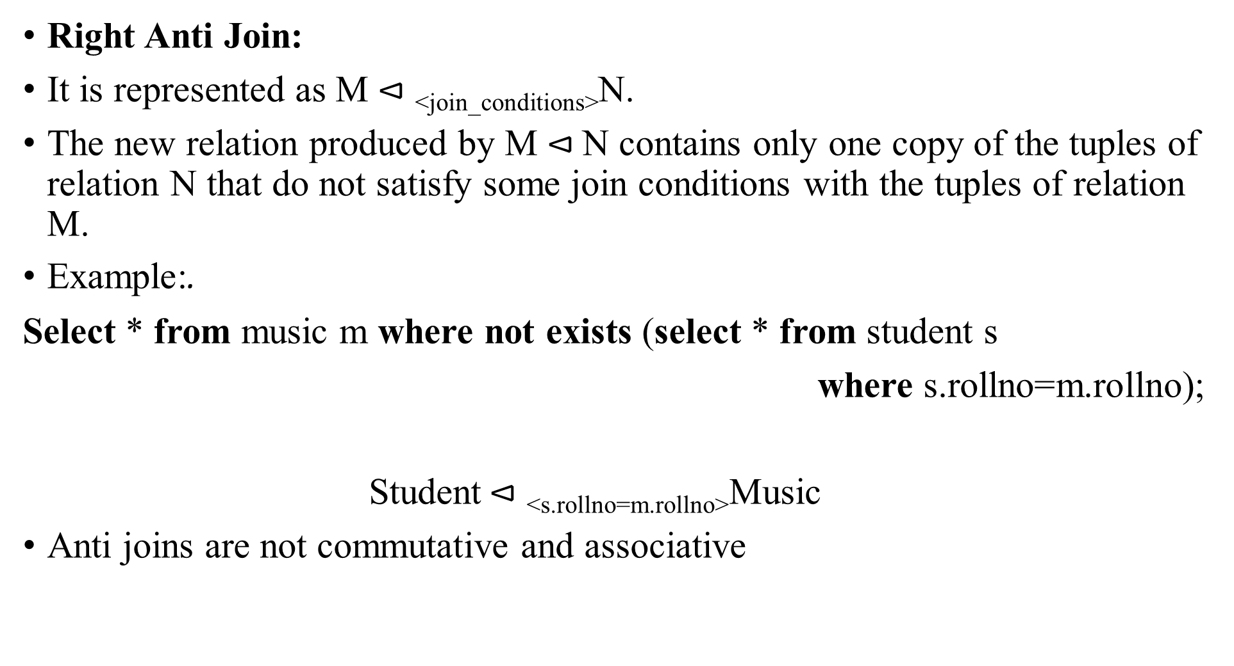
Right Anti Join:
It is represented as M $⊲\text{<}\text{join}\text{_}\text{conditions}\text{>}$N.
The new relation produced by M $⊲$N contains only one copy of the tuples of relation N that do not satisfy some join conditions with the tuples of relation M.
Example:.
Select * from music m where not exists (select * from student s
where s.rollno=m.rollno);
Student$⊲\text{<}\text{s}\text{.}\text{rollno}\text{=}\text{m}\text{.}\text{rollno}\text{>}$Music
Anti joins are not commutative and associative

Slide 164
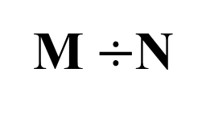
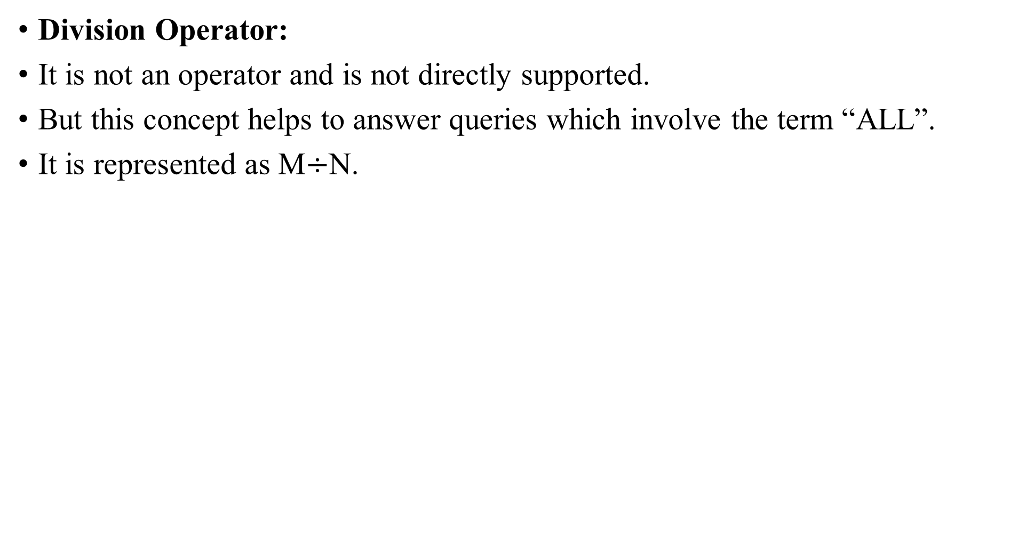
Division Operator:
It is not an operator and is not directly supported.
But this concept helps to answer queries which involve the term “ALL”.
It is represented as M$÷$N.
Roll | Sub
101 | DAA
101 | DBMS
102 | DAA
103 | DBMS
104 | DBMS
104 | DAA
Sub
DAA
DBMS
Roll
101
104
Relation N
M$÷$N
Relation M

Slide 165
Example:
Q. Let M be the student registration relation.
Let N be the mandatory subjects for this semester of CSE.
* Find the students who have registered for all the mandatory subject for this semester of CSE?

Slide 166
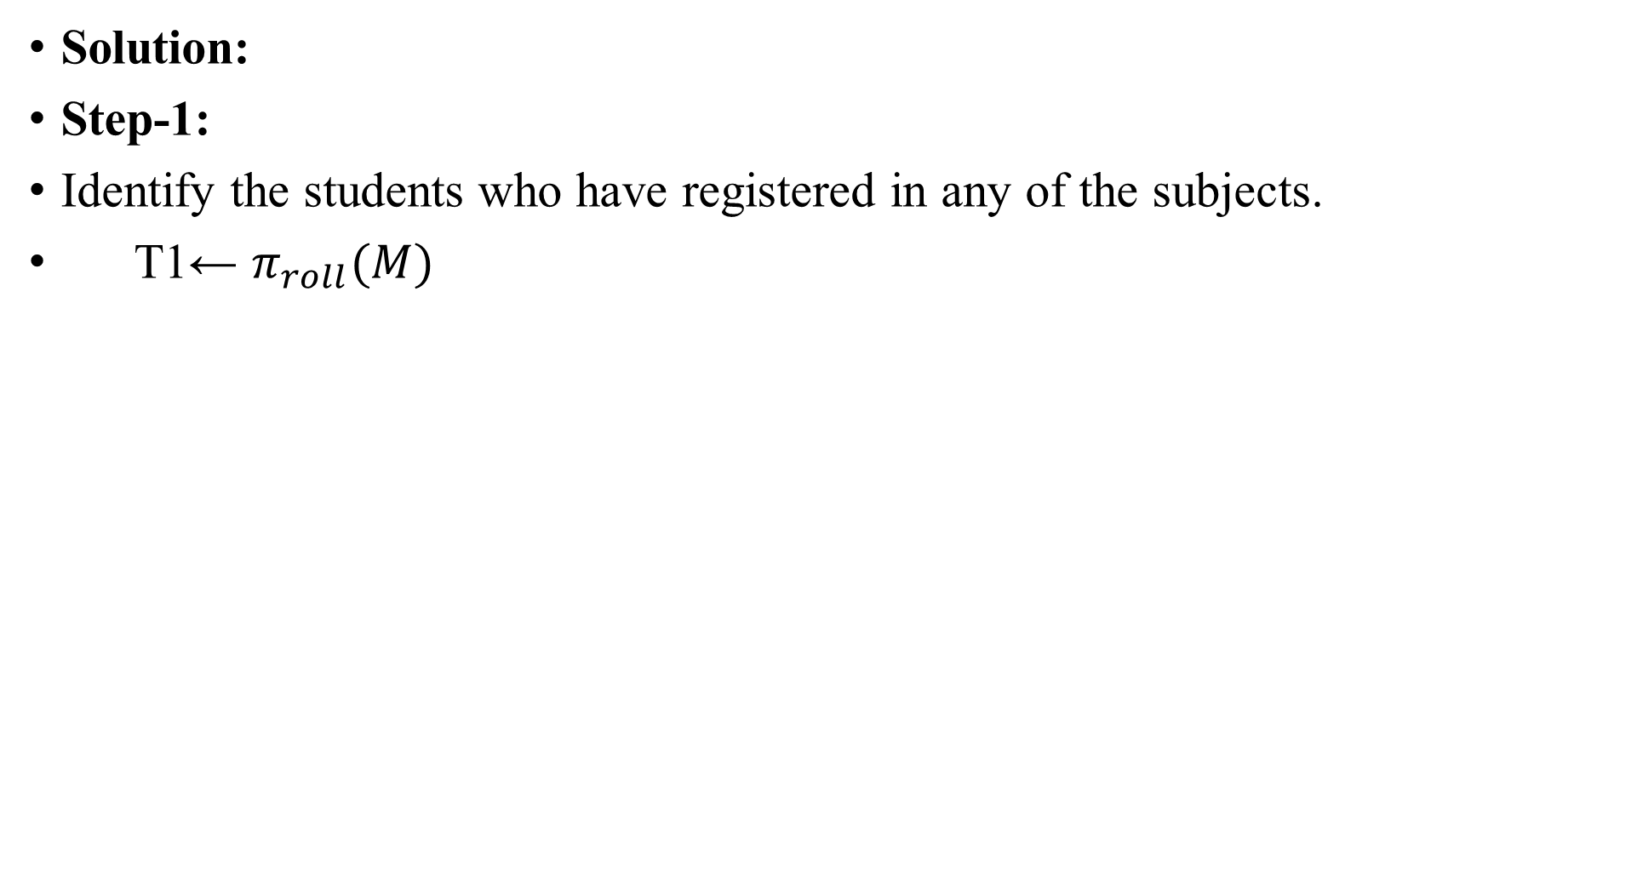
Solution:
Step-1:
Identify the students who have registered in any of the subjects.
T1← $π_{roll}(M)$
Roll | Sub
101 | DAA
101 | DBMS
102 | DAA
103 | DBMS
104 | DBMS
104 | DAA
Roll
101
102
103
104
T1
Relation M

Slide 167
Step-2:
Assume that the registered students have registered for all the mandatory subjects, and according compute such a relation.
T2 ← (T1× N)
Roll | Sub
101 | DAA
101 | DBMS
102 | DAA
102 | DBMS
103 | DAA
103 | DBMS
104 | DAA
104 | DBMS
Roll
101
102
103
104
Sub
DAA
DBMS
Relation N
T1
T2

Slide 168
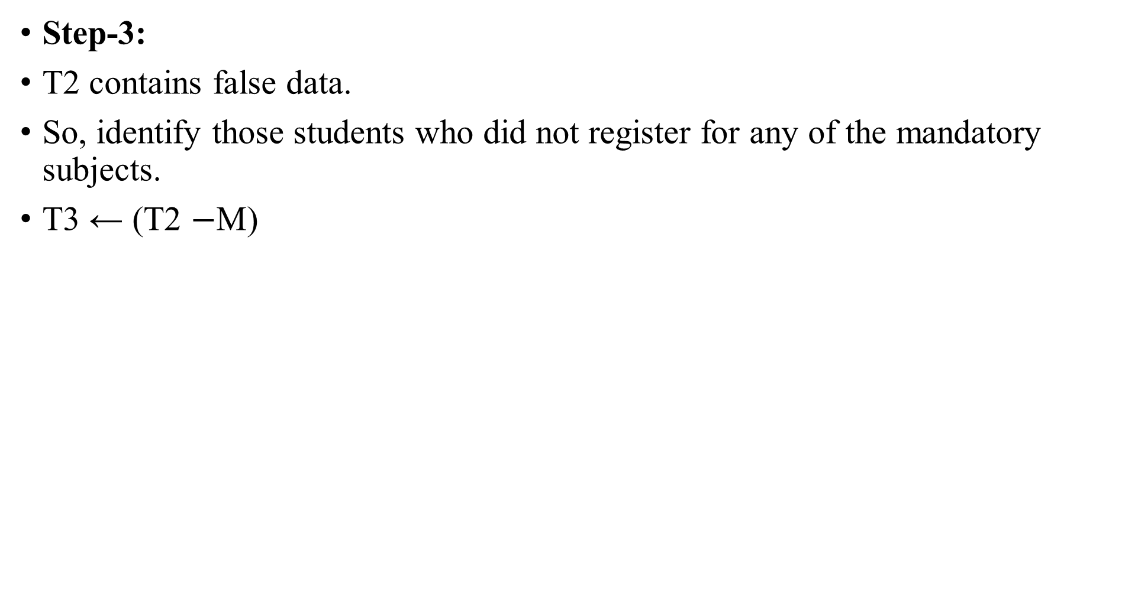
Step-3:
T2 contains false data.
So, identify those students who did not register for any of the mandatory subjects.
T3 ← (T2 $−$M)
Roll | Sub
101 | DAA
101 | DBMS
102 | DAA
102 | DBMS
103 | DAA
103 | DBMS
104 | DAA
104 | DBMS
Roll | Sub
101 | DAA
101 | DBMS
102 | DAA
103 | DBMS
104 | DBMS
104 | DAA
Roll | Sub
102 | DBMS
103 | DAA
T3
Relation M
T2

Slide 169
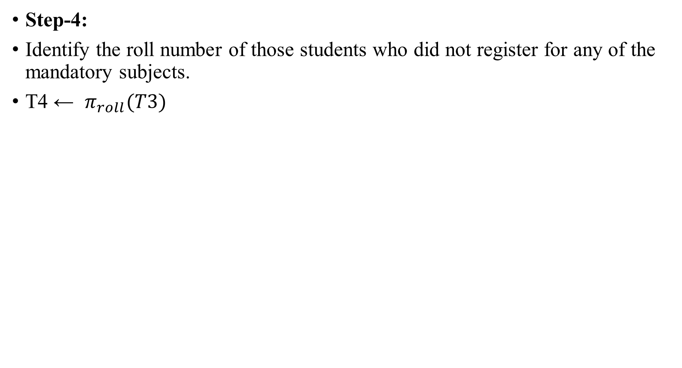
Step-4:
Identify the roll number of those students who did not register for any of the mandatory subjects.
T4 ← $π_{roll}(T3)$
Roll | Sub
102 | DBMS
103 | DAA
Roll
102
103
T3
T4

Slide 170
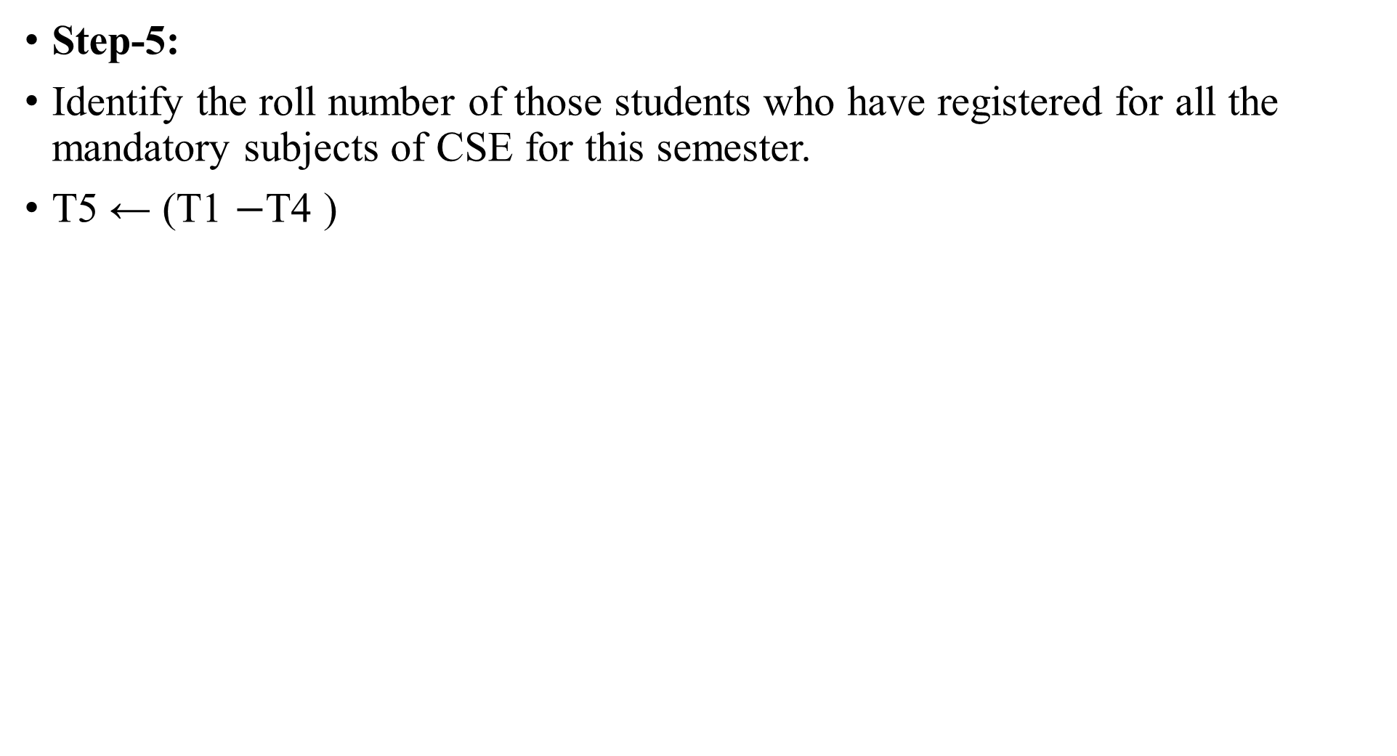
Step-5:
Identify the roll number of those students who have registered for all the mandatory subjects of CSE for this semester.
T5 ← (T1 $−$T4 )
Roll
101
102
103
104
Roll
102
103
Roll
101
104
T4
T5
T1

Slide 171
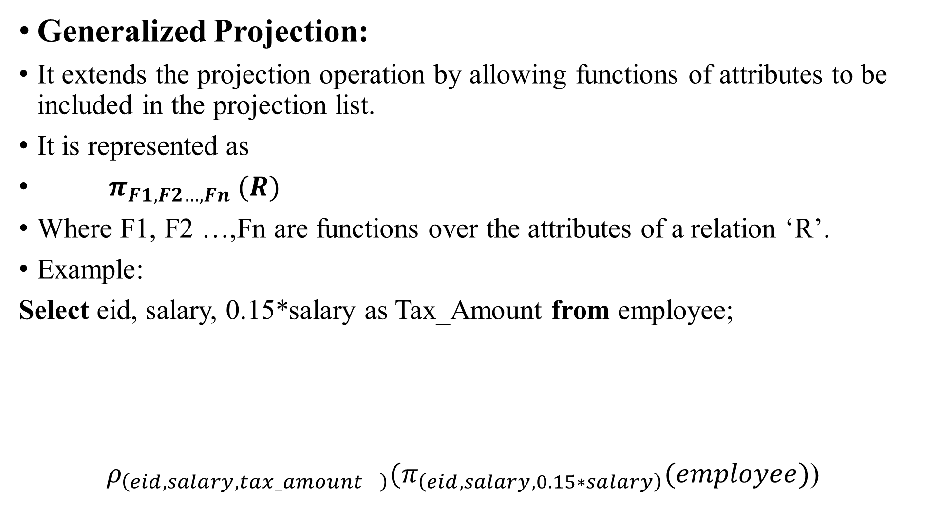
Generalized Projection:
It extends the projection operation by allowing functions of attributes to be included in the projection list.
It is represented as
$π_{F1,F2…,Fn} (R)$
Where F1, F2 …,Fn are functions over the attributes of a relation ‘R’.
Example:
Select eid, salary, 0.15*salary as Tax_Amount from employee;
${ ρ}_{\left(eid,salary,ta{x_amount}_{}\right)}(π_{\left(eid,salary,0.15∗salary\right)}(employee)$)

Slide 172
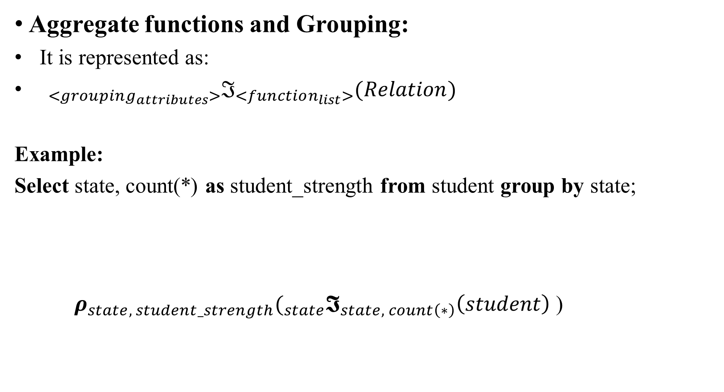
Aggregate functions and Grouping:
It is represented as:
${}_{<grouping_{attributes}>}ℑ_{<function_{list}>}(Relation)$
Example:
Select state, count(*) as student_strength from student group by state;
$ρ_{state, student_strength}(_{state}𝕴_{state, count\left(∗\right)}\left(student\right)$)

Slide 173
Tuple Relational Calculus:
1. Tuple Relational Calculus
2. Domain Relational Calculus

Slide 174
Tuple Relational Calculus:
A relational calculus expression does not specify how data has to be retrieved, but it specifies what data is to be retrieved.
So, it is a non-procedural language.
The expressive power of relational algebra and calculus are identical.
Tuple Variable:
It is a variable that takes on tuples of a particular relation schema values.
It ranges over a particular database relation.

Slide 175
General form of tuple relational calculus is:
{ T | Conditional_Expression( T )}
T is the Target Tuple variable.
T ranges over tuples of values.
Conditional_Expression( T ) is the body of the query.
It evaluates to TRUE or FALSE when T is substituted with some tuple values.
It can involve other tuple variables as well.

Slide 176
Example:
Select * from student;
{ t | student(t)}
Relation student is called the range relation of tuple variable t.
Student( t) is True if the tuple assigned to ‘t’ is a tuple of relation student.

Slide 177
Select roll, name from student;
{ t.roll, t.name | student(t)}
Or
{ t | student(s) AND t.roll=s.roll AND t.name=s.name}
Select roll, name from student where state=‘OD’;
{ t.roll, t.name | student(t) AND t.state = ‘OD’}
Student( t) is True if ‘t’ is a tuple of student relation.
t.state = ‘OD’ is true if the state attribute of t is ‘OD’.

Slide 178
Select s.roll, s.name from student s, music m where s.roll=m.roll;
{ s.roll,s.name | student(s) AND music(m) AND s.roll=m.roll}
Select s.roll, s.name from student s, grade g where (s.roll=g.roll and
g.cgpa>=9.0) ;
{s.roll,s.name | student(s) AND grade(g) AND s.roll=g.roll AND
g.cgpa>=9.0}

Slide 179
Query Conditions/Formula:
Atomic Conditions:
R(T) identifies the range of the tuple variable T and evaluates to true if T is a tuple in relation R.
(T.a comparison_operator S.b) or (T.a comparison_operator constant), where T and S are relation names, ‘a’ and ‘b’ are the attributes of relation T and S respectively.
General Conditions:
If C1 and C2 are conditions then (C1 AND C2 ), (C1 OR C2), and NOT C1 are also conditions.

Slide 180
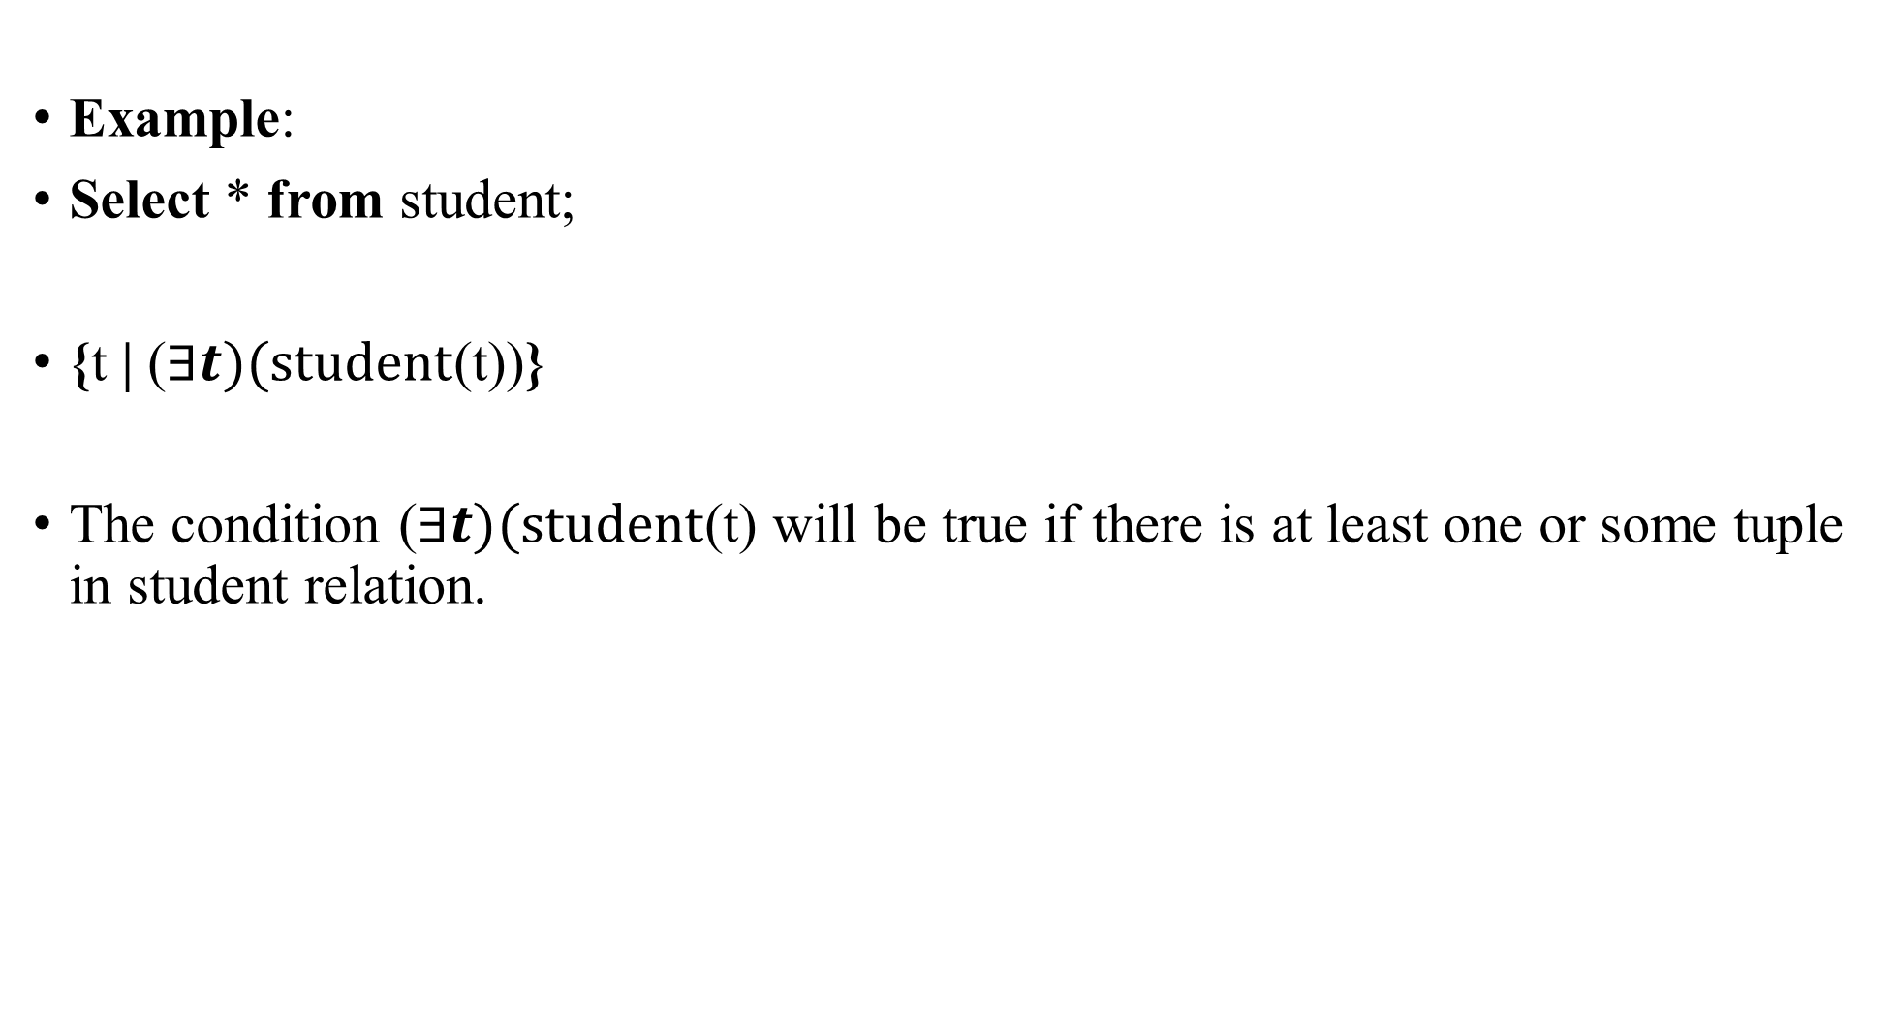
Example:
Select * from student;
{t | ($∃t)(student$(t))}
The condition ($∃t)(student$(t) will be true if there is at least one or some tuple in student relation.

Slide 181
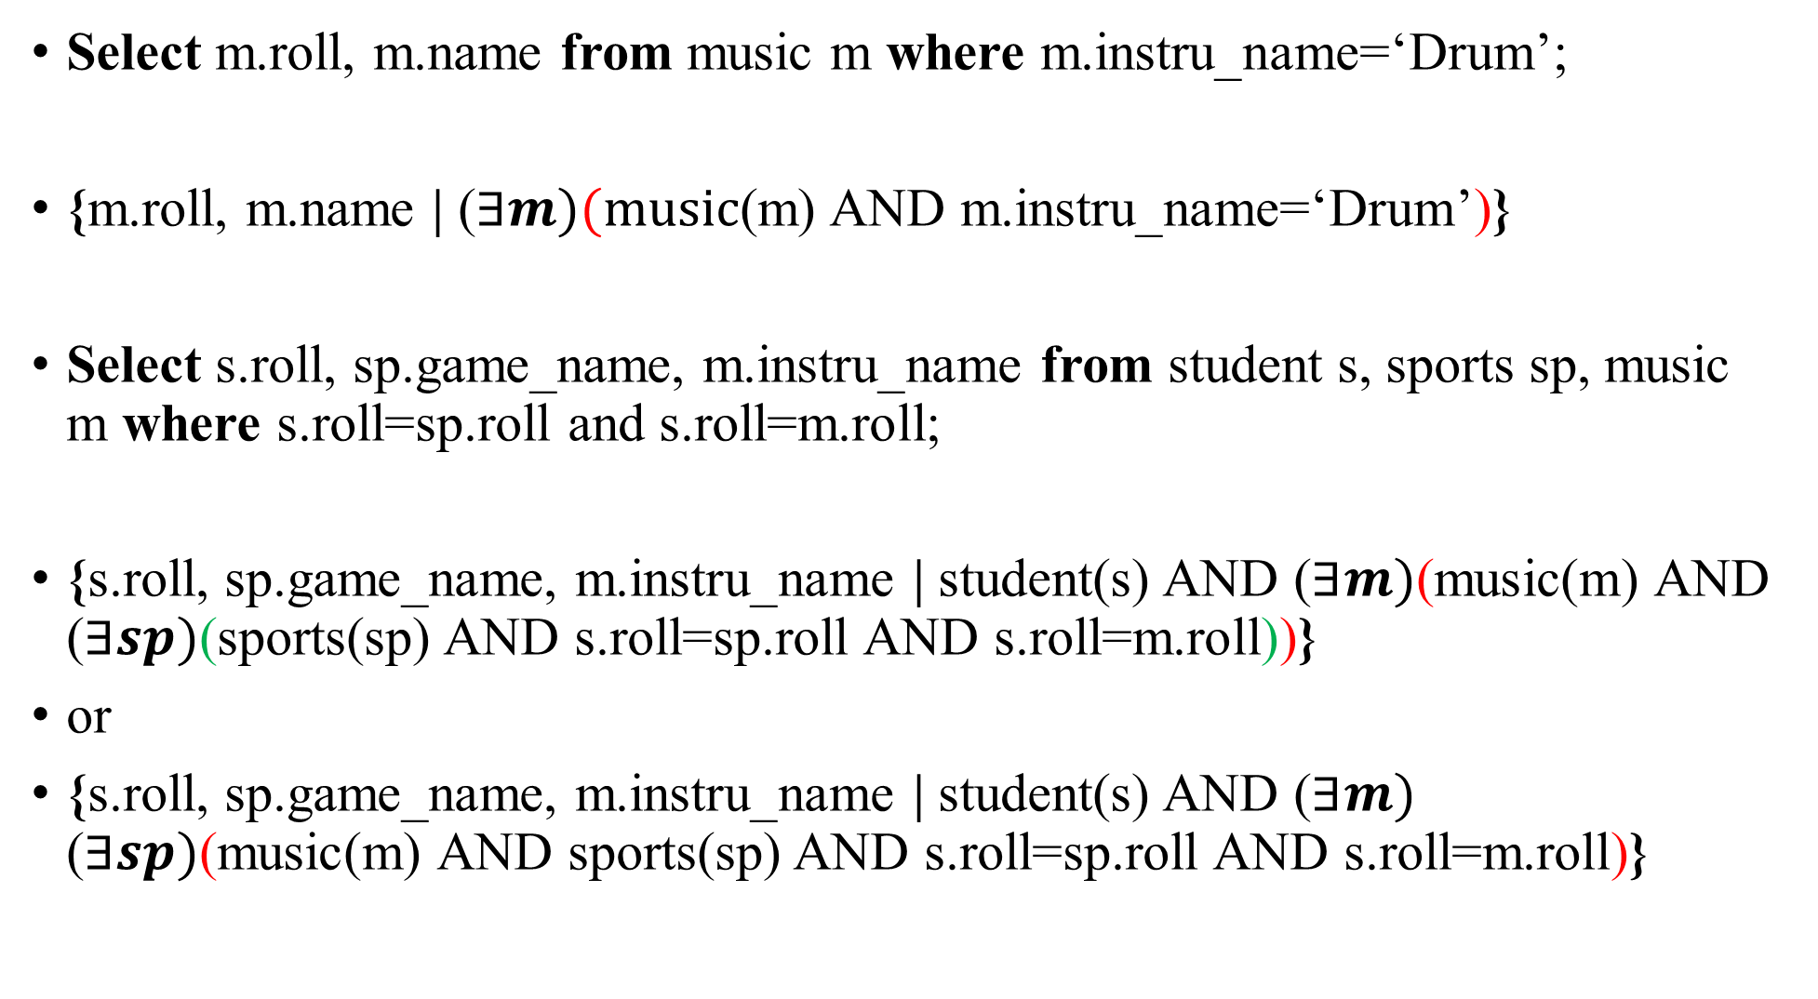
Select m.roll, m.name from music m where m.instru_name=‘Drum’;
{m.roll, m.name | ($∃m)(music$(m) AND m.instru_name=‘Drum’)}
Select s.roll, sp.game_name, m.instru_name from student s, sports sp, music m where s.roll=sp.roll and s.roll=m.roll;
{s.roll, sp.game_name, m.instru_name | student(s) AND ($∃m)$(music(m) AND ($∃sp)$(sports(sp) AND s.roll=sp.roll AND s.roll=m.roll))}
or
{s.roll, sp.game_name, m.instru_name | student(s) AND ($∃m)$ ($∃sp)$(music(m) AND sports(sp) AND s.roll=sp.roll AND s.roll=m.roll)}

Slide 182
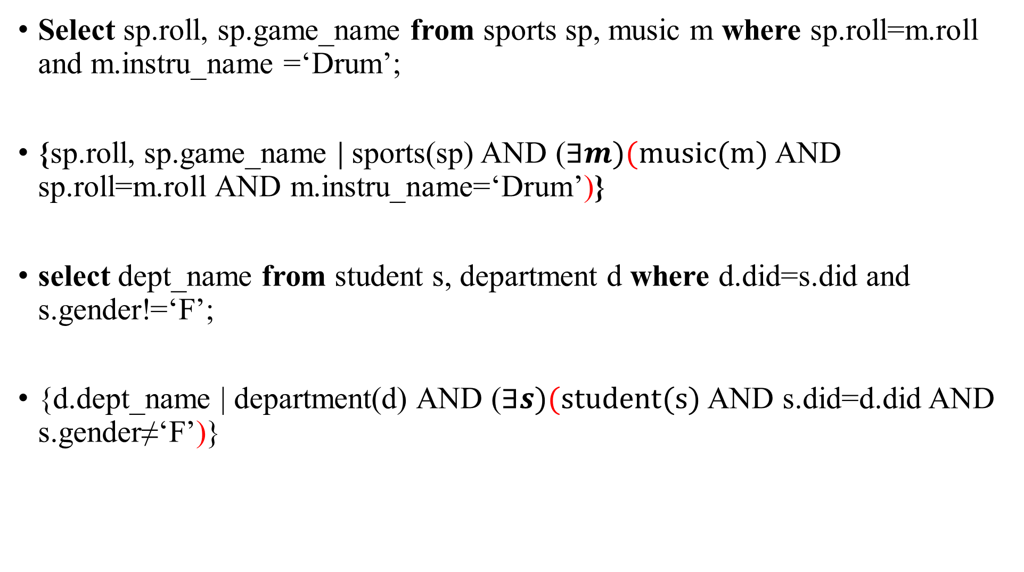
Select sp.roll, sp.game_name from sports sp, music m where sp.roll=m.roll and m.instru_name =‘Drum’;
{sp.roll, sp.game_name | sports(sp) AND ($∃m)(music(m)$ AND sp.roll=m.roll AND m.instru_name=‘Drum’)}
select dept_name from student s, department d where d.did=s.did and s.gender!=‘F’;
{d.dept_name | department(d) AND ($∃s)(student(s)$ AND s.did=d.did AND s.gender≠‘F’)}

Slide 183
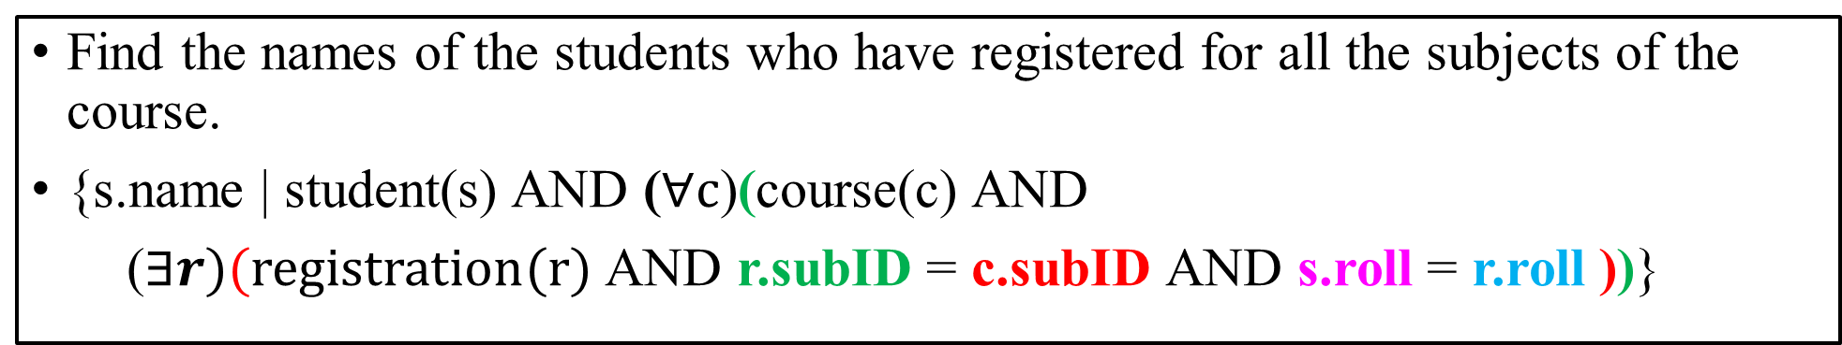
Student
Course
Registration
Roll | Name
101 | John
102 | James
103 | Tom
104 | Mary
SubID | SubName
CS2055 | DAA
CS2043 | DBMS
CS1000 | DS
Roll | SubID | Grade
101 | CS2055 | Ex
101 | CS2043 | Ex
101 | CS1000 | Ex
102 | CS2055 | A
102 | CS2043 | A
103 | CS1000 | B
104 | CS2055 | Ex
104 | CS2043 | A
104 | CS1000 | C
Find the names of the students who have registered for all the subjects of the course.
{s.name | student(s) AND ($∀c$)(course(c) AND
($∃r)(registration(r)$ AND r.subID = c.subID AND s.roll = r.roll ))}

Slide 184
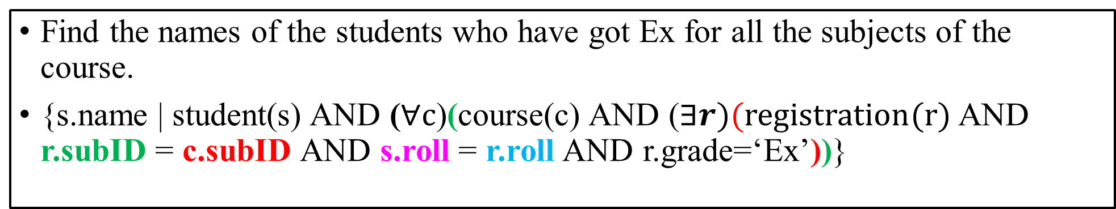
Student
Course
Registration
Roll | Name
101 | John
102 | James
103 | Tom
104 | Mary
SubID | SubName
CS2055 | DAA
CS2043 | DBMS
CS1000 | DS
Roll | SubID | Grade
101 | CS2055 | Ex
101 | CS2043 | Ex
101 | CS1000 | Ex
102 | CS2055 | A
102 | CS2043 | A
103 | CS1000 | B
104 | CS2055 | Ex
104 | CS2043 | A
104 | CS1000 | C
Find the names of the students who have got Ex for all the subjects of the course.
{s.name | student(s) AND ($∀c$)(course(c) AND ($∃r)(registration(r)$ AND r.subID = c.subID AND s.roll = r.roll AND r.grade=‘Ex’))}

Slide 185
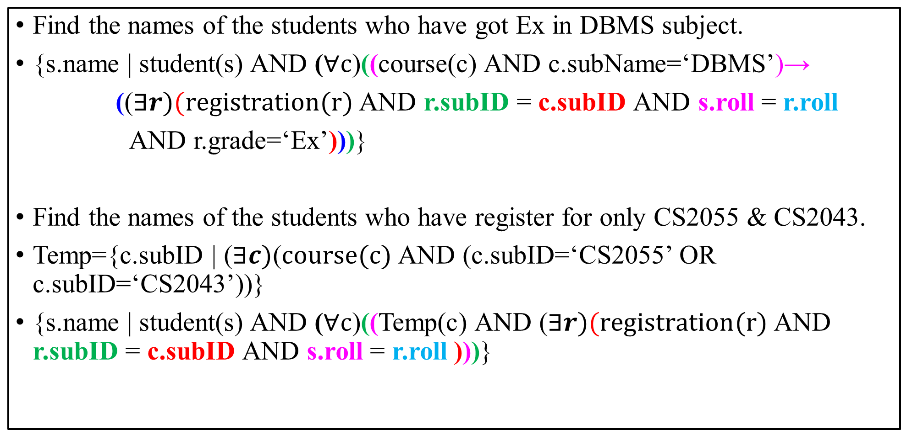
Find the names of the students who have got Ex in DBMS subject.
{s.name | student(s) AND ($∀c$)((course(c) AND c.subName=‘DBMS’)→
(($∃r)(registration(r)$ AND r.subID = c.subID AND s.roll = r.roll
AND r.grade=‘Ex’)))}
Find the names of the students who have register for only CS2055 & CS2043.
Temp={c.subID | ($∃c)\text{(}course(c)$AND (c.subID=‘CS2055’ OR c.subID=‘CS2043’))}
{s.name | student(s) AND ($∀c$)((Temp(c) AND ($∃r)(registration(r)$ AND r.subID = c.subID AND s.roll = r.roll )))}

Slide 186
Domain Relational Calculus:
Domain Variable:
It is a variable that takes a value from a domain of a particular attribute of a relational schema.
Example:
Select * from student;
{<R,N> | student(R,N)}
Here, R and N are domain variables.
Student
Roll | Name
101 | John
102 | James
103 | Tom
104 | Mary

Slide 187
Select roll, name from student where roll=104 ;
{<R,N> | student(R,N) AND R=104}
Select name from student where roll=104;
{<N> | student(R,N) AND R=104}
Select s.name, m.instru_name from student s, music m where s.roll=m.roll;
{<N,C> | student(R,N) AND music(A,B,C) AND R=B}
Music
M-ID | Roll | Instru-name
M801 | 101 | Drum
M802 | 104 | Guitar
M803 | 103 | Sitar

Slide 188
Database Design:
Step-1: Construct a conceptual model of the Problem using High level data model like ER diagram.
Step-2: Convert the conceptual model into a logical model using relational data model.
Step-3: Tune the logical model using normalization
Step-4: Implement the logical model using oracle
Step-5: Physical tuning for performance

Slide 189
Step-1: Construct a conceptual model of the Problem using High level data model like ER diagram.
Entity Relationship (ER) Diagram:
It is a data model that is used to build a conceptual schema by mapping the essential real world objects and their relationships.
Entity:
It may be an object with physical/conceptual existence in the real world.
Example: person, car, hospital, job etc.
Symbol:

Slide 190
Attribute:
It is the properties that describe an entity.
Example: person’s name, ID, height, marital status, address etc.

Slide 191
Types of Attribute:
1. Atomic attribute or single valued attribute
2. Composite attribute
3. Multivalued attribute
4. Derived attribute
5. Complex attribute

Slide 192
Atomic/single valued Attribute:
It cannot be divided or decomposed into any other attributes.
It can be assigned with only one value at a time.
Example: ID, First_Name, Last_Name, height, House_No, Lane_No, age, etc.

Slide 193
Composite Attribute:
It is composed by combining many atomic attributes.
It can be divided or decomposed into many other atomic attributes.
Example: Name, Address, Mobile_No, etc
Street
Town
District
State
House_No
Country
Address

Slide 194
Multi valued Attribute:
It can be assigned with a set of values.
Example: Shirt_Color, Mobile_No, Office_Address, Hobby, etc.

Slide 195
Derived Attribute:
It is can be derived from the attributes that are stored in DBMS.
Example: age, class_strength, average_CGPA, etc.

Slide 196
Complex Attribute:
It is a nesting of composite and multi-valued attributes.
Example:
{Office_Address(Buiding_Name, Floor_No, Street, Lane, Dist, State, Country)}
Building
Name
Floor_No
Street
Office
Address

Slide 197
Entity Type:
It is a set of entities with same attributes.
Example: Student entity type, Car entity type
Student
Entity Type
Roll | Name
101 | John
102 | Luke
Attributes
Entities
Entity Set

Slide 198
Entity Type:
H.No.
Town
District
State
Name
Address
DOB
Roll
Age
Student
Mobile.No

Slide 199
Example:
Entity Types for a Dummy Company:
D-ID
Manager
Manager_start_date
Name
Department
Locations

Slide 200
Example:
Entity Types for a Dummy Company:
Name
Location
Controlling_department
P-ID
Project

Slide 201
Example:
Entity Types for a Dummy Company:
Fname
Minit
Lname
Project
Hours
Salary
Name
ssn
sex
Works_On
Department
DOB
Employee
Address

Slide 202
Example:
Entity Types for a Dummy Company:
Relationship
Sex
DOB
Employee
Dependent
Dependent_name

Slide 203
Entity types of a particular eco-system or mini-world are related to one another.
Relationships among the entity types are generally captured as attributes in the Initial design.
Relationship among entity types are represented as Relationship Type.
A set of associations/relationships that exists among a collection of entity types is called a Relationship Type.
Symbol:

Slide 204
Relationship Type.
D-ID
SSN
Employee
Works_For
Department

Slide 205
Relationship Type.
D-ID
SSN
Employee
Works_For
Department
SSN
101
102
103
104
D-ID
F-601
M-602
S-603
RD-604
Entity Sets

Slide 206
Relationship Type.
D-ID
SSN
Employee
Works_For
Department
SSN
101
102
103
104
D-ID
F-601
M-602
S-603
RD-604

Slide 207
Relationship Type.
D-ID
SSN
Employee
Works_For
Department
SSN
101
102
103
104
SSN
101
102
103
104
D-ID
M-602
F-601
S-603
RD-604
D-ID
F-601
M-602
S-603
RD-604

Slide 208
Relationship Type.
D-ID
SSN
Employee
Works_For
Department
SSN
101
102
103
104
SSN
101
102
103
104
D-ID
M-602
F-601
S-603
RD-604
D-ID
F-601
M-602
S-603
RD-604
Relationship Set

Slide 209
Degree of Relationship Type:
is the number of entity types participating in a Relationship Type.
Attributes of Relationship Type:
A Relationship type can have attributes.
Hours
P-ID
SSN
Employee
Works_On
Project

Slide 210
Role Names:
Specify the role of the participating entity type.
D-ID
SSN
Manager
Department
Managed
Employee
Manages
Department

Slide 211
Role Names are important in Recursive relationship types.
SSN
Employee
Supervisor
Supervisee
Supervision

Slide 212
Constraints on Binary Relationship Types:
Cardinality ratio:
It specifies the maximum number of relationship that an entity can participate in.
Here, manages is a One-to-One (1:1) relationship
D-ID
SSN
Department
Managed
Manager 1
Employee
1
Department
Manages
SSN
101
104
D-ID
M-602
RD-604

Slide 213
Here, manages is a One-to-One (1:1) relationship
D-ID
SSN
Department
Managed
Manager
1
Employee
1
Department
Manages
SSN
101
104
D-ID
M-602
RD-604
Mng_SSN
101
104
D-ID
M-602
RD-604

Slide 214
Here, manages is a One-to-Many (1:N) relationship
Where, N=2
D-ID
SSN
Department
Managed
Manager
1
N
Employee
Manages
Department
SSN
101
102
D-ID
F-601
M-602
S-603
RD-604

Slide 215
Here, manages is a One-to-Many (1:N) relationship
Where, N=2
D-ID
SSN
Department
Managed
Manager
1
N
Department
Employee
Manages
SSN
101
102
D-ID
F-601
M-602
S-603
RD-604
Mng_SSN
101
101
102
102
D-ID
F-601
M-602
S-603
RD-604

Slide 216
Here, Works_On is a Many-to-Many (M:N) relationship
Where, M=2:N=3
P-ID
SSN
project
worker
M
N
Project
Employee
Works_On
SSN
101
102
P-ID
P-601
P-602
P-603

Slide 217
P-ID
Here, Works_On is a Many-to-Many (M:N) relationship
Where, M=2:N=3
SSN
Project
Employee
Worker
M
N
Project
Works_On
SSN
101
102
P-ID
P-601
P-602
Wr_SSN
101
101
101
102
P-ID
P-601
P-602
P-603
P-601
P-603
102
P-602
102
P-603

Slide 218
Constraints on Binary Relationship Types:
Participation/minimum cardinality constraint:
It specifies the minimum number of relationship that each entity can participate in.
Types of participation constraint:
1. total participation
2. partial participation

Slide 219
Total participation:
Constraint: Every employee must work for at least one department and at most two department(cardinality ratio). A department can have at least one employee & at most N employees.
D-ID
SSN
(min=1, max=2)
(min=1, max=N)
employee
department
Employee
Works_For
Department
SSN
101
102
103
104
D-ID
F-601
M-602
S-603
RD-604

Slide 220
Total participation:
Constraint: Every employee must work for at least one department and at most two department(cardinality ratio). A department can have at least one employee & at most N employees.
D-ID
SSN
(1, 2)
(1, N)
Employee
employee
department
Department
Works_For
SSN
101
102
103
104
D-ID
F-601
M-602
S-603
RD-604

Slide 221
Total participation:
D-ID
SSN
(1, N)
(1, 2)
department
Employee
employee
Department
Works_For
SSN
101
102
103
104
SSN
101
102
103
104
D-ID
F-601
M-602
S-603
S-603
D-ID
F-601
M-602
S-603
RD-604
104
RD-604

Slide 222
Alternative representation for Total participation:
D-ID
SSN
N
2
employee
department
Department
Employee
Works_For
SSN
101
102
103
104
SSN
101
102
103
104
D-ID
F-601
M-602
S-603
S-603
D-ID
F-601
M-602
S-603
RD-604
104
RD-604

Slide 223
Partial participation:
Constraint: Some employees may not manage any department and some employee may manage at most 3 departments (cardinality ratio). A department must have only one manager.
D-ID
SSN
(min=0, max=3)
(min=1, max=1)
manager
department
Employee
Manages
Department
SSN
101
102
103
104
D-ID
F-601
M-602
S-603
RD-604

Slide 224
Partial participation:
Constraint: Some employees may not manage any department and some employee may manage at most 3 departments (cardinality ratio). A department must have only one manager.
D-ID
SSN
(0, 3)
(1, 1)
manager
department
Employee
Manages
Department
SSN
101
102
103
104
D-ID
F-601
M-602
S-603
RD-604

Slide 225
Partial participation:
Constraint: Some employees may not manage any department and some employee may manage at most 3 departments (cardinality ratio). A department must have only one manager.
D-ID
SSN
(0, 3)
(1, 1)
manager
department
Employee
Manages
Department
M-SSN
101
104
D-ID
F-601
M-602
S-603
RD-604
D-ID
F-601
M-602
S-603
RD-604
SSN
101
102
103
104
104
104

Slide 226
Alternative representation for Partial participation:
D-ID
SSN
1
3
Employee
manager
department
Department
Manages
M-SSN
101
104
D-ID
F-601
M-602
S-603
RD-604
D-ID
F-601
M-602
S-603
RD-604
SSN
101
102
103
104
104
104

Slide 227
Weak Entity Type:
Entity types that do not have key attributes of their own are called weak entities.
Example:
Dependents of employees
Dependent_Name | Dependent_Type
Jude | Children
Jessica | Wife
Mary | wife
John | children
Jessica | children
Dependent

Slide 228
Weak Entity Type:
Entity types that do not have key attributes of their own are called weak entities.
Dependent_Name | Dependent_Type
Jude | Children
Jessica | Wife
Mary | wife
John | children
Jessica | children
SSN | Name
E101 | James
E102 | Jack
Employee
Dependent

Slide 229
Weak Entity Type:
Entity types should be identified with a strong entity type via a relationship type.
Such relationship type is called identifying relationship.
DName
SSN
1
N
Employee
Dependents_Of
Dependent
DName | D_Type
Jude | Children
Jessica | wife
Mary | wife
John | children
Jessica | children
SSN | Name
E101 | James
E102 | Jack
SSN
E101
E101
DName | D_Type
Jude | Children
Jessica | Wife
Mary | wife
John | children
Jessica | children
Employee
E102
E102
E102
Dependent

Slide 230
Key of Weak Entity Type:
It is not unique
It is called partial key and is underlined with a dotted line.
DName
SSN
1
N
Employee
Dependents_Of
Dependent
DName | D_Type
Jude | Children
Jessica | wife
Mary | wife
John | children
Jessica | children
SSN | Name
E101 | James
E102 | Jack
SSN
E101
E101
DName | D_Type
Jude | Children
Jessica | Wife
Mary | wife
John | children
Jessica | children
Employee
E102
E102
E102
Dependent

Slide 231
Mapping a Conceptual Design into a Logical Design:
Step-1: Mapping of strong/regular entity types.
For each strong entity type ‘E’, create a relation ‘R’ and identify a super keys, candidate keys and primary key.
Relation ‘R’ must contain only simple attributes.
For composite attributes of entity type, only their constituent simple attributes must be included in its relation ‘R’.
For multivalued attributes of entity type,
the multivalued attributes should be treated as a separate entity type
Create a relation for the multivalued attributes entity type.
Link the relation for the multivalued attributes entity type with its parent relation using foreign keys.

Slide 232
Lname
Example:
Fname
Minit
Name
ssn
sex
DOB
Employee
Employee
SSN | Fname | Minit | Lname | DOB | Sex

Slide 233
Lname
Example:
Fname
Minit
Name
ssn
sex
create table employee
(
ssn varchar2(10),
Fname varchar2(30) not null,
Minit varchar2(4),
Lname varchar2(30),
DOB date,
sex varchar2(1),
constraint pk_employee primary key( ssn )
)
DOB
Employee
Employee
SSN | Fname | Minit | Lname | DOB | Sex

Slide 234
Example:
Fname
Minit
Lname
Type
H_ID
Name
ssn
sex
DOB
Hobbies
Employee
Employee
SSN | Fname | Minit | Lname | DOB | Sex | H-ID | H_Name | H-Type

Slide 235
Example:
Employee
SSN | Fname | Minit | Lname | DOB | Sex | H-ID | H_Name | H-Type
101 | john | n | taylor | 02-02-1996 | M | H01 | tracking | outdoor
101 | john | n | taylor | 02-02-1996 | M | H02 | gardening | outdoor
102 | breet | P | lee | 04-07-1980 | M | H01 | tracking | outdoor
Employee
Hobby
SSN | Fname | Minit | Lname | DOB | Sex
101 | john | n | taylor | 02-02-1996 | M
102 | breet | P | lee | 04-07-1980 | M
H-ID | H_Name | H-Type | SSN
H01 | tracking | outdoor | 101
H02 | gardening | outdoor | 101
H01 | tracking | outdoor | 102

Slide 236
Employee
Hobby
SSN | Fname | Minit | Lname | DOB | Sex
101 | john | n | taylor | 02-02-1996 | M
102 | breet | P | lee | 04-07-1980 | M
H-ID | H_Name | H-Type | SSN
H01 | tracking | outdoor | 101
H02 | gardening | outdoor | 101
H01 | tracking | outdoor | 102
create table employee
(
ssn varchar2(10),
Fname varchar2(30) not null,
Minit varchar2(4),
Lname varchar2(30),
DOB date,
sex varchar2(1),
constraint pk_employee primary key( ssn )
)
create table hobby
(
H-ID varchar2(10),
H_name varchar2(30) not null,
H-Type varchar2(4),
ssn varchar2(10),
constraint pk_hobby primary key( H-ID, ssn ),
constraint fk_hobby foreign key(ssn) references
employee(ssn) on delete cascade
)

Slide 237
Mapping a Conceptual Design into a Logical Design:
Step-2: Mapping of Weak entity types.
For a weak entity type ‘W’ of strong entity type ‘E’, create a relation ‘R’.
Include the simple attributes of weak entity type ‘W’ in relation ‘R’.
Also, include the primary keys of the strong entity type ‘E’ as foreign keys in ‘R’.
The primary key of ‘R’ is formed by combining the primary key of the strong entity type and weak entity type.

Slide 238
DName
Example:
SSN
Employee
Employee
Dependent
Dependent
SSN | Fname | Minit | Lname | DOB | Sex
DName | D_Type
Dependent
create table dependent
(
dname varchar2(10) not null,
D_type varchar2(30),
ssn varchar2(10) not null,
constraint fk_dependant foreign key(ssn) references
employee(ssn) on delete cascade
)
SSN | DName | D_Type

Slide 239
Mapping a Conceptual Design into a Logical Design:
Step-3: Mapping of Binary 1:1 Relationship Types.
Case-1(when the participations are only partial):
Create a separate relation ‘R’ for a relationship type, by combining the primary keys of the partially participating entity types ‘E’ and ‘D’ along with the attributes of the relationship type.
The primary keys of the partially participating entity types ‘E’ and ‘D’ are foreign keys in ‘R’.
Primary key of either ‘E’ or ‘D’ can be made as the primary key of ‘R’.
Draw back:
Needs extra relation
Needs extra join operation

Slide 240
Step-3: Mapping of Binary 1:1 Relationship Types.
Case-1(when the participations are only partial):
Hrs
D-ID
SSN
(0, 1)
(0, 1)
Employee
Works_for
Department
SSN | Fname | Minit | Lname | DOB | Sex
D-ID | Dname
101 | John | N | Taylor | 02/03/88 | M
D001 | CSE
D002 | ECE
102 | Mary | L | Smith | 02/03/92 | F
SSN | D-ID | Hrs
101 | D001 | 20
D003 | ME
103 | Mark | N | Lee | 02/03/82 | M
102 | D002 | 20
Primary Key Problem
Space Wastage
1003 | NULL | NULL
NULL | D003 | NULL

Slide 241
Step-3: Mapping of Binary 1:1 Relationship Types.
Case-1(when the participations are only partial):
Hrs
D-ID
SSN
(0, 1)
(0, 1)
Employee
Works_for
Department
D-ID | Dname
SSN | Fname | Minit | Lname | DOB | Sex
D-ID | Hrs
D001 | CSE
101 | John | N | Taylor | 02/03/88 | M
D001 | 20
D002 | ECE
D003 | ME
102 | Mary | L | Smith | 02/03/92 | F
D002 | 20
Space Wastage w.r.t deletion in department
103 | Mark | N | Lee | 02/03/82 | M
NULL | NULL

Slide 242
Step-3: Mapping of Binary 1:1 Relationship Types.
Case-1(when the participations are only partial):
Hrs
D-ID
SSN
(0, 1)
(0, 1)
Employee
Works_for
Department
SSN | Hrs
D-ID | Dname
SSN | Fname | Minit | Lname | DOB | Sex
101 | 20
D001 | CSE
101 | John | N | Taylor | 02/03/88 | M
102 | 20
D002 | ECE
NULL | NULL
D003 | ME
102 | Mary | L | Smith | 02/03/92 | F
Space Wastage w.r.t
deletion in employee
103 | Mark | N | Lee | 02/03/82 | M

Slide 243

Step-3: Mapping of Binary 1:1 Relationship Types.
Case-1(when the participations are only partial):
Hrs
D-ID
SSN
(0, 1)
(0, 1)
Employee
Works_for
Department
SSN | Fname | Minit | Lname | DOB | Sex
D-ID | Dname
101 | John | N | Taylor | 02/03/88 | M
D001 | CSE
D002 | ECE
102 | Mary | L | Smith | 02/03/92 | F
SSN | D-ID | Hrs
101 | D001 | 20
D003 | ME
103 | Mark | N | Lee | 02/03/82 | M
102 | D002 | 20
No Primary Key Problem
No Space Wastage w.r.t deletion in either employee or department

Slide 244
Step-3: Mapping of Binary 1:1 Relationship Types.
Case-1(when the participations are only partial):
Employee
Works_for
Department
SSN | Fname | Minit | Lname | DOB | Sex
SSN | D-ID | Hrs
D-ID | Dname
create table works_for
(
ssn varchar2(10),
D-ID varchar2(10) not null,
hrs varchar2(4),
constraint pk_ssn primary key( ssn ),
constraint fk_works_1 foreign key(ssn) references employee(ssn) on delete cascade
constraint fk_works_2 foreign key(D-ID) references department(D-ID) on delete
cascade
)

Slide 245
Step-3: Mapping of Binary 1:1 Relationship Types.
Case-2(when the participations are only total):
Create a single new relation ‘R’ by merging the attributes of the two totally participating entity types ‘E’ and ‘D’.
Select the either of the primary keys of the two totally participating entity types as the primary key of the new relation ‘R’.

Slide 246
Step-3: Mapping of Binary 1:1 Relationship Types.
Case-2(when the participations are only total):
Hrs
D-ID
SSN
(1, 1)
(1, 1)
Employee
Works_for
Department
SSN | Fname | Minit | Lname | DOB | Sex
D-ID | Dname
101 | John | N | Taylor | 02/03/88 | M
D001 | CSE
D002 | ECE
102 | Mary | L | Smith | 02/03/92 | F
SSN | D-ID | Hrs
D003 | ME
101 | D001 | 20
103 | Mark | N | Lee | 02/03/82 | M
102 | D002 | 20
103 | D003 | 18
Space Wastage

Slide 247
Step-3: Mapping of Binary 1:1 Relationship Types.
Case-2(when the participations are only total):
Hrs
D-ID
SSN
(1, 1)
(1, 1)
Employee
Works_for
Department
D-ID | Dname
D001 | CSE
SSN | Fname | Minit | Lname | DOB | Sex
D-ID | Hrs
D002 | ECE
101 | John | N | Taylor | 02/03/88 | M
D001 | 20
D003 | ME
102 | Mary | L | Smith | 02/03/92 | F
D002 | 20
103 | Mark | N | Lee | 02/03/82 | M
D003 | 18
Space Wastage

Slide 248
Step-3: Mapping of Binary 1:1 Relationship Types.
Case-2(when the participations are only total):
Hrs
D-ID
SSN
(1, 1)
(1, 1)
Employee
Works_for
Department
SSN | Fname | Minit | Lname | DOB | Sex
SSN | Hrs
D-ID | Dname
101 | John | N | Taylor | 02/03/88 | M
D001 | 20
D001 | CSE
D002 | 20
D002 | ECE
102 | Mary | L | Smith | 02/03/92 | F
D003 | 18
D003 | ME
103 | Mark | N | Lee | 02/03/82 | M
Space Wastage

Slide 249
Step-3: Mapping of Binary 1:1 Relationship Types.
Case-2(when the participations are only total):
Hrs
D-ID
SSN
(1, 1)
(1, 1)
Employee
Works_for
Department
SSN | Fname | Minit | Lname | DOB | Sex
Hrs
D-ID | Dname
101 | John | N | Taylor | 02/03/88 | M
20
D001 | CSE
102 | Mary | L | Smith | 02/03/92 | F
20
D002 | ECE
103 | Mark | N | Lee | 02/03/82 | M
18
D003 | ME
No Space Wastage

Slide 250
Step-3: Mapping of Binary 1:1 Relationship Types.
Case-2(when the participations are only total):
Hrs
D-ID
SSN
(1, 1)
(1, 1)
Employee
Works_for
Department
SSN | Fname | Minit | Lname | DOB | Sex
D-ID | Dname
SSN | Fname | Minit | Lname | DOB | Sex
Hrs
D-ID | Dname

Slide 251
Step-3: Mapping of Binary 1:1 Relationship Types.
Case-2(when the participations are only total):
Employee
Works_for
Department
SSN | Fname | Minit | Lname | DOB | Sex
Hrs
D-ID | Dname
create table Employee_works_for_Department
(
ssn varchar2(10),
Fname varchar2(30) not null,
Minit varchar2(4),
Lname varchar2(30),
DOB date,
sex varchar2(1),
Hrs number(5),
D-ID varchar2(10),
Dname varchar2(20),
constraint pk_employee_work_department primary key( ssn )
)

Slide 252
Step-3: Mapping of Binary 1:1 Relationship Types.
Case-3(when the participations are partial and total):
Identify the entity type ‘E’ that is totally participating in the relationship type ‘R’.
Also, identify the entity type ‘D’ that is partially participating in the relationship type ‘R’.
Include the primary key of the partially participating entity type ‘D’ in ‘E’ as its foreign key.
Also, include the attribute of ‘R’ in ‘E’.

Slide 253
Step-3: Mapping of Binary 1:1 Relationship Types.
Case-3(when the participations are partial and total):
Hrs
D-ID
SSN
(1, 1)
(0, 1)
Employee
Works_for
Department
SSN | Fname | Minit | Lname | DOB | Sex
D-ID | Dname
SSN | Fname | Minit | Lname | DOB | Sex
D-ID | Dname
101 | John | N | Taylor | 02/03/88 | M
SSN | D-ID | Hrs
D001 | CSE
101 | D001 | 20
D002 | ECE
102 | Mary | L | Smith | 02/03/92 | F
102 | D002 | 20
D003 | ME
103 | D003 | 18
D004 | Math
103 | Mark | N | Lee | 02/03/82 | M
NULL | D004 | NULL
Space Wastage

Slide 254
Step-3: Mapping of Binary 1:1 Relationship Types.
Case-3(when the participations are partial and total):
Hrs
D-ID
SSN
(1, 1)
(0, 1)
Employee
Works_for
Department
SSN | Fname | Minit | Lname | DOB | Sex
D-ID | Dname
SSN | Fname | Minit | Lname | DOB | Sex
SSN | Hrs
D-ID | Dname
101 | John | N | Taylor | 02/03/88 | M
101 | 20
D001 | CSE
102 | 20
D002 | ECE
102 | Mary | L | Smith | 02/03/92 | F
103 | 18
D003 | ME
NULL | NULL
D004 | Math
103 | Mark | N | Lee | 02/03/82 | M
Space Wastage w.r.t deletion in Employee

Slide 255
Step-3: Mapping of Binary 1:1 Relationship Types.
Case-3(when the participations are partial and total):
Hrs
D-ID
SSN
(1, 1)
(0, 1)
Employee
Works_for
Department
SSN | Fname | Minit | Lname | DOB | Sex
D-ID | Dname
SSN | Fname | Minit | Lname | DOB | Sex
D-ID | Hrs
D-ID | Dname
101 | John | N | Taylor | 02/03/88 | M
D001 | 20
D001 | CSE
102 | Mary | L | Smith | 02/03/92 | F
D002 | 20
D002 | ECE
D003 | ME
103 | Mark | N | Lee | 02/03/82 | M
D003 | 18
D004 | Math
No Space Wastage w.r.t deletion in Employee and Department

Slide 256
Step-3: Mapping of Binary 1:1 Relationship Types.
Case-3(when the participations are partial and total):
Hrs
D-ID
SSN
(1, 1)
(0, 1)
Employee
Works_for
Department
SSN | Fname | Minit | Lname | DOB | Sex
D-ID | Dname
SSN | Fname | Minit | Lname | DOB | Sex
D-ID | Hrs

Slide 257
Step-3: Mapping of Binary 1:1 Relationship Types.
Case-3(when the participations are partial and total):
Employee
Works_for
Department
SSN | Fname | Minit | Lname | DOB | Sex
D-ID | Hrs
D-ID | Dname
create table Employee_Works
(
ssn varchar2(10),
Fname varchar2(30) not null,
Minit varchar2(4),
Lname varchar2(30),
DOB date,
sex varchar2(1),
D-ID varchar2(10) not null unique,
Hrs number(5),
constraint pk_employee primary key( ssn ),
constraint fk_employee foreign key( D-ID ) references department(D-ID) on delete cascade
)

Slide 258
Step-4: Mapping of Binary 1:N Relationship Types.

Slide 259
Step-4: Mapping of Binary 1:N Relationship Types.
Case-1(when the participations are only partial):
Hrs
SSN
D-ID
(0, N)
(0, 1)
Employee
Department
Works_for
D-ID | Dname
SSN | Fname | Minit | Lname | DOB | Sex
D-ID | SSN | Hrs
D001 | CSE
D001 | 101 | 20
101 | John | N | Taylor | 02/03/88 | M
D002 | ECE
D001 | 102 | 20
D003 | ME
102 | Mary | L | Smith | 02/03/92 | F
D002 | NULL | NULL
NULL | 103 | NULL
103 | Mark | N | Lee | 02/03/82 | M
D003 | NULL | NULL
Primary Key Problem
Space Wastage

Slide 260
Step-4: Mapping of Binary 1:N Relationship Types.
Case-1(when the participations are only partial):
Hrs
SSN
D-ID
(0, N)
(0, 1)
Employee
Department
Works_for
D-ID | Dname
SSN | Hrs
SSN | Fname | Minit | Lname | DOB | Sex
D001 | CSE
101 | 20
101 | John | N | Taylor | 02/03/88 | M
D001 | CSE
102 | 20
D002 | ECE
NULL | NULL
102 | Mary | L | Smith | 02/03/92 | F
D003 | ME
NULL | NULL
103 | Mark | N | Lee | 02/03/82 | M
Primary Key Problem

Slide 261
Step-4: Mapping of Binary 1:N Relationship Types.
Case-1(when the participations are only partial):
Hrs
SSN
D-ID
(0, N)
(0, 1)
Employee
Department
Works_for
D-ID | Dname
D-ID | Hrs
SSN | Fname | Minit | Lname | DOB | Sex
D001 | CSE
D001 | 20
101 | John | N | Taylor | 02/03/88 | M
D002 | ECE
D003 | ME
D001 | 20
102 | Mary | L | Smith | 02/03/92 | F
NULL | NULL
103 | Mark | N | Lee | 02/03/82 | M
Less Space Wastage when there is ample participation

Slide 262
Step-4: Mapping of Binary 1:N Relationship Types.
Case-1(when the participations are only partial):
Hrs
SSN
D-ID
(0, N)
(0, 1)
Employee
Department
Works_for
D-ID | Dname
SSN | Fname | Minit | Lname | DOB | Sex
D-ID | Hrs
SSN | Fname | Minit | Lname | DOB | Sex

Slide 263
Step-4: Mapping of Binary 1:N Relationship Types.
Case-1(when the participations are only partial):
Department
Employee
Works_for
D-ID | Hrs
SSN | Fname | Minit | Lname | DOB | Sex
D-ID | Dname
create table Employee_Works
(
D-ID varchar2(10),
ssn varchar2(10),
Fname varchar2(30) not null,
Minit varchar2(4),
Lname varchar2(30),
DOB date,
sex varchar2(1),
Hrs number(5),
constraint pk_employee primary key( ssn ),
constraint fk_employee foreign key( D-ID ) references department(D-ID) on delete set NULL
)

Slide 264
Step-4: Mapping of Binary 1:N Relationship Types.
Case-1(when the participations are only partial):
Hrs
SSN
D-ID
(0, N)
(0, 1)
Employee
Department
Works_for
D-ID | Dname
SSN | Fname | Minit | Lname
D-ID | SSN | Hrs
101 | John | N | Taylor
D001 | CSE
D001 | 101 | 20
D002 | ECE
102 | Mary | L | Smith
D001 | 102 | 20
103 | Mark | N | Lee
D003 | ME
Less Space Wastage w.r.t deletion in Department

Slide 265
Step-4: Mapping of Binary 1:N Relationship Types.
Case-1(when the participations are only partial):
Department
Works_for
Employee
D-ID | Dname
D-ID | Hrs | SSN
SSN | Fname | Minit | Lname | DOB | Sex
create table Works_for
(
D-ID varchar2(10),
ssn varchar2(10),
Hrs number(5),
constraint pk_works_for primary key( ssn ),
constraint fk_works_for foreign key( D-ID ) references department(D-ID) on delete set cascade,
constraint fk_works_for foreign key( ssn ) references employee(ssn) on delete set cascade
)

Slide 266
Step-4: Mapping of Binary 1:N Relationship Types.
Case-2(when the participations are only total):
Identify the entity type on the N-side of the relationship as ‘E’.
Also, identify the entity type on the 1-side of the relationship as ‘D’.
Include the primary key of the of ‘D’ in ‘E’ as its foreign key.
Also, include the attributes of ‘R’ in ‘E’.

Slide 267
Step-4: Mapping of Binary 1:N Relationship Types.
Case-2(when the participations are only total):
Hrs
SSN
D-ID
(1, N)
(1, 1)
Employee
Department
Works_for
D-ID | Dname
SSN | Fname | Minit | Lname
D-ID | SSN | Hrs
101 | John | N | Taylor
D001 | CSE
D001 | 101 | 20
D002 | ECE
102 | Mary | L | Smith
D001 | 102 | 20
103 | Mark | N | Lee
D003 | ME
D002 | 103 | 20
104 | James | K | Tim
D003 | 104 | 20
Space Wastage

Slide 268
Step-4: Mapping of Binary 1:N Relationship Types.
Case-2(when the participations are only total):
Hrs
SSN
D-ID
(1, N)
(1, 1)
Employee
Department
Works_for
D-ID | Dname
SSN | Hrs
SSN | Fname | Minit | Lname
D001 | CSE
101 | 20
101 | John | N | Taylor
D001 | CSE
102 | 20
102 | Mary | L | Smith
103 | Mark | N | Lee
D002 | ECE
103 | 20
104 | James | K | Tim
D003 | ME
104 | 20
Primary Key problem
Space wastage

Slide 269
Step-4: Mapping of Binary 1:N Relationship Types.
Case-2(when the participations are only total):
Hrs
SSN
D-ID
(1, N)
(1, 1)
Employee
Department
Works_for
D-ID | Dname
D-ID | Hrs
SSN | Fname | Minit | Lname
D001 | CSE
D001 | 20
101 | John | N | Taylor
D002 | ECE
D001 | 20
102 | Mary | L | Smith
D003 | ME
D002 | 20
103 | Mark | N | Lee
D003 | 20
104 | James | K | Tim
No Space Wastage

Slide 270
Step-4: Mapping of Binary 1:N Relationship Types.
Case-2(when the participations are only total):
Hrs
SSN
D-ID
(1, N)
(1, 1)
Employee
Department
Works_for
D-ID | Dname
SSN | Fname | Minit | Lname
D-ID | Hrs
SSN | Fname | Minit | Lname

Slide 271
Step-4: Mapping of Binary 1:N Relationship Types.
Case-2(when the participations are only total):
Department
Employee
Works_for
D-ID | Hrs
SSN | Fname | Minit | Lname | DOB | Sex
D-ID | Dname
create table Employee_Work
(
D-ID varchar2(10),
ssn varchar2(10),
Fname varchar2(30) not null,
Minit varchar2(4),
Lname varchar2(30),
DOB date,
sex varchar2(1),
Hrs number(5),
constraint pk_employee primary key( ssn ),
constraint fk_employee foreign key( D-ID ) references department(D-ID) on delete cascade
)

Slide 272
Step-4: Mapping of Binary 1:N Relationship Types.
Case-3(when the participations are partial and total):
Identify the entity type on the N-side of the relationship as ‘E’.
Also, identify the entity type on the 1-side of the relationship as ‘D’.
Include the primary key of the of ‘D’ in ‘E’ as its foreign key.
Also, include the attributes of ‘R’ in ‘E’.

Slide 273
Step-4: Mapping of Binary 1:N Relationship Types.
Case-3(when the participations are partial and total):
Hrs
SSN
D-ID
(1, N)
(0, 1)
Employee
Department
Works_for
D-ID | Dname
SSN | Fname | Minit | Lname
D-ID | SSN | Hrs
101 | John | N | Taylor
D001 | CSE
D001 | 101 | 20
D002 | ECE
102 | Mary | L | Smith
D001 | 102 | 20
103 | Mark | N | Lee
D003 | ME
D002 | 103 | 20
104 | James | K | Tim
D003 | 104 | 20
105 | Ram | O | Das
NULL | 105 | NULL
Space Wastage

Slide 274
Step-4: Mapping of Binary 1:N Relationship Types.
Case-3(when the participations are partial and total):
Hrs
SSN
D-ID
(1, N)
(0, 1)
Employee
Department
Works_for
D-ID | Dname
SSN | Hrs
SSN | Fname | Minit | Lname
D001 | CSE
101 | 20
101 | John | N | Taylor
D001 | CSE
102 | 20
102 | Mary | L | Smith
103 | 20
103 | Mark | N | Lee
D002 | ECE
D003 | ME
104 | James | K | Tim
104 | 20
105 | Ram | O | Das
Primary Key Problem

Slide 275
Step-4: Mapping of Binary 1:N Relationship Types.
Case-3(when the participations are partial and total):
Hrs
SSN
D-ID
(1, N)
(0, 1)
Employee
Department
Works_for
D-ID | Dname
D-ID | Hrs
SSN | Fname | Minit | Lname
D001 | CSE
101 | 20
101 | John | N | Taylor
101 | 20
102 | Mary | L | Smith
D002 | ECE
102 | 20
103 | Mark | N | Lee
D003 | ME
103 | 20
104 | James | K | Tim
NULL | NULL
105 | Ram | O | Das
Less Space Wastage

Slide 276
Step-4: Mapping of Binary 1:N Relationship Types.
Case-3(when the participations are partial and total):
Hrs
SSN
D-ID
(1, N)
(0, 1)
Employee
Department
Works_for
D-ID | Dname
SSN | Fname | Minit | Lname
D-ID | Hrs
SSN | Fname | Minit | Lname

Slide 277
Step-4: Mapping of Binary 1:N Relationship Types.
Case-3(when the participations are partial and total):
Department
Employee
Works_for
D-ID | Dname
D-ID | Hrs
SSN | Fname | Minit | Lname | DOB | Sex
create table Employee_Work
(
D-ID varchar2(10),
ssn varchar2(10),
Fname varchar2(30) not null,
Minit varchar2(4),
Lname varchar2(30),
DOB date,
sex varchar2(1),
Hrs number(5),
constraint pk_employee primary key( ssn ),
constraint fk_employee foreign key( D-ID ) references department(D-ID) on delete set NULL
)

Slide 278
Step-4: Mapping of Binary 1:N Relationship Types.
Case-3(when the participations are partial and total):
Hrs
SSN
D-ID
(1, N)
(0, 1)
Employee
Department
Works_for
D-ID | Dname
SSN | Fname | Minit | Lname
D-ID | SSN | Hrs
101 | John | N | Taylor
D001 | CSE
D001 | 101 | 20
D002 | ECE
102 | Mary | L | Smith
D001 | 102 | 20
103 | Mark | N | Lee
D003 | ME
D002 | 103 | 20
104 | James | K | Tim
D003 | 104 | 20
105 | Ram | O | Das
Less Space Wastage w.r.t deletion in Department

Slide 279
Step-4: Mapping of Binary 1:N Relationship Types.
Case-3(when the participations are partial and total):
Department
Works_for
Employee
D-ID | Dname
D-ID | Hrs | SSN
SSN | Fname | Minit | Lname | DOB | Sex
create table Works_for
(
D-ID varchar2(10) not null,
ssn varchar2(10),
Hrs number(5),
constraint pk_works_for primary key( ssn ),
constraint fk_works_for foreign key( D-ID ) references department(D-ID) on delete set cascade,
constraint fk_works_for foreign key( ssn ) references employee(ssn) on delete set cascade
)

Slide 280
Step-5: Mapping of Binary M:N Relationship Types.

Slide 281
Step-5: Mapping of Binary M:N Relationship Types.
Case-1(when the participations are only partial):
Hrs
SSN
D-ID
(0, N)
(0, M)
Employee
Department
Works_for
D-ID | Dname
SSN | Hrs
SSN | Fname | Minit | Lname | DOB | Sex
D001 | CSE
101 | 10
101 | John | N | Taylor | NULL | M
D001 | CSE
102 | 20
102 | Mary | L | Smith | NULL | F
D002 | ECE
101 | 10
103 | Mark | N | Lee | NULL | M
D003 | ME
NULL | NULL
Primary Key Problem

Slide 282
Step-5: Mapping of Binary M:N Relationship Types.
Case-1(when the participations are only partial):
Hrs
SSN
D-ID
(0, N)
(0, M)
Employee
Department
Works_for
D-ID | Dname
D-ID | Hrs
SSN | Fname | Minit | Lname | DOB | Sex
D001 | CSE
D001 | 10
101 | John | N | Taylor | NULL | M
D002 | ECE
D002 | 10
101 | John | N | Taylor | NULL | M
D003 | ME
D001 | 20
102 | Mary | L | Smith | NULL | F
NULL | NULL
103 | Mark | N | Lee | NULL | M
Space Wastage when there is less participation of employees

Slide 283
Step-5: Mapping of Binary M:N Relationship Types.
Case-1(when the participations are only partial):
Hrs
SSN
D-ID
(0, N)
(0, M)
Employee
Department
Works_for
D-ID | Dname
SSN | Fname | Minit | Lname | DOB | Sex
D-ID | SSN | Hrs
D001 | CSE
D001 | 101 | 10
101 | John | N | Taylor | NULL | M
D002 | ECE
D001 | 102 | 20
102 | Mary | L | Smith | NULL | F
D003 | ME
D002 | 101 | 10
103 | Mark | N | Lee | NULL | M
D003 | NULL | NULL
NULL | 103 | NULL
Primary Key Problem
Space Wastage

Slide 284
Step-5: Mapping of Binary M:N Relationship Types.
Case-1(when the participations are only partial):
Hrs
SSN
D-ID
(0, N)
(0, M)
Employee
Department
Works_for
D-ID | Dname
SSN | Fname | Minit | Lname | DOB | Sex
D-ID | SSN | Hrs
D001 | CSE
D001 | 101 | 10
101 | John | N | Taylor | NULL | M
D002 | ECE
D001 | 102 | 20
102 | Mary | L | Smith | NULL | F
D003 | ME
D002 | 101 | 10
103 | Mark | N | Lee | NULL | M
Less Space Wastage

Slide 285
Step-5: Mapping of Binary M:N Relationship Types.
Case-1(when the participations are only partial):
Hrs
SSN
D-ID
(0, N)
(0, M)
Employee
Department
Works_for
D-ID | Dname
SSN | Fname | Minit | Lname | DOB | Sex
D-ID | Hrs | SSN

Slide 286
Step-5: Mapping of Binary M:N Relationship Types.
Case-1(when the participations are only partial):
Works_for
Employee
Department
SSN | Fname | Minit | Lname | DOB | Sex
D-ID | Dname
D-ID | SSN | Hrs
create table Works_for
(
D-ID varchar2(10),
ssn varchar2(10),
Hrs number(5),
constraint pk_works_for primary key( D-ID, ssn ),
constraint fk_works_for1 foreign key( ssn ) references employee(ssn) on delete set cascade,
constraint fk_works_for2 foreign key( D-ID ) references department(D-ID) on delete set cascade
)

Slide 287
Step-5: Mapping of Binary M:N Relationship Types.
Case-2(when the participations are only total):
Hrs
SSN
D-ID
(1, N)
(1, M)
Employee
Department
Works_for
D-ID | Dname
SSN | Hrs
SSN | Fname | Minit | Lname | DOB | Sex
D001 | CSE
101 | 10
101 | John | N | Taylor | NULL | M
D001 | CSE
102 | 20
102 | Mary | L | Smith | NULL | F
D002 | ECE
101 | 10
103 | Mark | N | Lee | NULL | M
D003 | ME
103 | 20
Primary Key Problem

Slide 288
Step-5: Mapping of Binary M:N Relationship Types.
Case-2(when the participations are only total):
Hrs
SSN
D-ID
(1, N)
(1, M)
Employee
Department
Works_for
D-ID | Dname
D-ID | Hrs
SSN | Fname | Minit | Lname | DOB | Sex
D001 | CSE
D001 | 10
101 | John | N | Taylor | NULL | M
D002 | ECE
D002 | 10
101 | John | N | Taylor | NULL | M
D003 | ME
D001 | 20
102 | Mary | L | Smith | NULL | F
D003 | 20
103 | Mark | N | Lee | NULL | M
Primary Key Problem

Slide 289
Step-5: Mapping of Binary M:N Relationship Types.
Case-2(when the participations are only total):
Hrs
SSN
D-ID
(1, N)
(1, M)
Employee
Department
Works_for
D-ID | Dname
SSN | Fname | Minit | Lname | DOB | Sex
D-ID | SSN | Hrs
D001 | CSE
D001 | 101 | 10
101 | John | N | Taylor | NULL | M
D002 | ECE
D001 | 102 | 20
102 | Mary | L | Smith | NULL | F
D003 | ME
D002 | 101 | 10
103 | Mark | N | Lee | NULL | M
D003 | 103 | 20
No Primary Key Problem

Slide 290
Step-5: Mapping of Binary M:N Relationship Types.
Case-2(when the participations are only total):
Hrs
SSN
D-ID
(1, N)
(1, M)
Employee
Department
Works_for
D-ID | Dname
SSN | Fname | Minit | Lname | DOB | Sex
D-ID | Hrs | SSN

Slide 291
Step-5: Mapping of Binary M:N Relationship Types.
Case-2(when the participations are only total):
Works_for
Employee
Department
SSN | Fname | Minit | Lname | DOB | Sex
D-ID | Dname
D-ID | SSN | Hrs
create table Works_for
(
D-ID varchar2(10),
ssn varchar2(10),
Hrs number(5),
constraint pk_works_for primary key( D-ID, ssn ),
constraint fk_works_for1 foreign key( ssn ) references employee(ssn) on delete set cascade,
constraint fk_works_for2 foreign key( D-ID ) references department(D-ID) on delete set cascade
)

Slide 292
Step-5: Mapping of Binary M:N Relationship Types.
Case-3(when the participations are partial and total):
Hrs
SSN
D-ID
(1, N)
(0, M)
Employee
Department
Works_for
D-ID | Dname
SSN | Hrs
SSN | Fname | Minit | Lname | DOB | Sex
D001 | CSE
101 | 10
101 | John | N | Taylor | NULL | M
D001 | CSE
102 | 10
102 | Mary | L | Smith | NULL | F
D002 | ECE
101 | 10
103 | Mark | N | Lee | NULL | M
D003 | ME
102 | 10
Primary Key Problem

Slide 293
Step-5: Mapping of Binary M:N Relationship Types.
Case-3(when the participations are partial and total):
Hrs
SSN
D-ID
(1, N)
(0, M)
Employee
Department
Works_for
D-ID | Dname
D-ID | Hrs
SSN | Fname | Minit | Lname | DOB | Sex
D001 | CSE
D001 | 10
101 | John | N | Taylor | NULL | M
D002 | ECE
D002 | 10
101 | John | N | Taylor | NULL | M
D003 | ME
D001 | 10
102 | Mary | L | Smith | NULL | F
D003 | 10
102 | Mary | L | Smith | NULL | F
NULL | NULL
103 | Mark | N | Lee | NULL | M
Primary Key Problem

Slide 294
Step-5: Mapping of Binary M:N Relationship Types.
Case-3(when the participations are partial and total):
Hrs
SSN
D-ID
(1, N)
(0, M)
Employee
Department
Works_for
D-ID | Dname
SSN | Fname | Minit | Lname | DOB | Sex
D-ID | SSN | Hrs
D001 | CSE
D001 | 101 | 10
101 | John | N | Taylor | NULL | M
D002 | ECE
D001 | 102 | 10
102 | Mary | L | Smith | NULL | F
D003 | ME
D002 | 101 | 10
103 | Mark | N | Lee | NULL | M
D003 | 102 | 10
No Primary Key Problem

Slide 295
Step-5: Mapping of Binary M:N Relationship Types.
Case-3(when the participations are partial and total):
Hrs
SSN
D-ID
(1, N)
(0, M)
Employee
Department
Works_for
D-ID | Dname
SSN | Fname | Minit | Lname | DOB | Sex
D-ID | Hrs | SSN

Slide 296
Step-5: Mapping of Binary M:N Relationship Types.
Case-3(when the participations are partial and total):
Works_for
Employee
Department
SSN | Fname | Minit | Lname | DOB | Sex
D-ID | Dname
D-ID | SSN | Hrs
create table Works_for
(
D-ID varchar2(10),
ssn varchar2(10),
Hrs number(5),
constraint pk_works_for primary key( D-ID, ssn ),
constraint fk_works_for1 foreign key( ssn ) references employee(ssn) on delete set cascade,
constraint fk_works_for2 foreign key( D-ID ) references department(D-ID) on delete set cascade
)

Slide 297
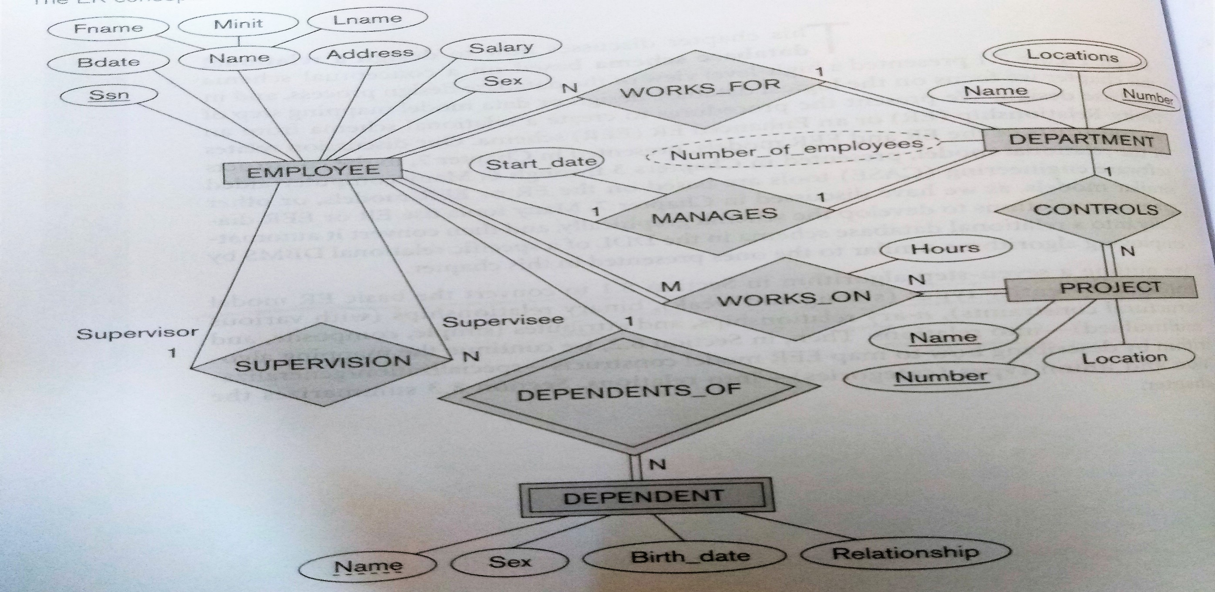
Construct the relational schema for the given ER Diagram.

Slide 298
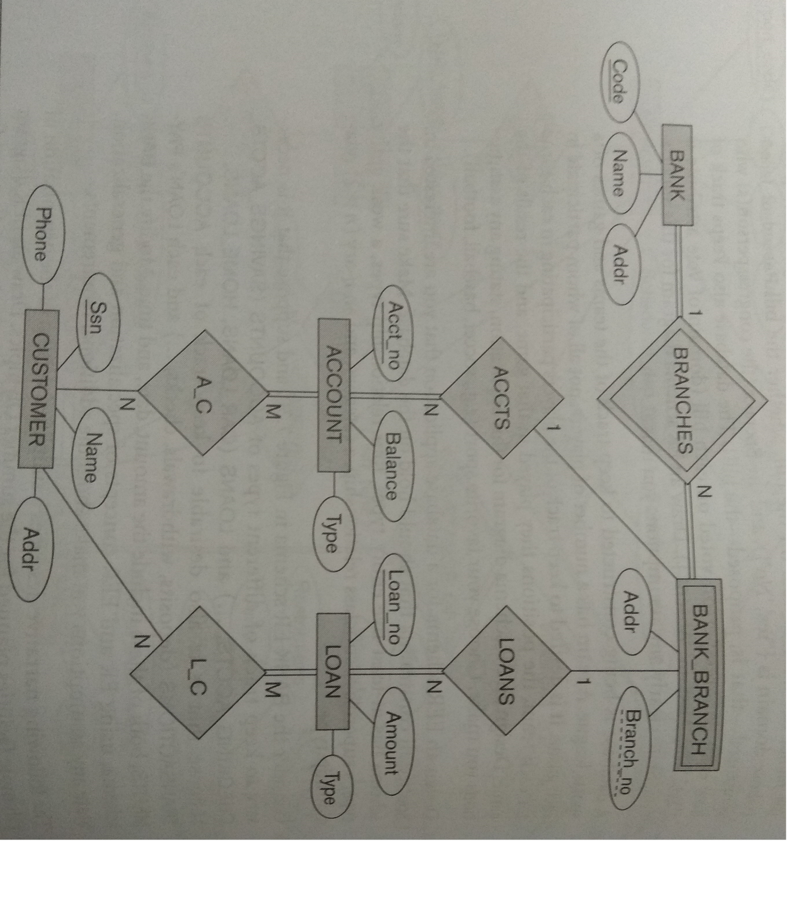
Construct the relational schema for the given ER Diagram.

Slide 299
Normalization

Slide 300
Database Design Guidelines:
Semantics of the attributes in relation schema should be unambiguous and should represent the real world problem domain.
Redundant data in the tuples of relations should be minimal.
NULL values in the tuples of relations should be minimal.
Likelihood of generating spurious tuples should be entirely eliminated.

Slide 301
Problems due to Redundant Data:
Insertion Anomaly
Deletion Anomaly
Update Anomaly

Slide 302
Insertion Anomaly:
Employee
SSN | E_name | H.NO | District | State
S101 | John | h45 | SD | OD
S102 | Mary | h98 | SB | OD
Dept-ID | D_name | Building.NO | District | State
D501 | CSE | B98 | SD | OD
D502 | ECE | B96 | SD | OD

Slide 303
Insertion Anomaly:
Suppose only the Employee Data is available and Department data is not available for a new employee.
Employee
SSN | E_name | H.NO | District | State
S101 | John | h45 | SD | OD
S102 | Mary | h98 | SB | OD
S103 | Mark | h76 | GH | WB
Dept-ID | D_name | Building.NO | District | State
D501 | CSE | B98 | SD | OD
D502 | ECE | B96 | SD | OD
NULL | NULL | NULL | NULL | NULL

Slide 304
Insertion Anomaly:
Suppose both Employee Data for a new employee who works for CSE is available.
There is always a possibility that the data about a particular department may be different in different tuples of the same relation.
Employee
SSN | E_name | H.NO | District | State
S101 | John | h45 | SD | OD
S102 | Mary | h98 | SB | OD
S103 | Mark | h76 | GH | WB
s104 | James | h55 | MK | AP
Dept-ID | D_name | Building.NO | District | State
D501 | CSE | B98 | SD | OD
D502 | ECE | B96 | SD | OD
NULL | NULL | NULL | NULL | NULL
D501 | CSE | B99 | SD | OD

Slide 305
Insertion Anomaly:
Suppose only the data about a new Department is available.
But the data of the new department can not be stored in the above relation, since there is no employee in that department that will satisfy the primary key constraint of the above relation.
Employee
SSN | E_name | H.NO | District | State
S101 | John | h45 | SD | OD
S102 | Mary | h98 | SB | OD
S103 | Mark | h76 | GH | WB
S104 | James | h55 | MK | AP
Dept-ID | D_name | Building.NO | District | State
D501 | CSE | B98 | SD | OD
D502 | ECE | B96 | SD | OD
NULL | NULL | NULL | NULL | NULL
D501 | CSE | B99 | SD | OD
D601 | AI | B74 | SD | OD

Slide 306
Deletion Anomaly:
Deletion of tuple with SSN=S102 will cause the data about ECE department to be completely lost from the database, if the above relation was the only relation that stored the department data in the database.
Deletion of tuple with SSN=S105 will cause the data about AI department to be completely lost from the database, if the above relation was the only relation that stored the department data in the database.
Employee
SSN | E_name | H.NO | District | State
S101 | John | h45 | SD | OD
S102 | Mary | h98 | SB | OD
S103 | Mark | h76 | GH | WB
S104 | James | h55 | MK | AP
S105 | Martha | h51 | LM | JK
Dept-ID | D_name | Building.NO | District | State
D501 | CSE | B98 | SD | OD
D502 | ECE | B96 | SD | OD
NULL | NULL | NULL | NULL | NULL
D501 | CSE | B99 | SD | OD
D601 | AI | B74 | SD | OD

Slide 307
Update Anomaly:
If the attributes Dept-ID and D_name of CSE department is updated, then multiple tuples in the above relation have to be updated.
This may cause the data of CSE department to be erroneous.
Employee
SSN | E_name | H.NO | District | State
S101 | John | h45 | SD | OD
S102 | Mary | h98 | SB | OD
S103 | Mark | h76 | GH | WB
S104 | James | h55 | MK | AP
S105 | Martha | h51 | LM | JK
Dept-ID | D_name | Building.NO | District | State
D501 | CSE | B98 | SD | OD
D502 | ECE | B96 | SD | OD
NULL | NULL | NULL | NULL | NULL
D501 | CSE | B98 | SD | OD
D601 | AI | B74 | SD | OD

Slide 308
Functional Dependency

Slide 309
Functional Dependency
It is a semantic constraint between two sets of attributes (X, Y) of a relation schema R of a database.
It is defined according to the semantic of the attributes of R.
It is represented as X → Y.
X is called determinant and Y is called dependent.
It is read as X functionally determines Y.
It is read as Y is functionally determined by X.
The constraint imposed by a functional dependency, X → Y, is that for any two tuples t1 and t2 of a relational instance r of relation schema R:
If (t1.X = t2.X) then (t1.Y = t2.Y )

Slide 310
Functional Dependency
Employee
SSN | E_name | H.NO | District | S_code
S101 | John | h45 | SD | OD
S102 | Mary | h45 | SD | OD
S103 | Mark | h76 | GH | WB
S104 | John | h22 | SG | Jk
S105 | Martha | h45 | MK | JK
State
Odisha
Odisha
West Bengal
Jharkand
Jharkand

Slide 311
Functional Dependency
Employee
SSN | E_name | H.NO | District | S_code
S101 | John | h45 | SD | OD
S102 | Mary | h45 | SD | OD
S103 | Mark | h76 | GH | WB
S104 | John | h22 | SG | Jk
S105 | Martha | h45 | MK | JK
State
Odisha
Odisha
West Bengal
Jharkand
Jharkand
S_code → State

Slide 312
Functional Dependency
Employee
SSN | E_name | H.NO | District | S_code
S101 | John | h45 | SD | OD
S102 | Mary | h45 | SD | OD
S103 | Mark | h76 | GH | WB
S104 | John | h22 | SG | Jk
S105 | Martha | h45 | MK | JK
State
Odisha
Odisha
West Bengal
Jharkand
Jharkand
SSN → E_name

Slide 313
Functional Dependency
Employee
SSN | E_name | H.NO | District | S_code
S101 | John | h45 | SD | OD
S102 | Mary | h45 | SD | OD
S103 | Mark | h76 | GH | WB
S104 | John | h22 | SG | Jk
S105 | Martha | h45 | MK | JK
State
Odisha
Odisha
West Bengal
Jharkand
Jharkand
SSN → H.NO

Slide 314
Functional Dependency
Employee
SSN | E_name | H.NO | District | S_code
S101 | John | h45 | SD | OD
S102 | Mary | h45 | SD | OD
S103 | Mark | h76 | GH | WB
S104 | John | h22 | SG | Jk
S105 | Martha | h45 | MK | JK
State
Odisha
Odisha
West Bengal
Jharkand
Jharkand
SSN → District

Slide 315
Functional Dependency
Employee
SSN | E_name | H.NO | District | S_code
S101 | John | h45 | SD | OD
S102 | Mary | h45 | SD | OD
S103 | Mark | h76 | GH | WB
S104 | John | h22 | SG | Jk
S105 | Martha | h45 | MK | JK
State
Odisha
Odisha
West Bengal
Jharkand
Jharkand
SSN → S_code

Slide 316
Functional Dependency
Employee
SSN | E_name | H.NO | District | S_code
S101 | John | h45 | SD | OD
S102 | Mary | h45 | SD | OD
S103 | Mark | h76 | GH | WB
S104 | John | h22 | SG | Jk
S105 | Martha | h45 | MK | JK
State
Odisha
Odisha
West Bengal
Jharkand
Jharkand
SSN → State

Slide 317
Functional Dependency
Employee
SSN | E_name | H.NO | District | S_code
S101 | John | h45 | SD | OD
S102 | Mary | h45 | SD | OD
S103 | Mark | h76 | GH | WB
S104 | John | h22 | SG | Jk
S105 | Martha | h45 | MK | JK
State
Odisha
Odisha
West Bengal
Jharkand
Jharkand
SSN → E_name, H.NO, District, S_code, State

Slide 318
Functional Dependency
Employee
SSN | E_name | H.NO | District | S_code
S101 | John | h45 | SD | OD
S102 | Mary | h45 | SD | OD
S103 | Mark | h76 | GH | WB
S104 | John | h22 | SG | Jk
S105 | Martha | h45 | MK | JK
State
Odisha
Odisha
West Bengal
Jharkand
Jharkand
E_name H.NO

Slide 319
Functional Dependency
Employee
SSN | E_name | H.NO | District | S_code
S101 | John | h45 | SD | OD
S102 | Mary | h45 | SD | OD
S103 | Mark | h76 | GH | WB
S104 | John | h22 | SG | Jk
S105 | Martha | h45 | MK | JK
State
Odisha
Odisha
West Bengal
Jharkand
Jharkand
E_name H.NO, District, S_code, State

Slide 320
Functional Dependency
Employee
SSN | E_name | H.NO | District | S_code
S101 | John | h45 | SD | OD
S102 | Mary | h45 | SD | OD
S103 | Mark | h76 | GH | WB
S104 | John | h22 | SG | Jk
S105 | Martha | h45 | MK | JK
State
Odisha
Odisha
West Bengal
Jharkand
Jharkand
H.NO District

Slide 321
Functional Dependency
Employee
SSN | E_name | H.NO | District | S_code
S101 | John | h45 | SD | OD
S102 | Mary | h45 | SD | OD
S103 | Mark | h76 | GH | WB
S104 | John | h22 | SG | Jk
S105 | Martha | h45 | MK | JK
State
Odisha
Odisha
West Bengal
Jharkand
Jharkand
H.NO District, S_code, State

Slide 322
Functional Dependency
SSN | E_name | Mobile | Bank_Account_No | S_code
S101 | John | 9876555412 | B_A11298 | OD
S102 | Mary | 8876555467 | B_A41298 | OD
S103 | Mark | 8476555168 | B_A11399 | WB
S104 | John | 9976545411 | B_A41290 | Jk
S105 | Martha | 9876555410 | B_A51253 | JK
State
Odisha
Odisha
West Bengal
Jharkand
Jharkand
Super Key: X= {SSN,E_name,Mobile,Bank_Account_No, S_code, State
X X
This a trivial Functional Dependency

Slide 323
Functional Dependency
SSN | E_name | Mobile | Bank_Account_No | S_code
S101 | John | 9876555412 | B_A11298 | OD
S102 | Mary | 8876555467 | B_A41298 | OD
S103 | Mark | 8476555168 | B_A11399 | WB
S104 | John | 9976545411 | B_A41290 | Jk
S105 | Martha | 9876555410 | B_A51253 | JK
State
Odisha
Odisha
West Bengal
Jharkand
Jharkand
Super Key: X = SSN, Mobile, Bank_Account_No
X E_name, S_code, State

Slide 324
Functional Dependency
SSN | E_name | Mobile | Bank_Account_No | S_code
S101 | John | 9876555412 | B_A11298 | OD
S102 | Mary | 8876555467 | B_A41298 | OD
S103 | Mark | 8476555168 | B_A11399 | WB
S104 | John | 9976545411 | B_A41290 | Jk
S105 | Martha | 9876555410 | B_A51253 | JK
State
Odisha
Odisha
West Bengal
Jharkand
Jharkand
Super Key: X = SSN, Mobile
X E_name, Bank_Account_No, S_code, State

Slide 325
Functional Dependency
SSN | E_name | Mobile | Bank_Account_No | S_code
S101 | John | 9876555412 | B_A11298 | OD
S102 | Mary | 8876555467 | B_A41298 | OD
S103 | Mark | 8476555168 | B_A11399 | WB
S104 | John | 9976545411 | B_A41290 | Jk
S105 | Martha | 9876555410 | B_A51253 | JK
State
Odisha
Odisha
West Bengal
Jharkand
Jharkand
Super Key: X = SSN, Bank_Account_No
X E_name, Mobile, S_code, State

Slide 326
Functional Dependency
SSN | E_name | Mobile | Bank_Account_No | S_code
S101 | John | 9876555412 | B_A11298 | OD
S102 | Mary | 8876555467 | B_A41298 | OD
S103 | Mark | 8476555168 | B_A11399 | WB
S104 | John | 9976545411 | B_A41290 | Jk
S105 | Martha | 9876555410 | B_A51253 | JK
State
Odisha
Odisha
West Bengal
Jharkand
Jharkand
Super Key: X = Mobile, Bank_Account_No
X SSN, E_name, S_code, State

Slide 327
Functional Dependency
SSN | E_name | Mobile | Bank_Account_No | S_code
S101 | John | 9876555412 | B_A11298 | OD
S102 | Mary | 8876555467 | B_A41298 | OD
S103 | Mark | 8476555168 | B_A11399 | WB
S104 | John | 9976545411 | B_A41290 | Jk
S105 | Martha | 9876555410 | B_A51253 | JK
State
Odisha
Odisha
West Bengal
Jharkand
Jharkand
Candidate Key: X = Mobile
X SSN, E_name, Bank_Account_No, S_code, State

Slide 328
Functional Dependency
SSN | E_name | Mobile | Bank_Account_No | S_code
S101 | John | 9876555412 | B_A11298 | OD
S102 | Mary | 8876555467 | B_A41298 | OD
S103 | Mark | 8476555168 | B_A11399 | WB
S104 | John | 9976545411 | B_A41290 | Jk
S105 | Martha | 9876555410 | B_A51253 | JK
State
Odisha
Odisha
West Bengal
Jharkand
Jharkand
Candidate Key: X = Bank_Account_No
X SSN, E_name, Mobile, S_code, State

Slide 329
Functional Dependency
SSN | E_name | Mobile | Bank_Account_No | S_code
S101 | John | 9876555412 | B_A11298 | OD
S102 | Mary | 8876555467 | B_A41298 | OD
S103 | Mark | 8476555168 | B_A11399 | WB
S104 | John | 9976545411 | B_A41290 | Jk
S105 | Martha | 9876555410 | B_A51253 | JK
State
Odisha
Odisha
West Bengal
Jharkand
Jharkand
Primary Key: is One of the candidate keys.

Slide 330
Functional Dependency
SSN | E_name | Mobile | Bank_Account_No | S_code
S101 | John | 9876555412 | B_A11298 | OD
S102 | Mary | 8876555467 | B_A41298 | OD
S103 | Mark | 8476555168 | B_A11399 | WB
S104 | John | 9976545411 | B_A41290 | Jk
S105 | Martha | 9876555410 | B_A51253 | JK
State
Odisha
Odisha
West Bengal
Jharkand
Jharkand
Primary Key: is One of the candidate keys.

Slide 331
Functional Dependency
FDs can increase data redundancy and its associated problems.
Roll | Name | Sub_Code | Subject | Sub_Teacher
S101 | John | CS102 | DBMS | RAM
S102 | Mary | CS102 | DBMS | RAM
S103 | Mark | CS102 | DBMS | RAM
S104 | John | CS104 | DAA | Gautam
S105 | Martha | CS104 | DAA | Gautam
Sub_Code Subject, Sub_Teacher
Roll Name, Sub_Code, Subject, Sub_Teacher
Subject Sub_Teacher

Slide 332
Functional Dependency
FDs can increase data redundancy and its associated problems.
Roll | Name | Sub_Code | Subject | Sub_Teacher
S101 | John | CS102 | DBMS | RAM
S102 | Mary | CS102 | DBMS | RAM
S103 | Mark | CS102 | DBMS | RAM
S104 | John | CS104 | DAA | Gautam
S105 | Martha | CS104 | DAA | Gautam
Sub_Code Subject, Sub_Teacher
Roll | Name | Sub_Code
S101 | John | CS102
S102 | Mary | CS102
S103 | Mark | CS102
S104 | John | CS104
S105 | Martha | CS104
Sub_Code | Subject | Sub_Teacher
CS102 | DBMS | RAM
CS104 | DAA | Gautam
Redundancy is Minimized

Slide 333
Normal Forms:
First Normal Form
Second Normal Form
Third Normal Form
Boyce-Codd Normal Form
Fourth Normal Form
Fifth Normal Form

Slide 334
First Normal Forms(1NF):
First Normal Form

